Slide 1
Welcome talk
Year 3 2025-2026

Slide 2
The Y3 Team
Teachers:
3C – Mrs Cooper
3S – Mr Shelley
Teaching assistants:
Miss Litchfield (Monday, Tuesday, Wednesday)
Mrs Leddie
Miss Bloodworth

Slide 3

The school day
8.55am - 4-a-day – it’s extremely important children aren’t consistently late as this is a fundamental part of maths and helps children develop maths fluency.
Morning lessons – Maths and English (usually)
Afternoon lessons – usually wider curriculum lessons (Computing, History, DT etc.)
End of the day - children will be taken to the playground with their class teacher. Once they have seen their adult, they must inform their class teacher before leaving.

Slide 4
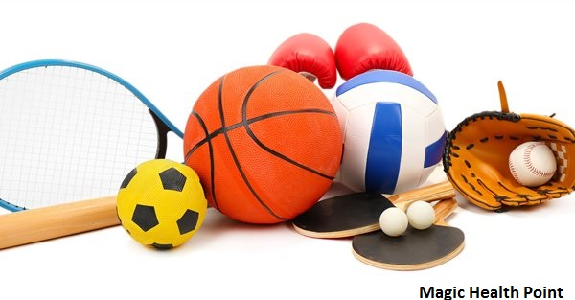
PE
Two PE lessons a week (sometimes taught by a sports coach).
Children need to wear their PE kit on the correct days (appropriate PE kit – whatever the weather).
The timetable for the year’s PE is on the website
Swimming counts as 1 PE lesson.
3C
Monday AM – PE lesson
Friday AM – PE lesson
3S
Tuesday PM – Swimming
Friday AM – PE lesson

Slide 5
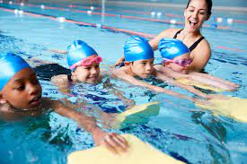
Swimming
In year 3, children start school swimming lessons!
3S - 12th Sept – 8th Dec
3C - 15th Dec Last Tuesday before Christmas–?? March – The last week of the term
3S have had the first 2 sessions and they went very well.
We swim at the Portland Pool on Friday afternoons, travelling to and from the centre on a bus. Children will be back at school before the end of the school day.
If you would like your child to wear goggles, you must return the goggles form to school (the instructors will not allow children to wear goggles without the consent form being signed). The instructors encourage their use
Children need to be able to get undressed and redressed independently.
Girls – 1-piece swimming costume
We will need volunteers for this to happen.

Slide 6

Photo permission
We update our class pages on the school website to share events and activities with you throughout the year.
Due to GDPR regulations we aren’t able to use your child’s photo image without your permission.
You can check or update this at the office.
Unfortunately, if we do not have consent, we will have to ask children to stand out of group photos, or cover them with an emoji or something.

Slide 7

Reading and reading diaries
We expect the children to read at home at least 4 times a week - this needs to be recorded in their reading diaries.
Reading diaries should be in school every day. If you write a message, please ask your child to show us as they’re not checked weekly in KS2.
Children will have an individual book band colour and are now responsible for changing their own books at the start and/or end of the school day.
Reading in school consists of a weekly reading and comprehension session. Children will have the chance to read independently, in groups, in front of the class.
Children that need extra support with reading will be read with weekly (and in some cases daily) by the class teacher, TA or reading volunteer.

Slide 8
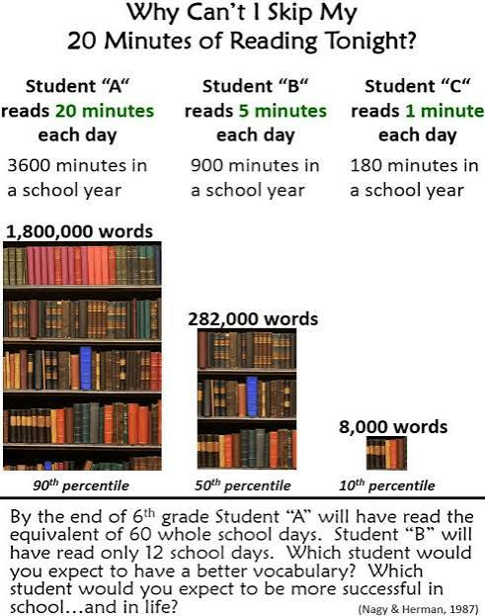

Slide 9
Spellings
The way we teach spellings has changed. It is now based on Super Sonic Spelling – which follows on from Super Sonic Phonics.
There are 3 spelling sessions over two weeks
The words for the whole term will be sent home on Friday
Some children may be given differentiated spellings to learn and practise, to increase their confidence in spelling high frequency words.

Slide 10
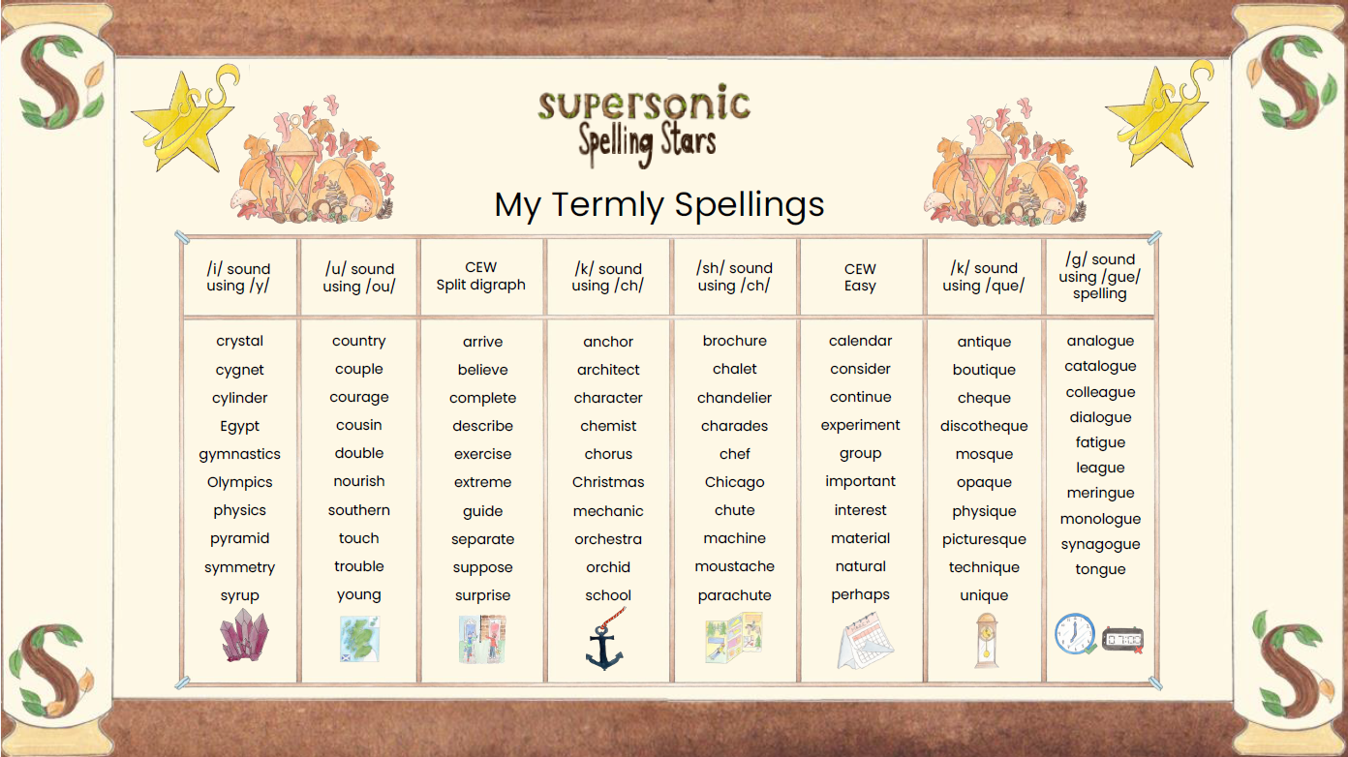
Spellings

Slide 11
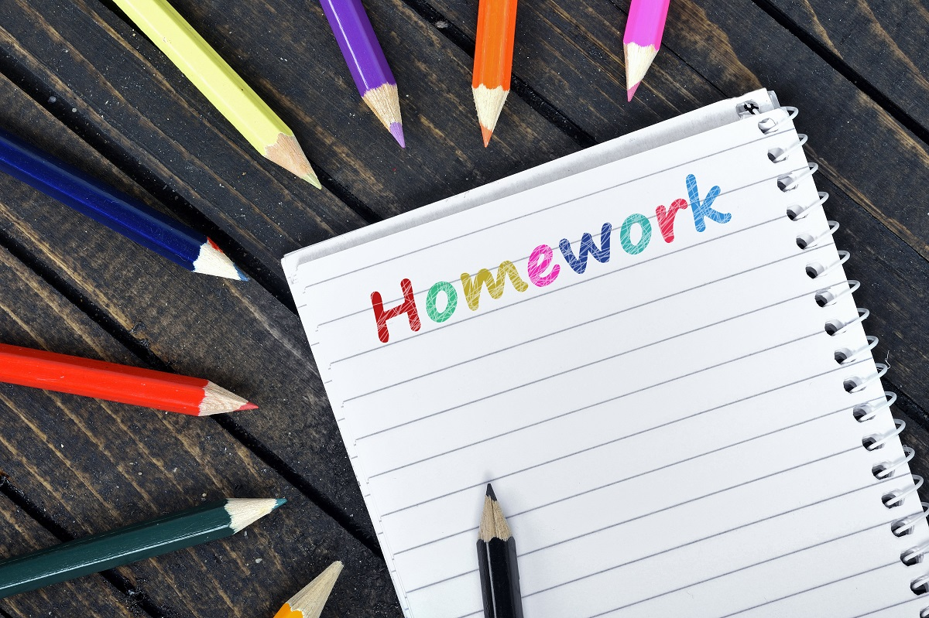
Homework
Children have been given homework books. We would encourage these to be covered or decorated.
Homework will be handed out on a Thursday or Friday and will be due in by the following Thursday/Friday.

Slide 12
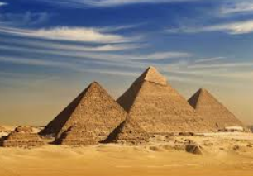

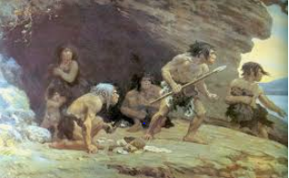
Topics
History/Geography Topics
Ancient Egypt
The Mediterranean
Prehistoric Ages (focusing on the Stone Age)
Volcanoes and Earthquakes
Science Topics
Plants
Forces and Magnets
Rocks and Fossils
Animals and Humans
Light and Shadow

Slide 13
Additional notes/changes from Year 2
No show and tell (however if your child has a special award, they can share this in dragons assemblies on a Friday morning)
Fruit and milk is no longer provided for free for junior children. If you would like your child to have fruit or milk you can order it at the office.
Children can bring in a piece of fruit or a similar healthy snack from home to eat at playtime.
No afternoon play in KS2!

Slide 14
Helping out at home
Telling the time on an analogue and digital clock.
Regular times-table practice!
By the end of Year 3 children are expected to have a secure knowledge of multiplication facts for the 2,3,4,5 8 and 10 times tables.
There is a national statutory times table test on all times tables up to 12 x 12 at the end of Year 4, so the more the children can secure now the better!
Each child has their own login details for TT Rockstars – this can be used at home. TT Rockstars uses a similar format to the statutory test. This year, we have added restrictions to limit how much time can be spent on it out of school
Regular reading – 4 times a week.
We encourage a range of texts and genres to keep them engaged and enjoying reading. As the children become more confident at reading words, they need to be able to understand the text at a deeper level and be able to answer a range of comprehension questions.

Slide 15
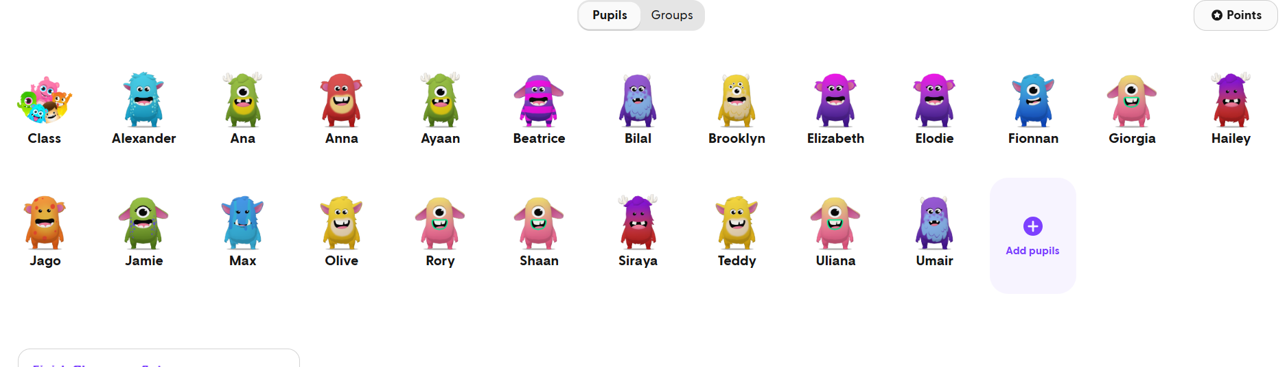
Class Dojo
We use Class Dojo to encourage positive behaviour. Children can get individual and/or group points for almost anything. There will be a reward for the group and individual winners.
Dragon’s Gold-Children can earn Dragon’s Gold alongside Dojos. The winners of the Dragon’s Gold total have a group reward.
We follow the School’s behaviour policy if expectations aren’t followed

Slide 16
Questions?

