Slide 1
Year 4 Residential
Caythorpe Court
Wednesday 22nd April – Friday 24th April 2026

Slide 2
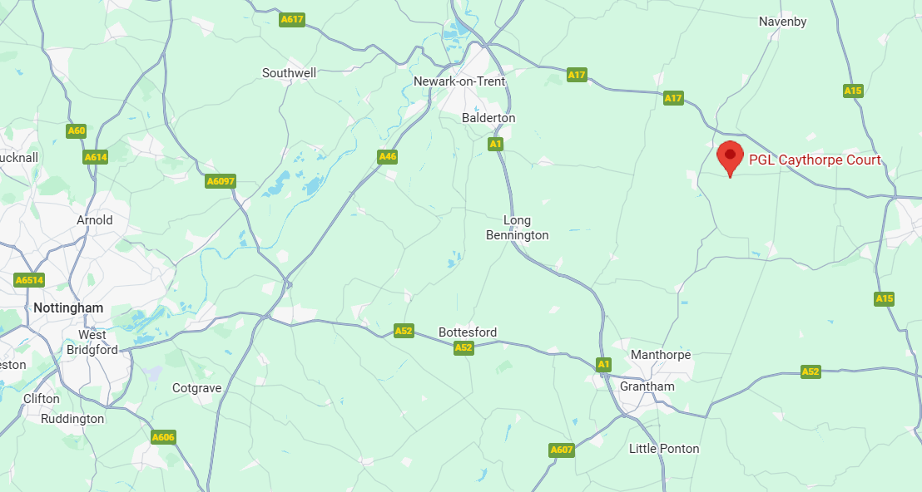
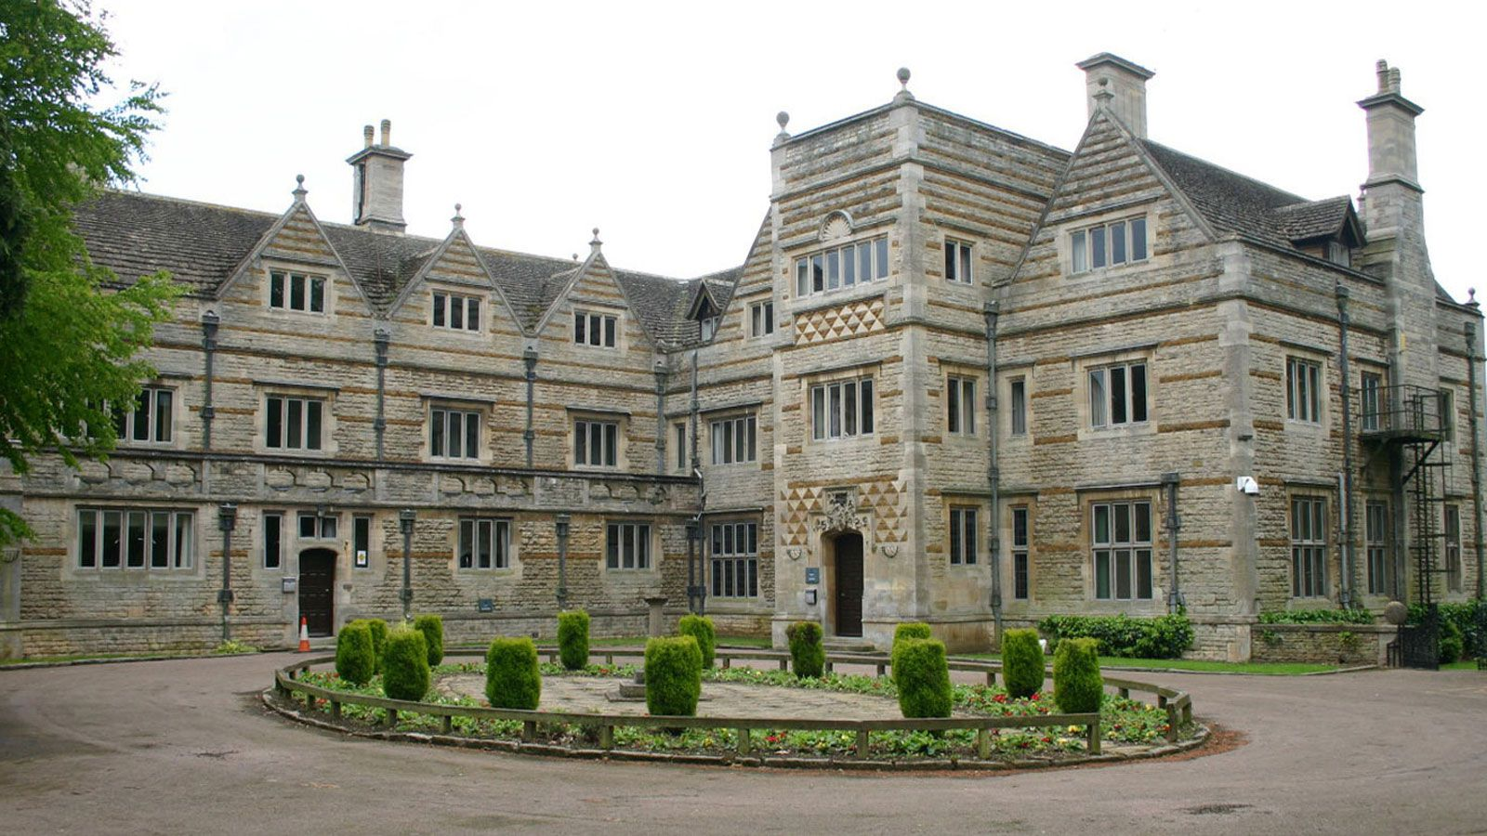
Where is it?
Caythorpe Heath Ln, Caythorpe, Grantham NG32 3ER
It is about an hour away

Slide 3
Staffing
There will be 7 members of staff going…
Miss Stubbs
Mrs Bradford
Mrs Baylis (formerly Mrs Oakes)
Miss Bloodworth (1-1)
And others to be confirmed

Slide 4
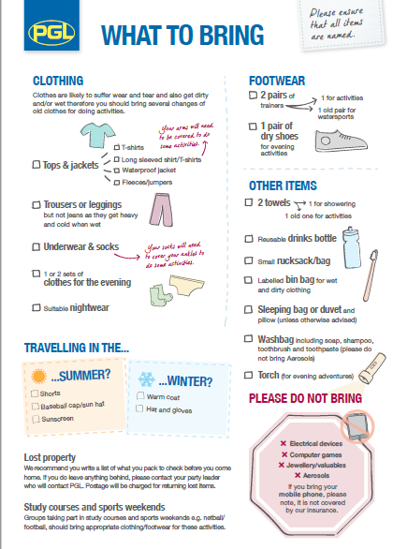
Kit list
(See handout)
Don’t send your child in their best party clothes as they may get wet, dirty and torn (it’s unlikely that they will tear, but they could get snagged on something).
Very short shorts can mean that harness aren’t safe for aerial activities.
We cannot carry everything for all children so they need to be able to carry it themselves.
Speak with your child about how to pack their bag back up and look after their belongings.
They cannot bring sweets for their dorms.

Slide 5
Activities
We do one from this section:
Zip wire
Abseiling
High Ropes
Two from this section:
Challenge course
Orienteering
Archery
Buggy building
Tunnel Trail
Sensory Trail
Two evening activities from:
Campfire
Capture The Flag
Ambush
Cluedo
Sports Night
Disco
Wacky Races
Quiz Show
Snap Shot
Splash
There are plenty of activities to keep the children busy. We will get a full itinerary nearer to the time.
We do up to 5 activities from this
section:
Raft building
Survivor
Aeroball
Problem Solving
All Aboard
Zip Wire
Abesiling
High Ropes
Canoeing
Climbing

Slide 6
The full day will look like this:
Schedule | Activities
07.00 - 08.50 | Get up, get ready and fuel up for the day ahead with a hearty breakfast.
08.50 - 12.00 | Morning activities - 2 sessions with a 10 minute break in-between.
12.00 - 13.50 | Enjoy a fresh and tasty two-course hot lunch and some free time.
13.50 - 17.00 | Afternoon activities - 2 sessions with a 10 minute break in-between.
17.00 - 19.00 | Time to eat again - a different dinner menu each day.
19.00 - 21.00 | Discos, campfires, quizzes and more - our evening entertainment programme keeps everyone engaged until bedtime.
21.00 / 21.30 | Bedtime. Catch up on some zzzs ready to do it all again tomorrow!

Slide 7
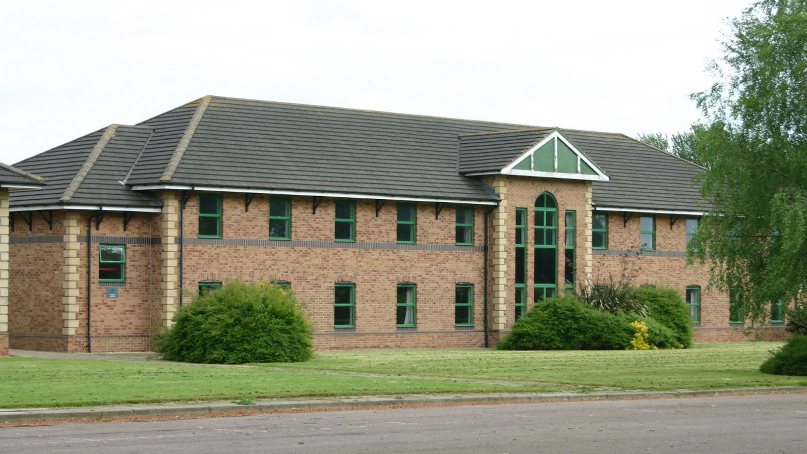
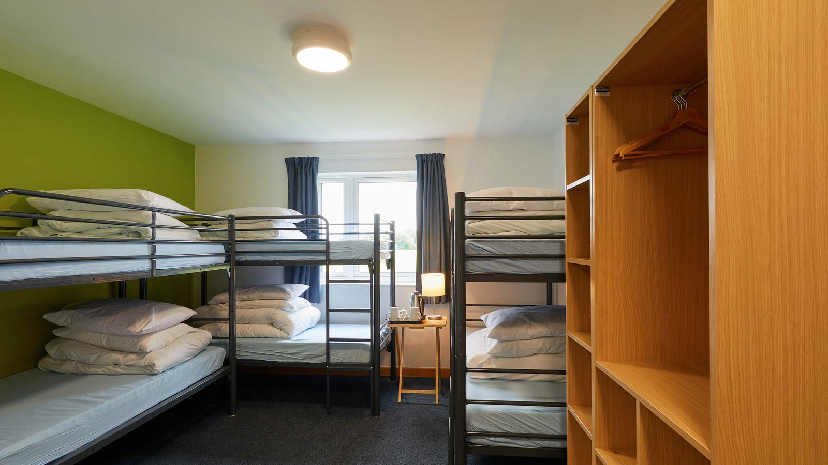
Accommodation
The children will be in rooms that sleep between 3 and 8 children, with en-suite toilets.
We will choose who goes in which rooms and tell the children who they are sharing with, as this ensures that no one feels left out. They won’t get to know until we arrive (as we don’t want the focus to be who is with who etc).

Slide 8
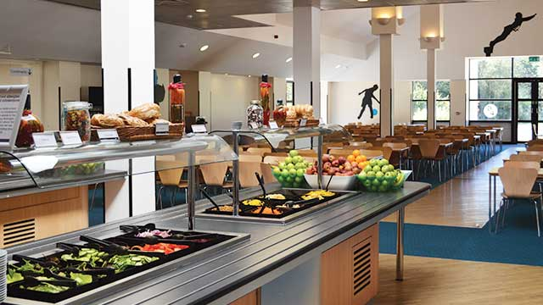
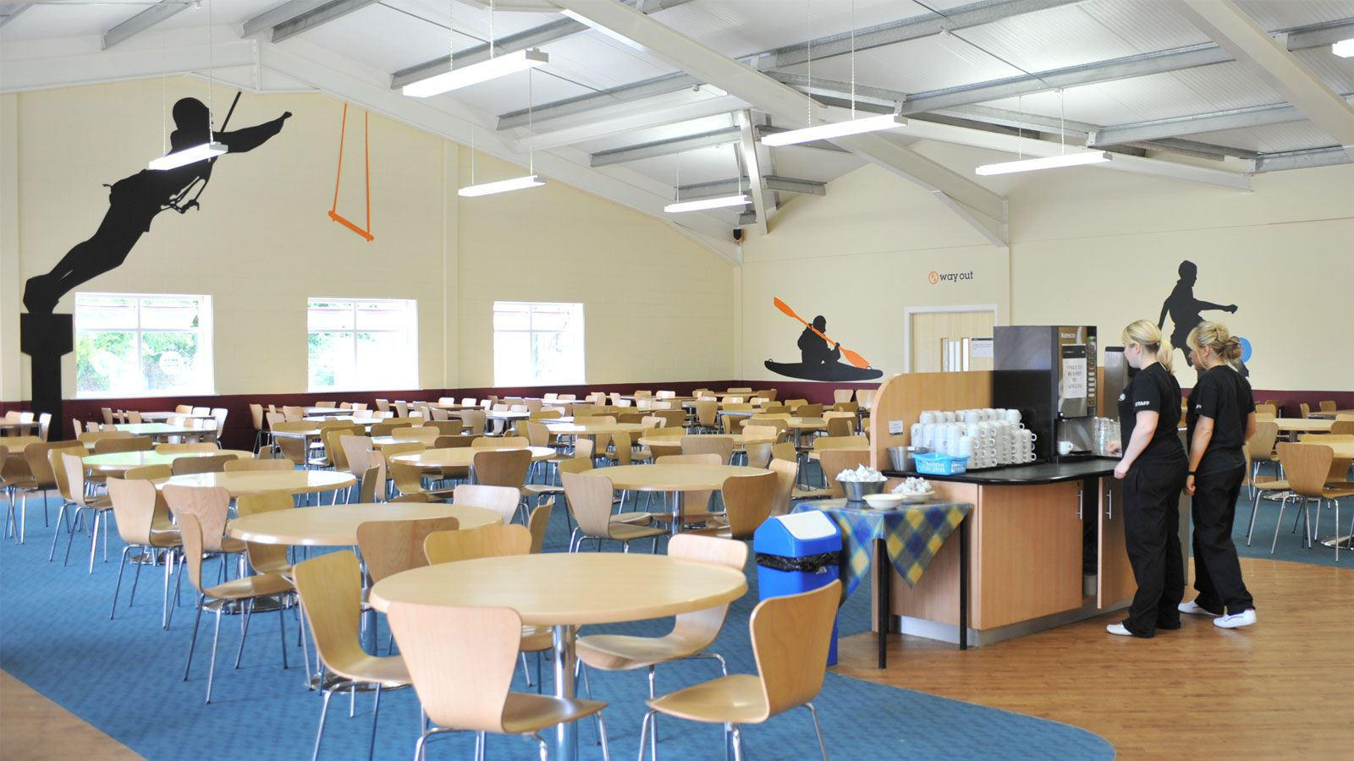
Food
The children will need a packed lunch on the first day.
All the other meals are provided in a cafeteria. They can cater to many different dietary needs – coeliac, dairy free, vegetarian, vegan etc.
Make sure you let us know in advance (the sooner, the better) if anything has changed – the office should have a record of any current dietary requirements.

Slide 9
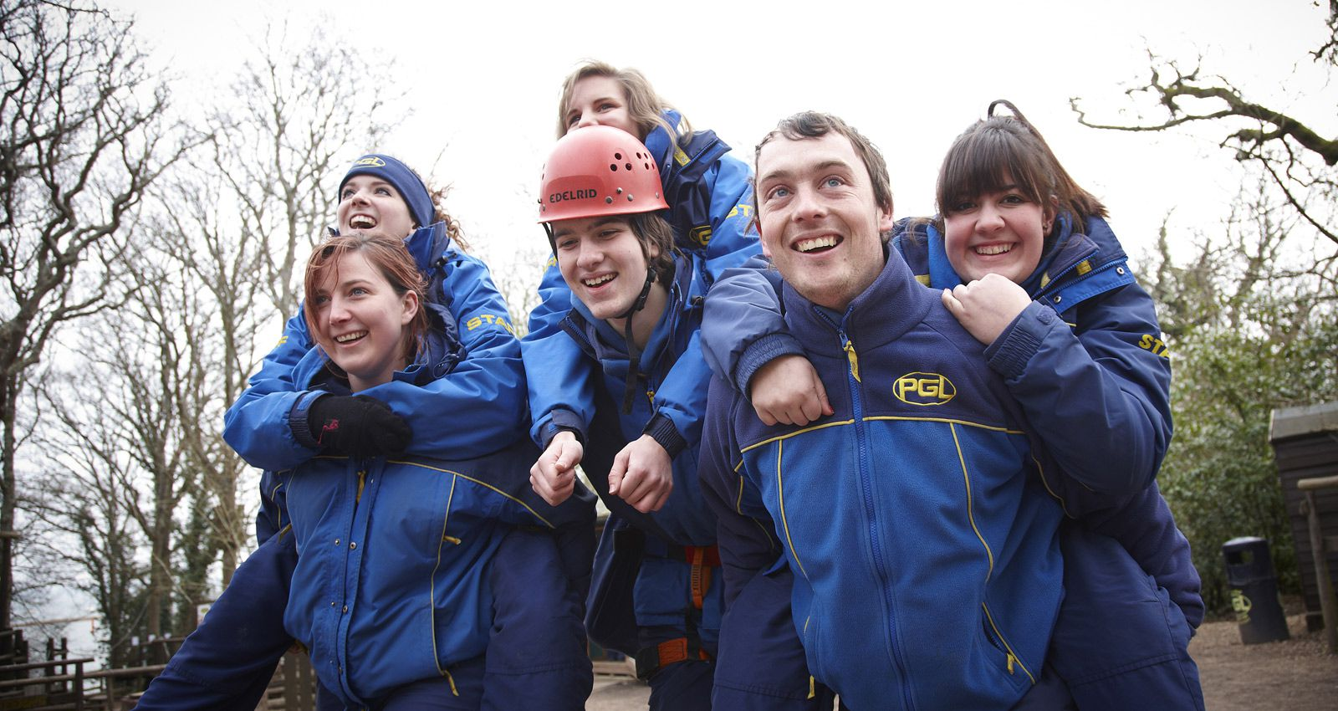
Staff
The activities are all run by the PGL staff who have the correct training and certificates for the particular activities.

Slide 10
We really hope that the children get as much out of this as we expect them to.
We will be focusing a lot on independence: they will be responsible for sorting their clean/dirty clothes, keeping their room tidy, being ready on time in the morning etc.
We know there will be some children who are nervous, who haven’t spent a night away from home before, who may have a fear of heights or something else etc. Nobody will be forced to do anything they are really frightened of, but we will try to encourage them to try and overcome those fears and make the most of what opportunities they have.
There is a gift shop so the children can take £5 to buy a souvenir (we will collect these in so it will need to be in a named envelope or purse).
Although the kit list says a sleeping bag or duvet, a sleeping bag is far more suitable as it is easier to carry.

Slide 11
Any questions?

