Slide 1
Y4 Welcome Meeting

Slide 2
Who are we…
Hannah Stubbs
Louise Williams
Becca Bradford
Grace Bloodworth
Di Daglish

Slide 3
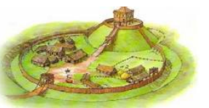
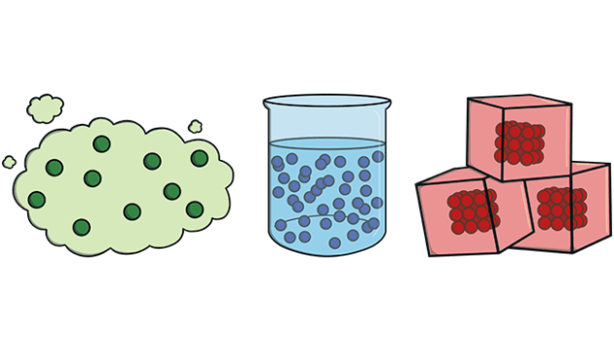
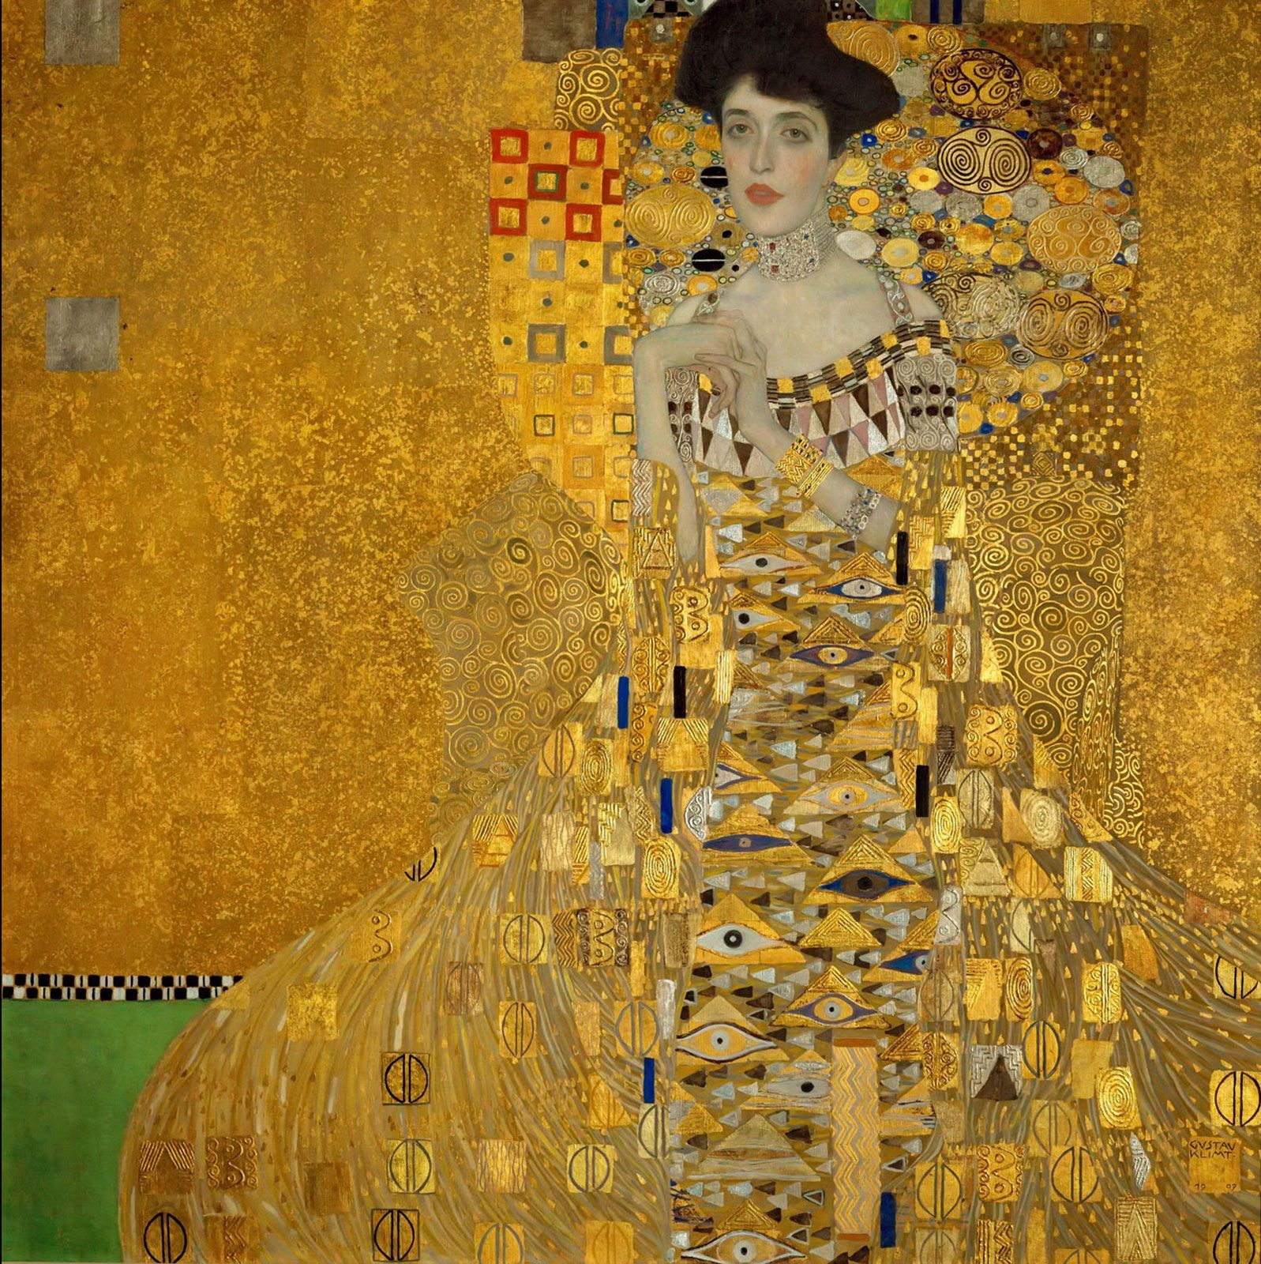
Curriculum
Our Topics for this term are:
William The Conqueror and The Normans
States Of Matter
Journey of Life (RE)
Gustav Klimt (Art)
Electricity
Early Lawmakers

Slide 4
Admin
All the children have been given new reading diaries with TTRockstars passwords in the back.
Spellings will be given on Wednesday to practise for the test the following week.
Please, where possible, listen to your children read.
Homework will be given out and expected back on a Friday
Notes:
Reading diary – communication

Slide 5


P.E.
Our P.E. days this half term are:
Wednesday afternoon (indoor PE) – Gymnastics
Thursday afternoon (outdoor PE) – Ball Skills
Please take earrings out before the lesson – they aren’t allowed to do PE with ears taped over.
Please ensure long hair is tied up.

Slide 6
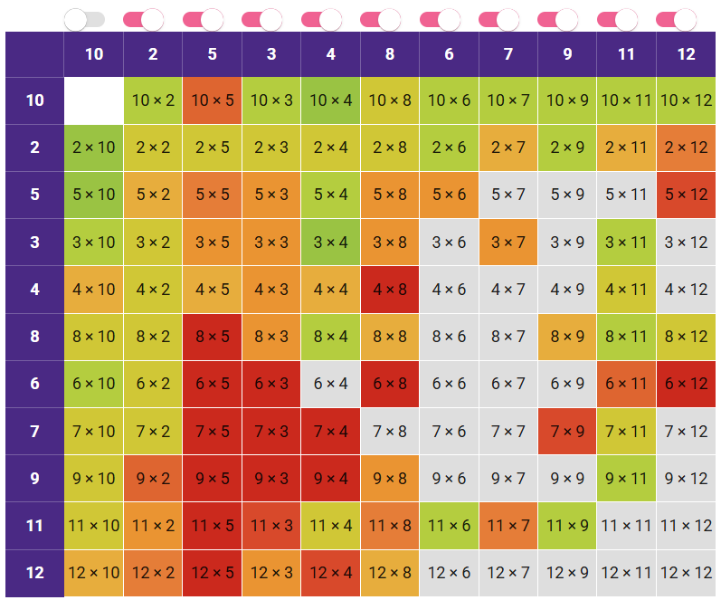
Times Tables
The expectation for Year 4 is that, by the end of the year, all the children know all the times tables (up to 12x12).
There will be opportunities throughout the week to practice these in variety of ways including a dedicated Times Tables lesson on Fridays.
There will a statutory times tables test in June.

Slide 7
Residential
This year will be our 5th year doing a PGL led residential at Caythorpe. We’d encourage everyone to come, as going on a residential with school is a fantastic experience. We will have an information meeting on Monday 1st December (4pm).
Key information:
Dates: Wednesday 22nd April – Friday 24th April
Caythorpe
We will choose the activities later in the year.
We’ll get a kit list out sooner, rather than later.

Slide 8
Thank you for attending.

