Slide 1


Slide 2
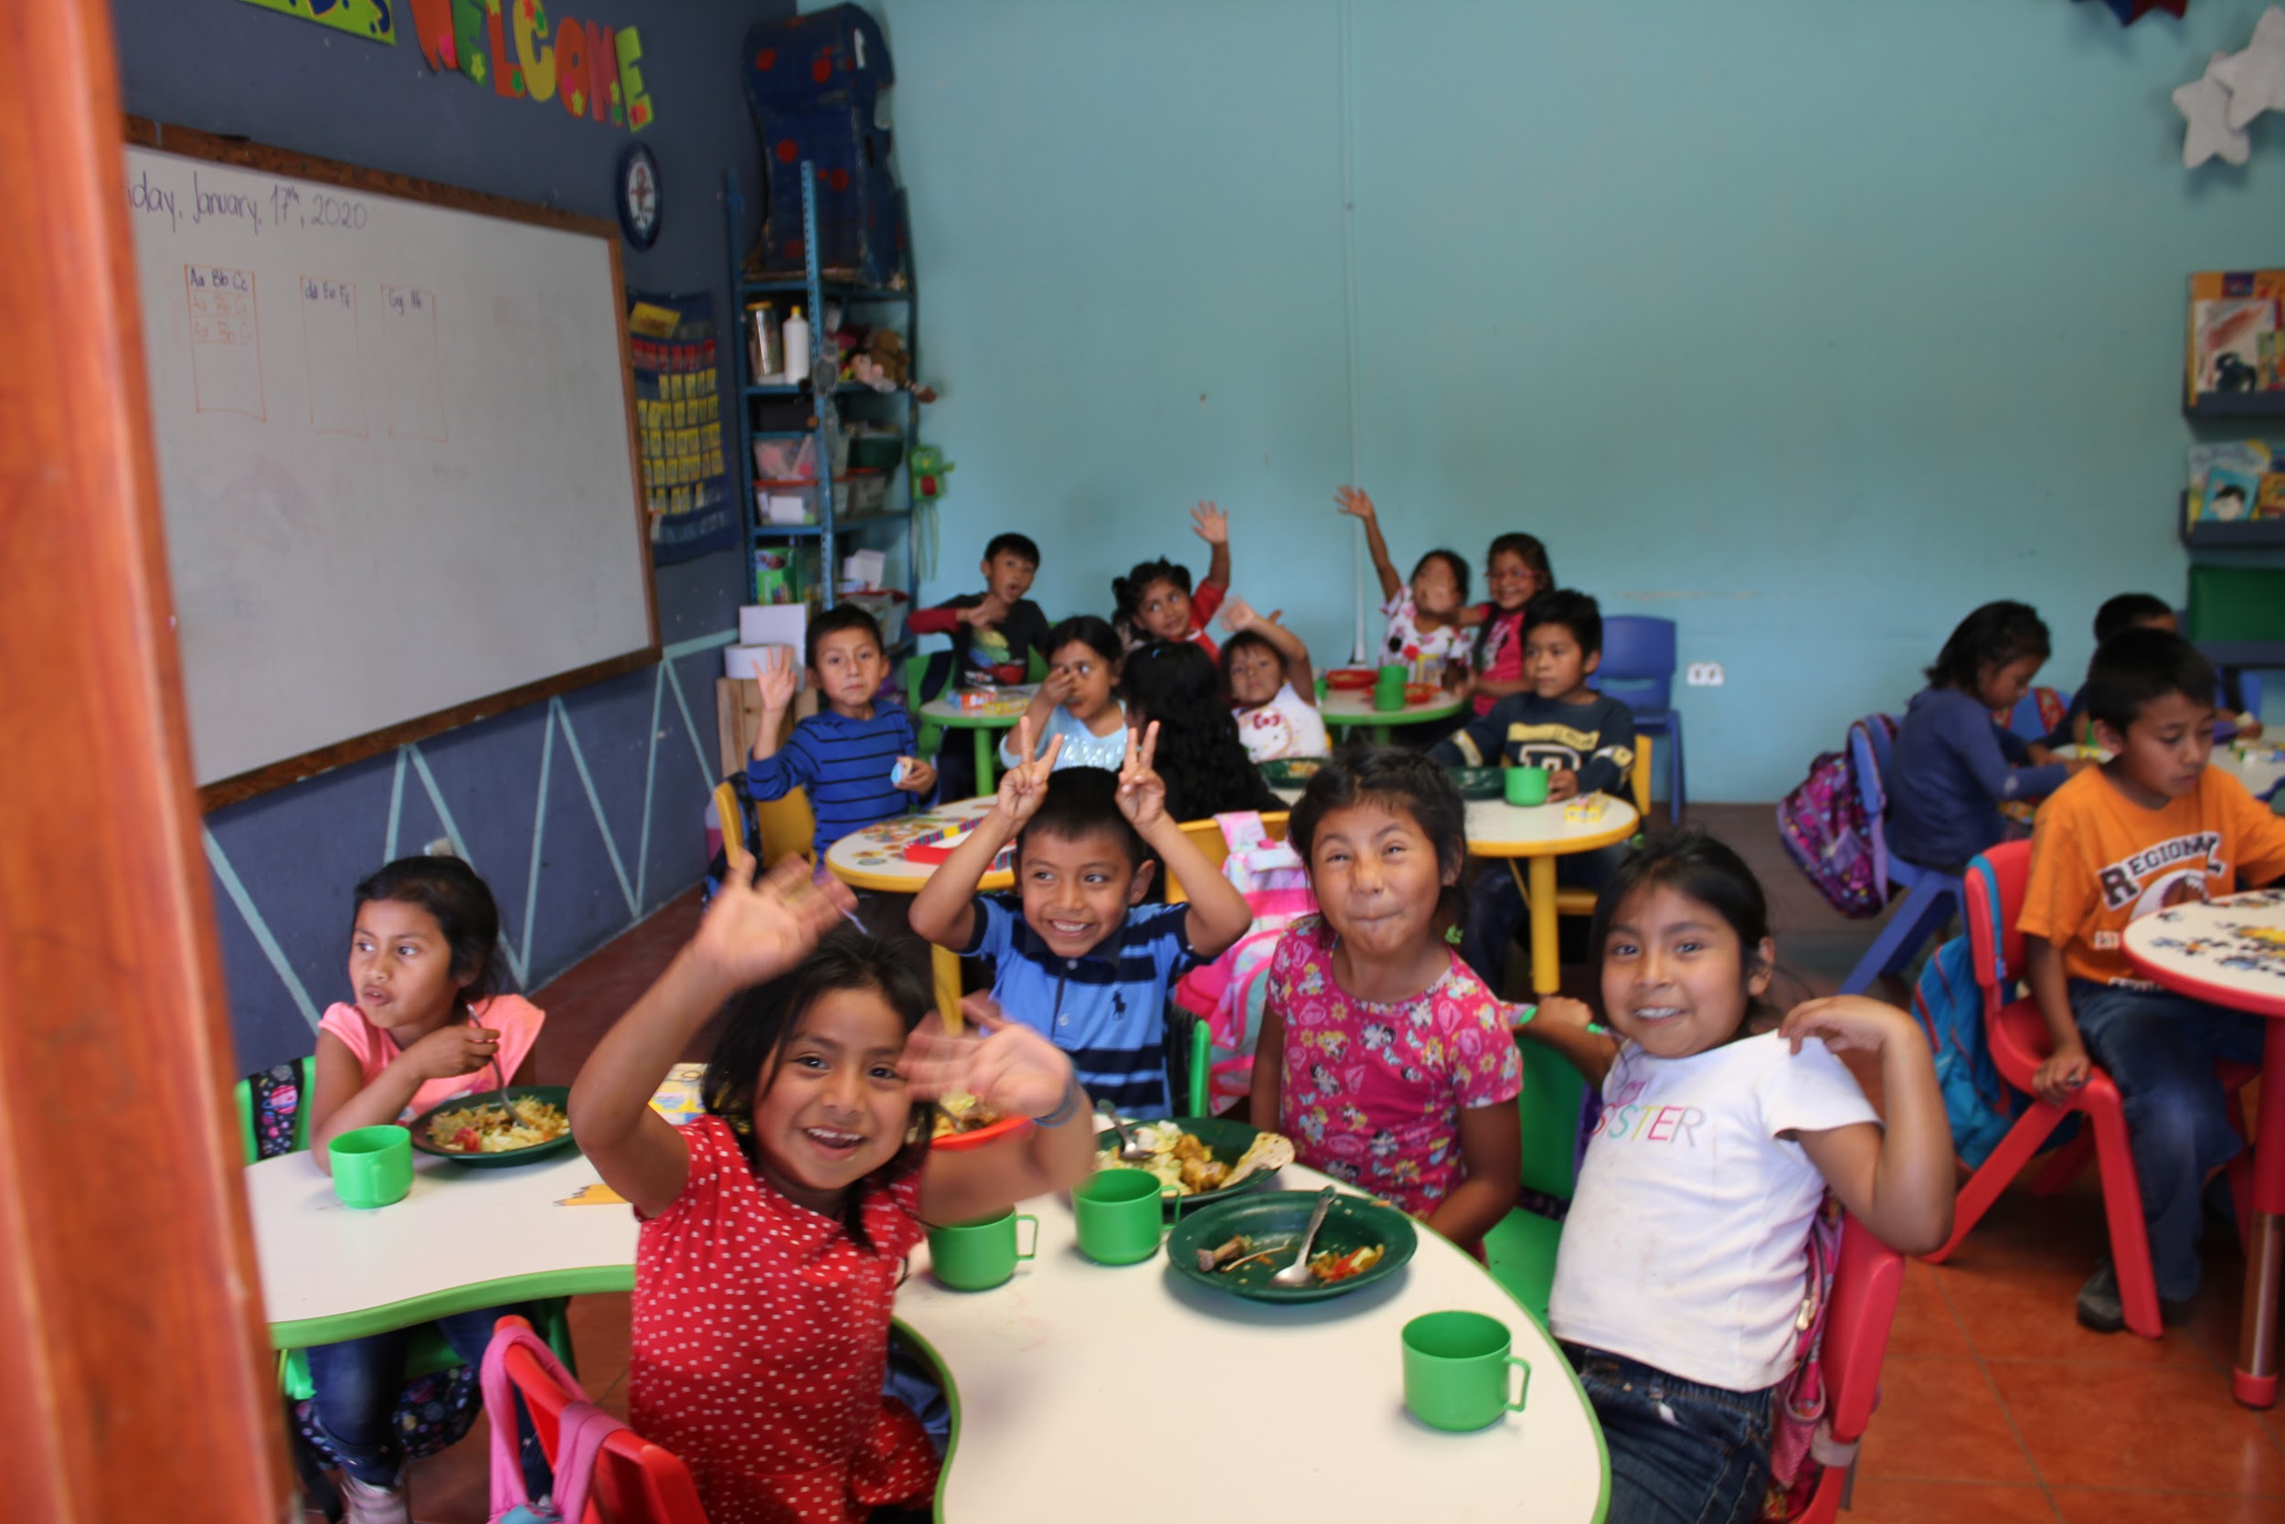
What does EFTC do?
Our Vision:
That young people from all backgrounds have the ability to access quality education and opportunities for rewarding employment
Working with young people and families from the Jocotenango area to access quality education, nutritious food, healthcare and social support.
Through a highly individualised approach we empower young people with the skills and confidence to be successful in their chosen careers.

Slide 3
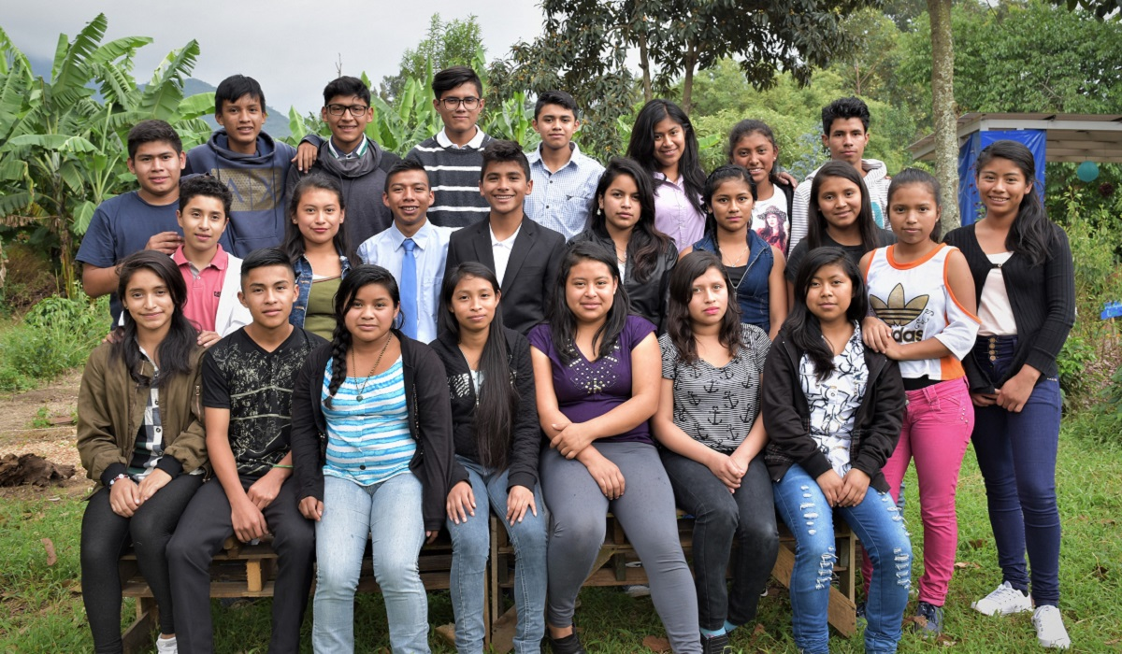
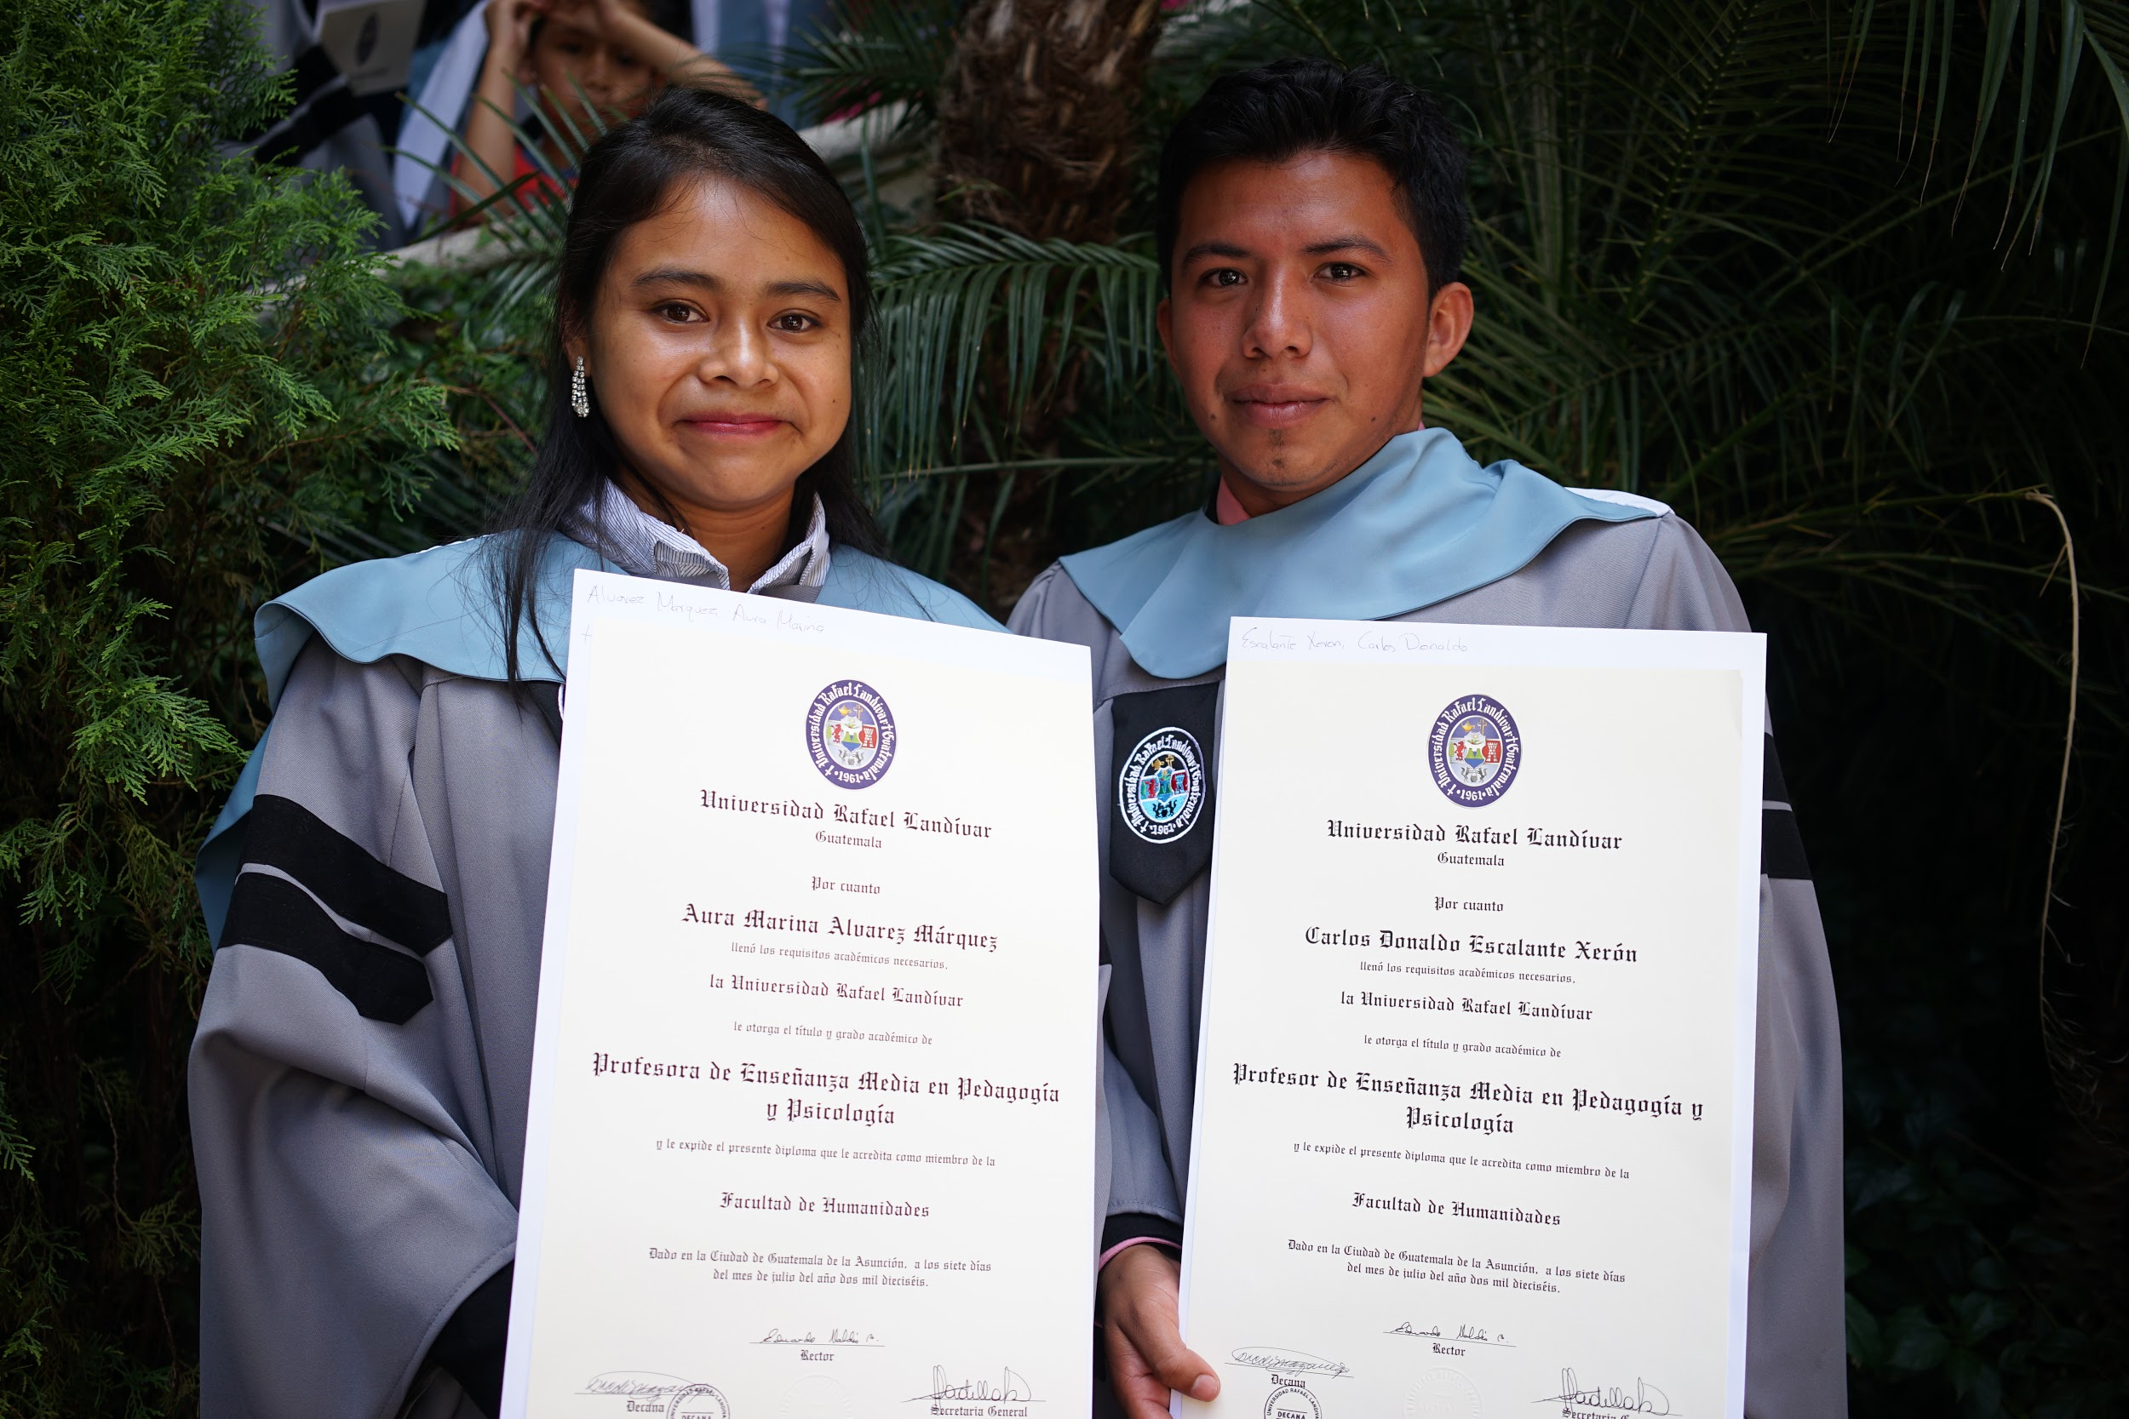
Education For The Children Foundation
Set up in 2003, the foundation provides a bilingual education and gives over 700 students the opportunity to study from reception through to university

Slide 4
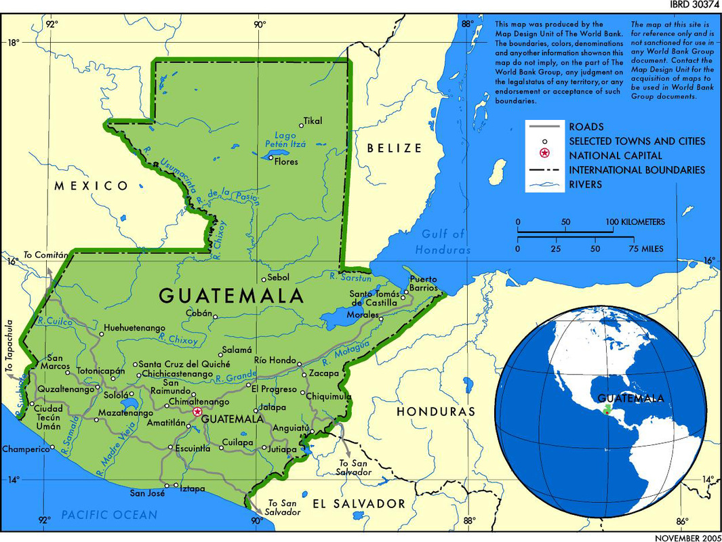
Guatemala
66% of the 16 million people live in extreme poverty, surviving on less than £1.50 a day
Literacy rates in people over 15 are some of the lowest in the world
50% of children under five suffer stunted growth and ill health due to chronic malnutrition
80% of children will never attend high school

Slide 5
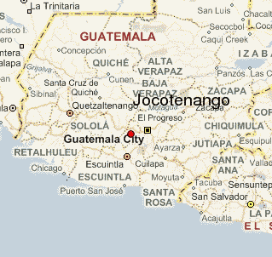
Jocotenango
The school is located in Jocotenango, where extreme violence, poverty, gang crime and alcoholism are amongst some of the everyday realities

Slide 6
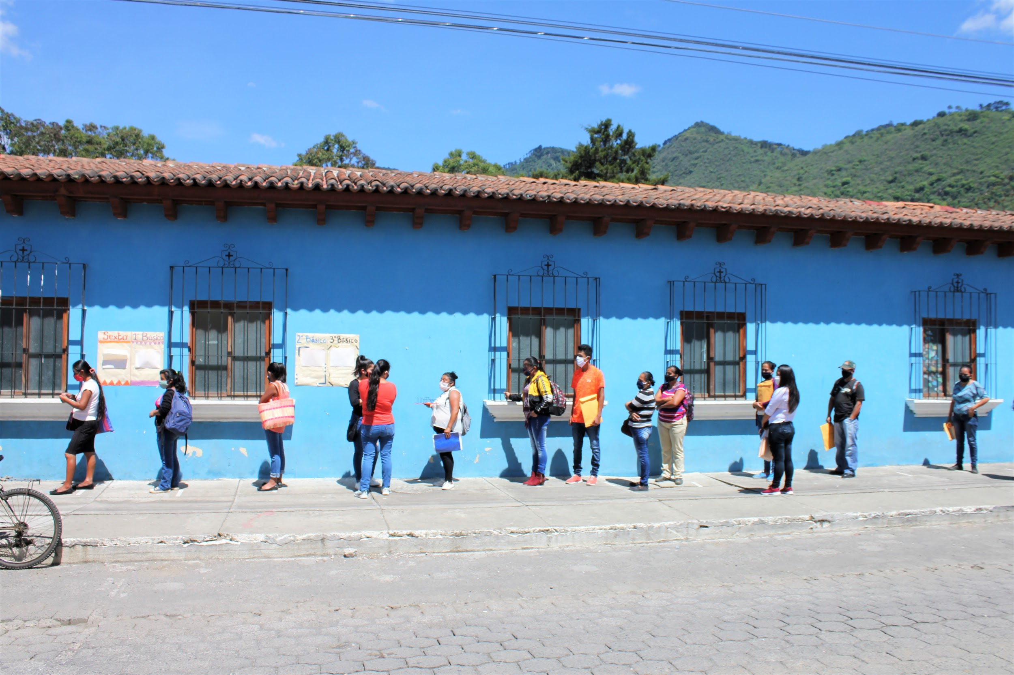
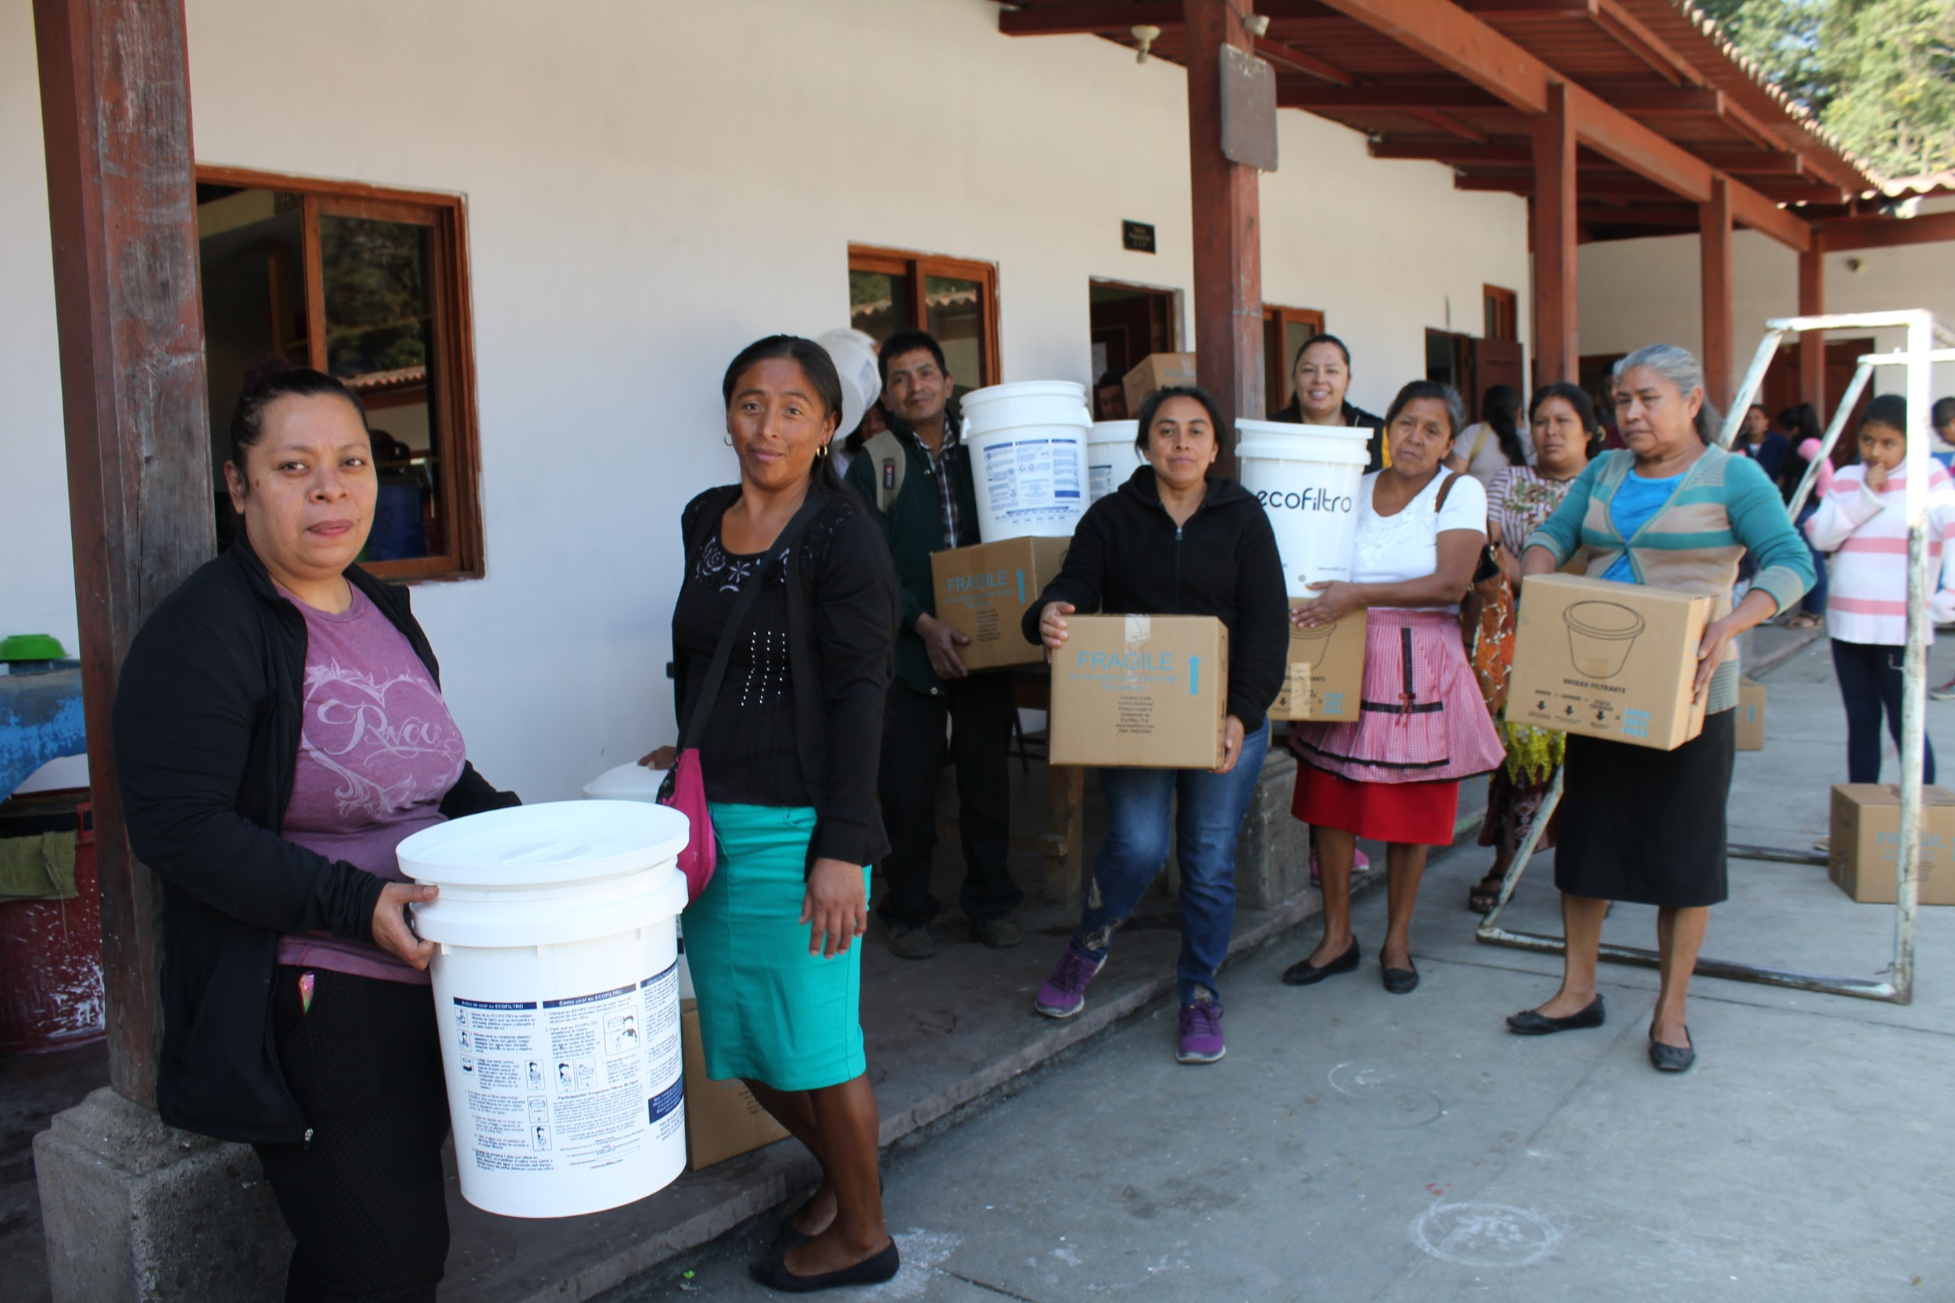
Life in Guatemala
Big gap between the rich and the poor
Families don’t have enough money to feed themselves, see doctors or send their children to school
School is free but families can’t afford to pay for books, uniforms, bus fares etc.
Children are forced to go into work or beg to help support their family

Slide 7
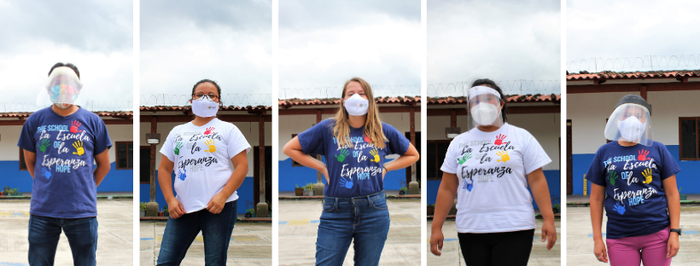
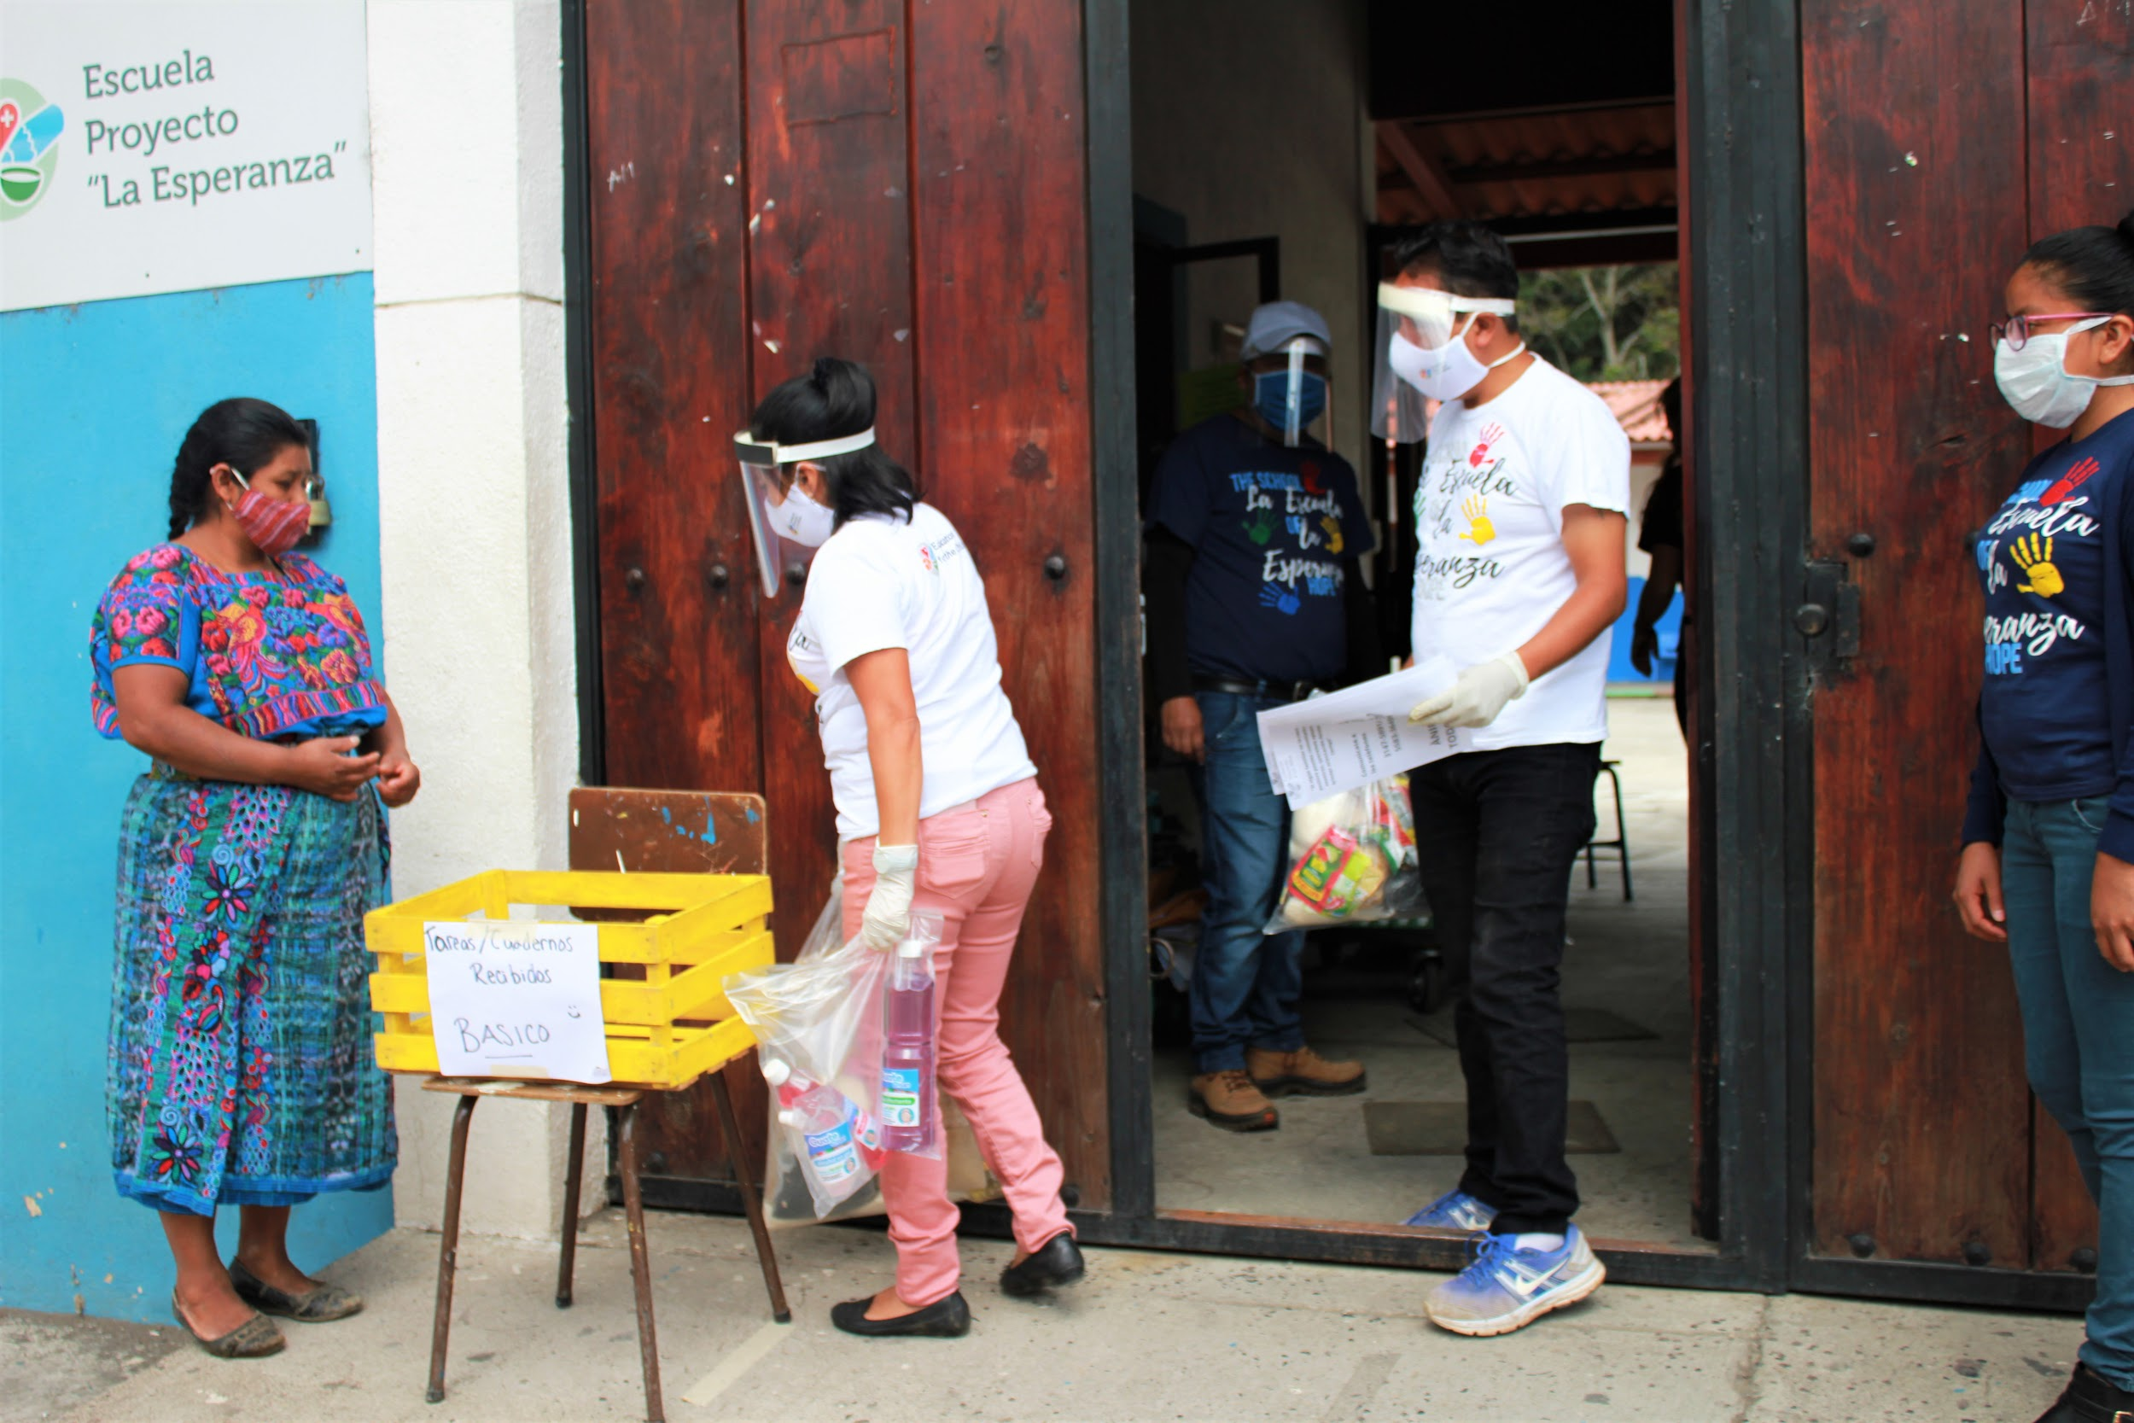
Covid-19 current situation
School has opened for staff only
Monthly distribution of emergency food hampers to students and their families
Some online classes limited access to devices and internet access
Homework swaps and exam written assignments

Slide 8
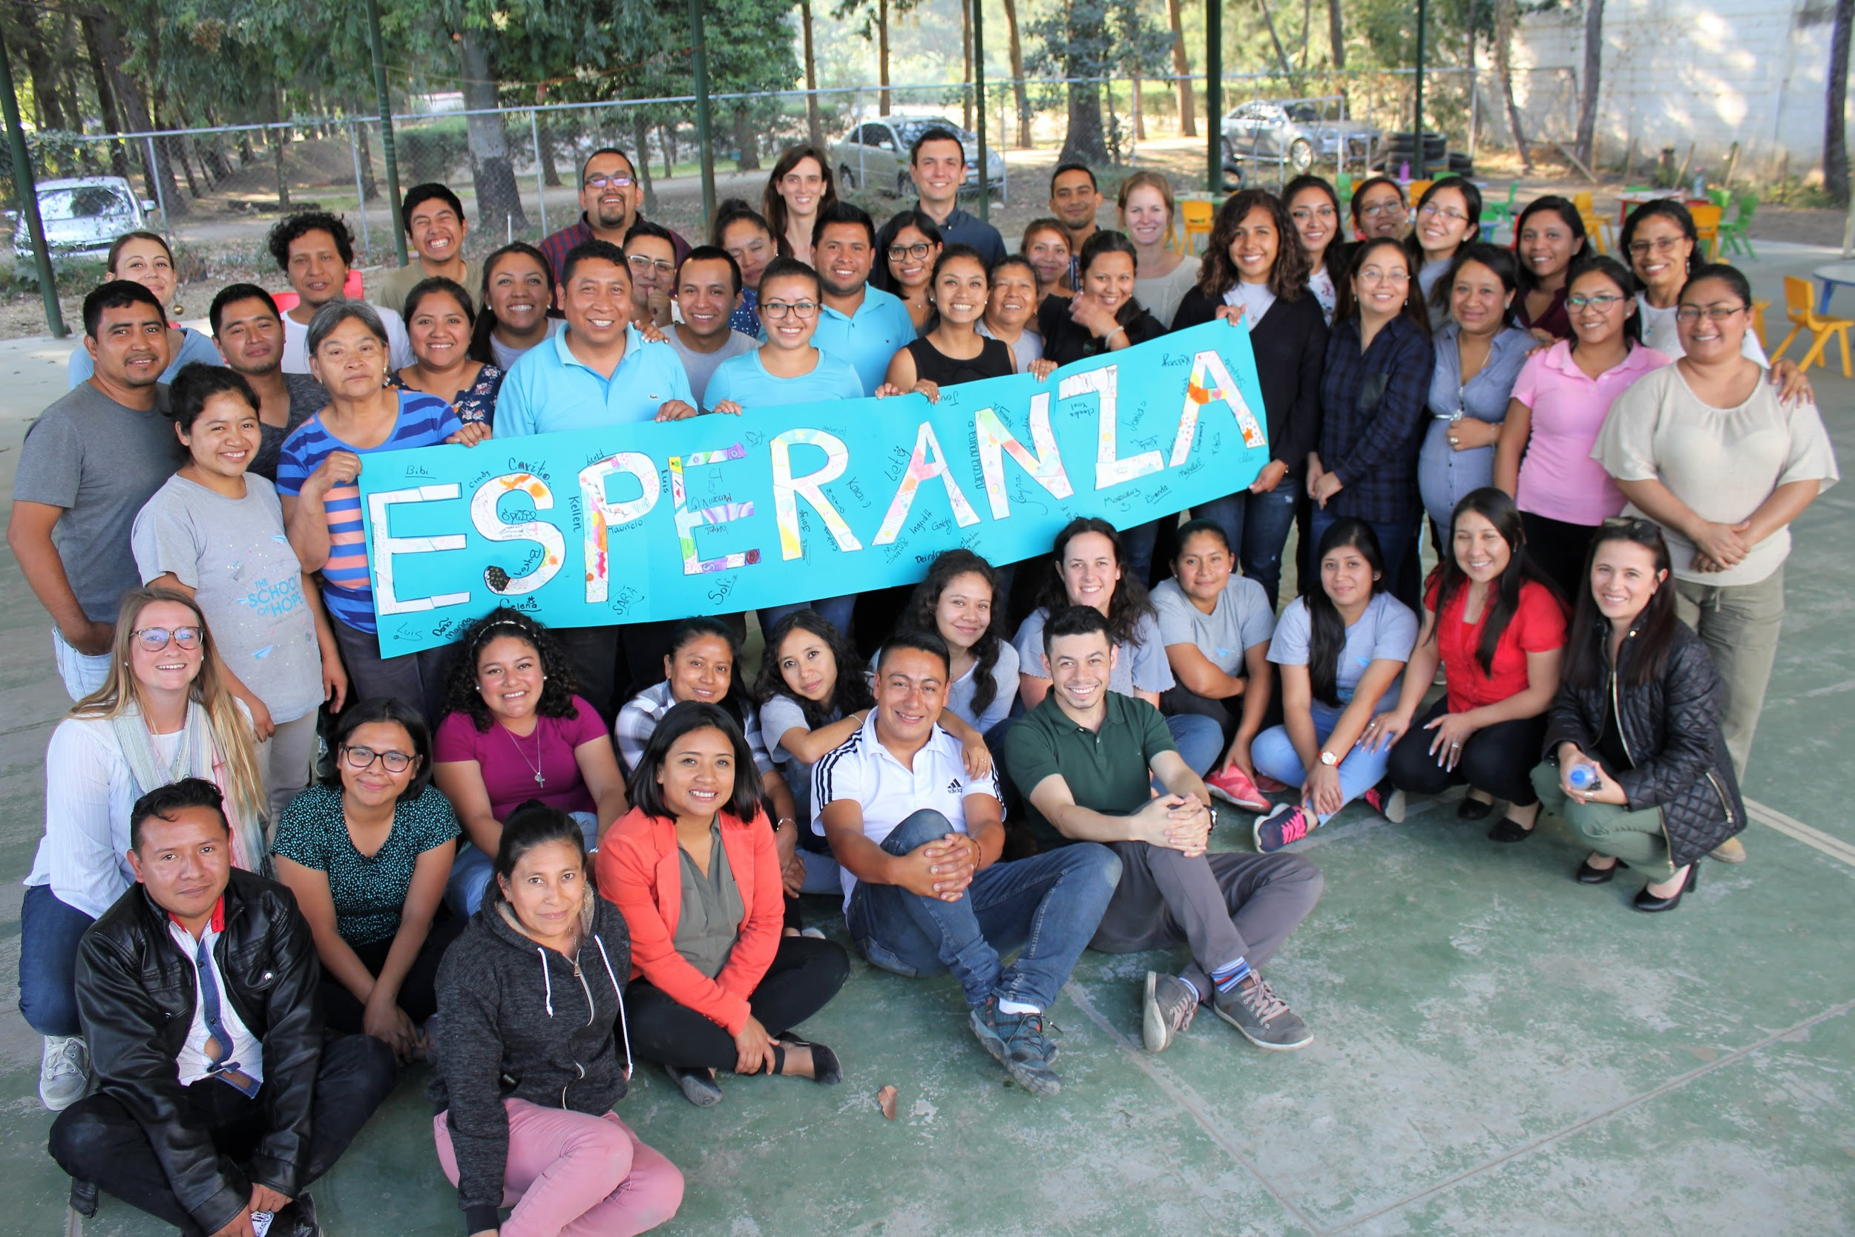
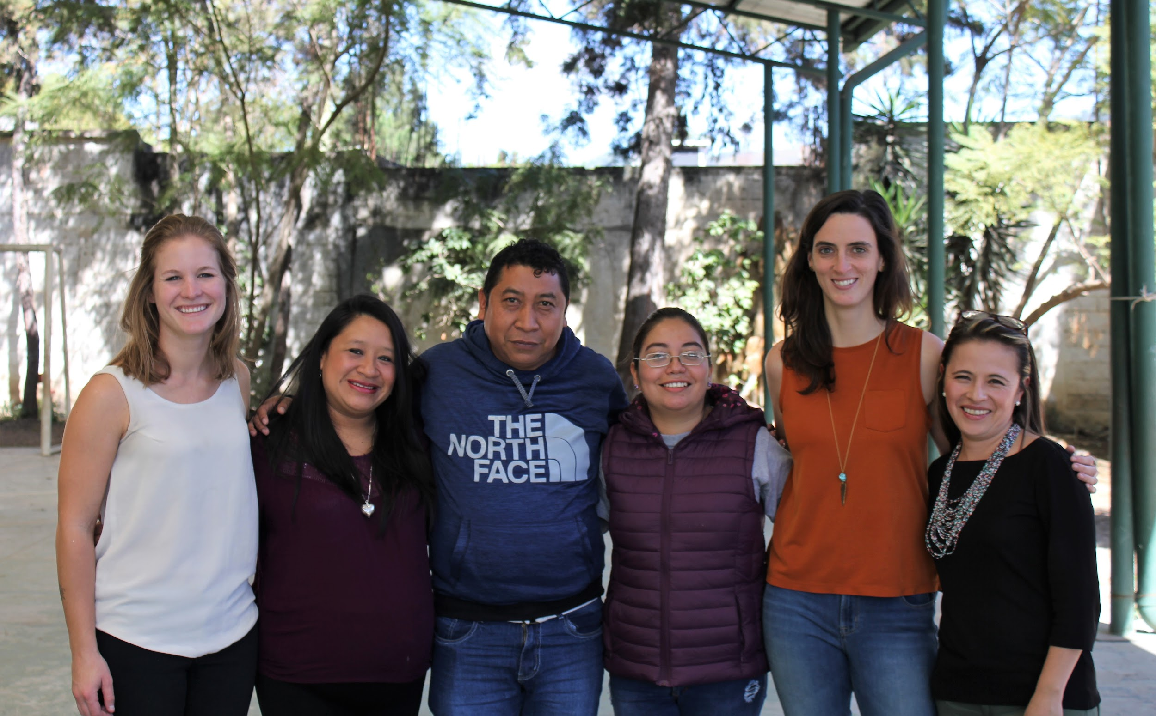
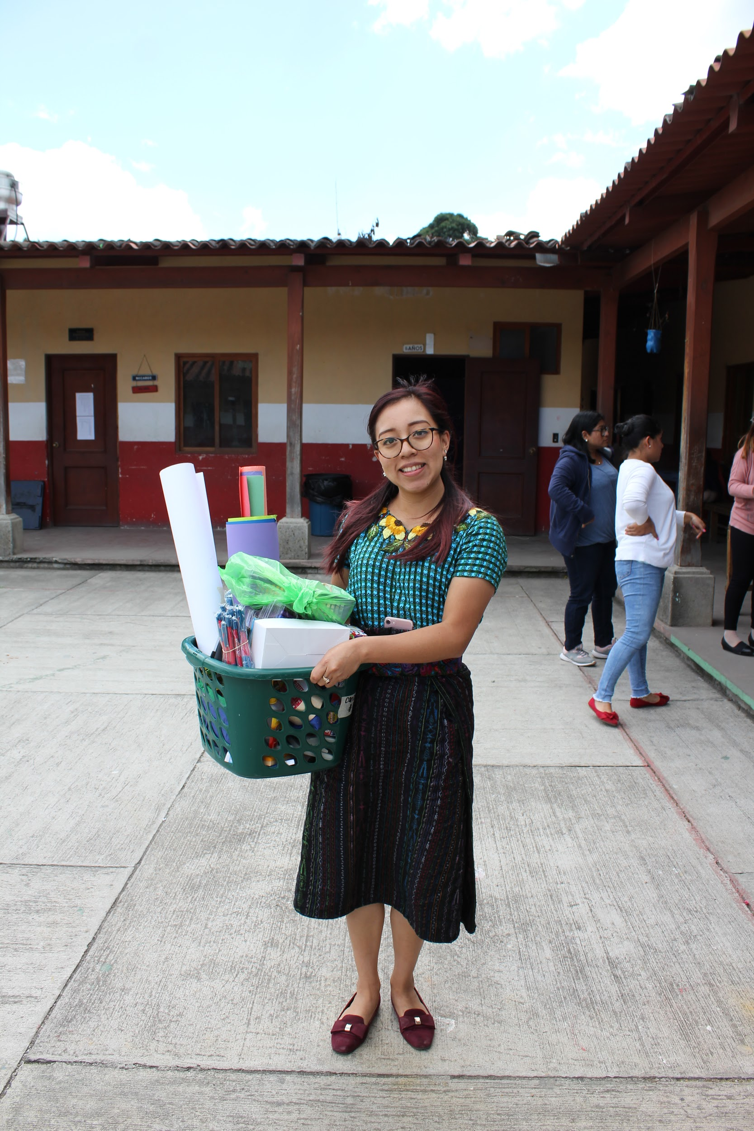
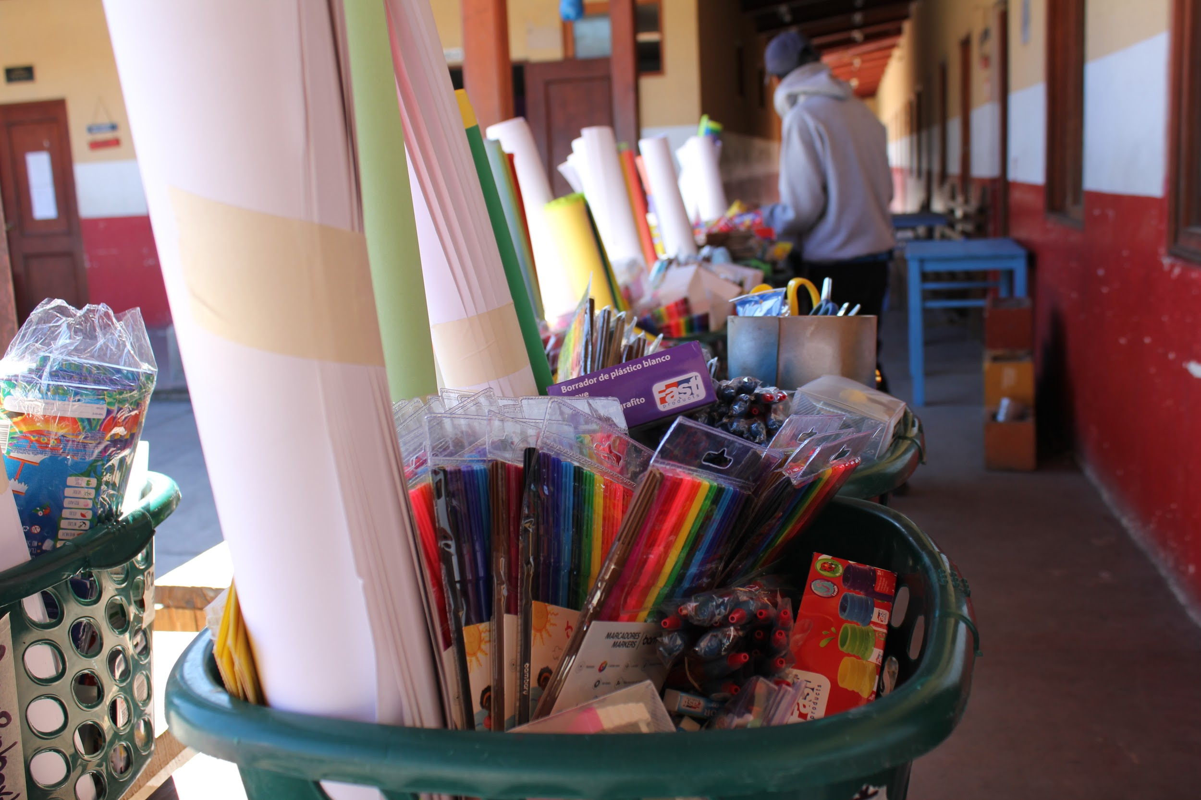
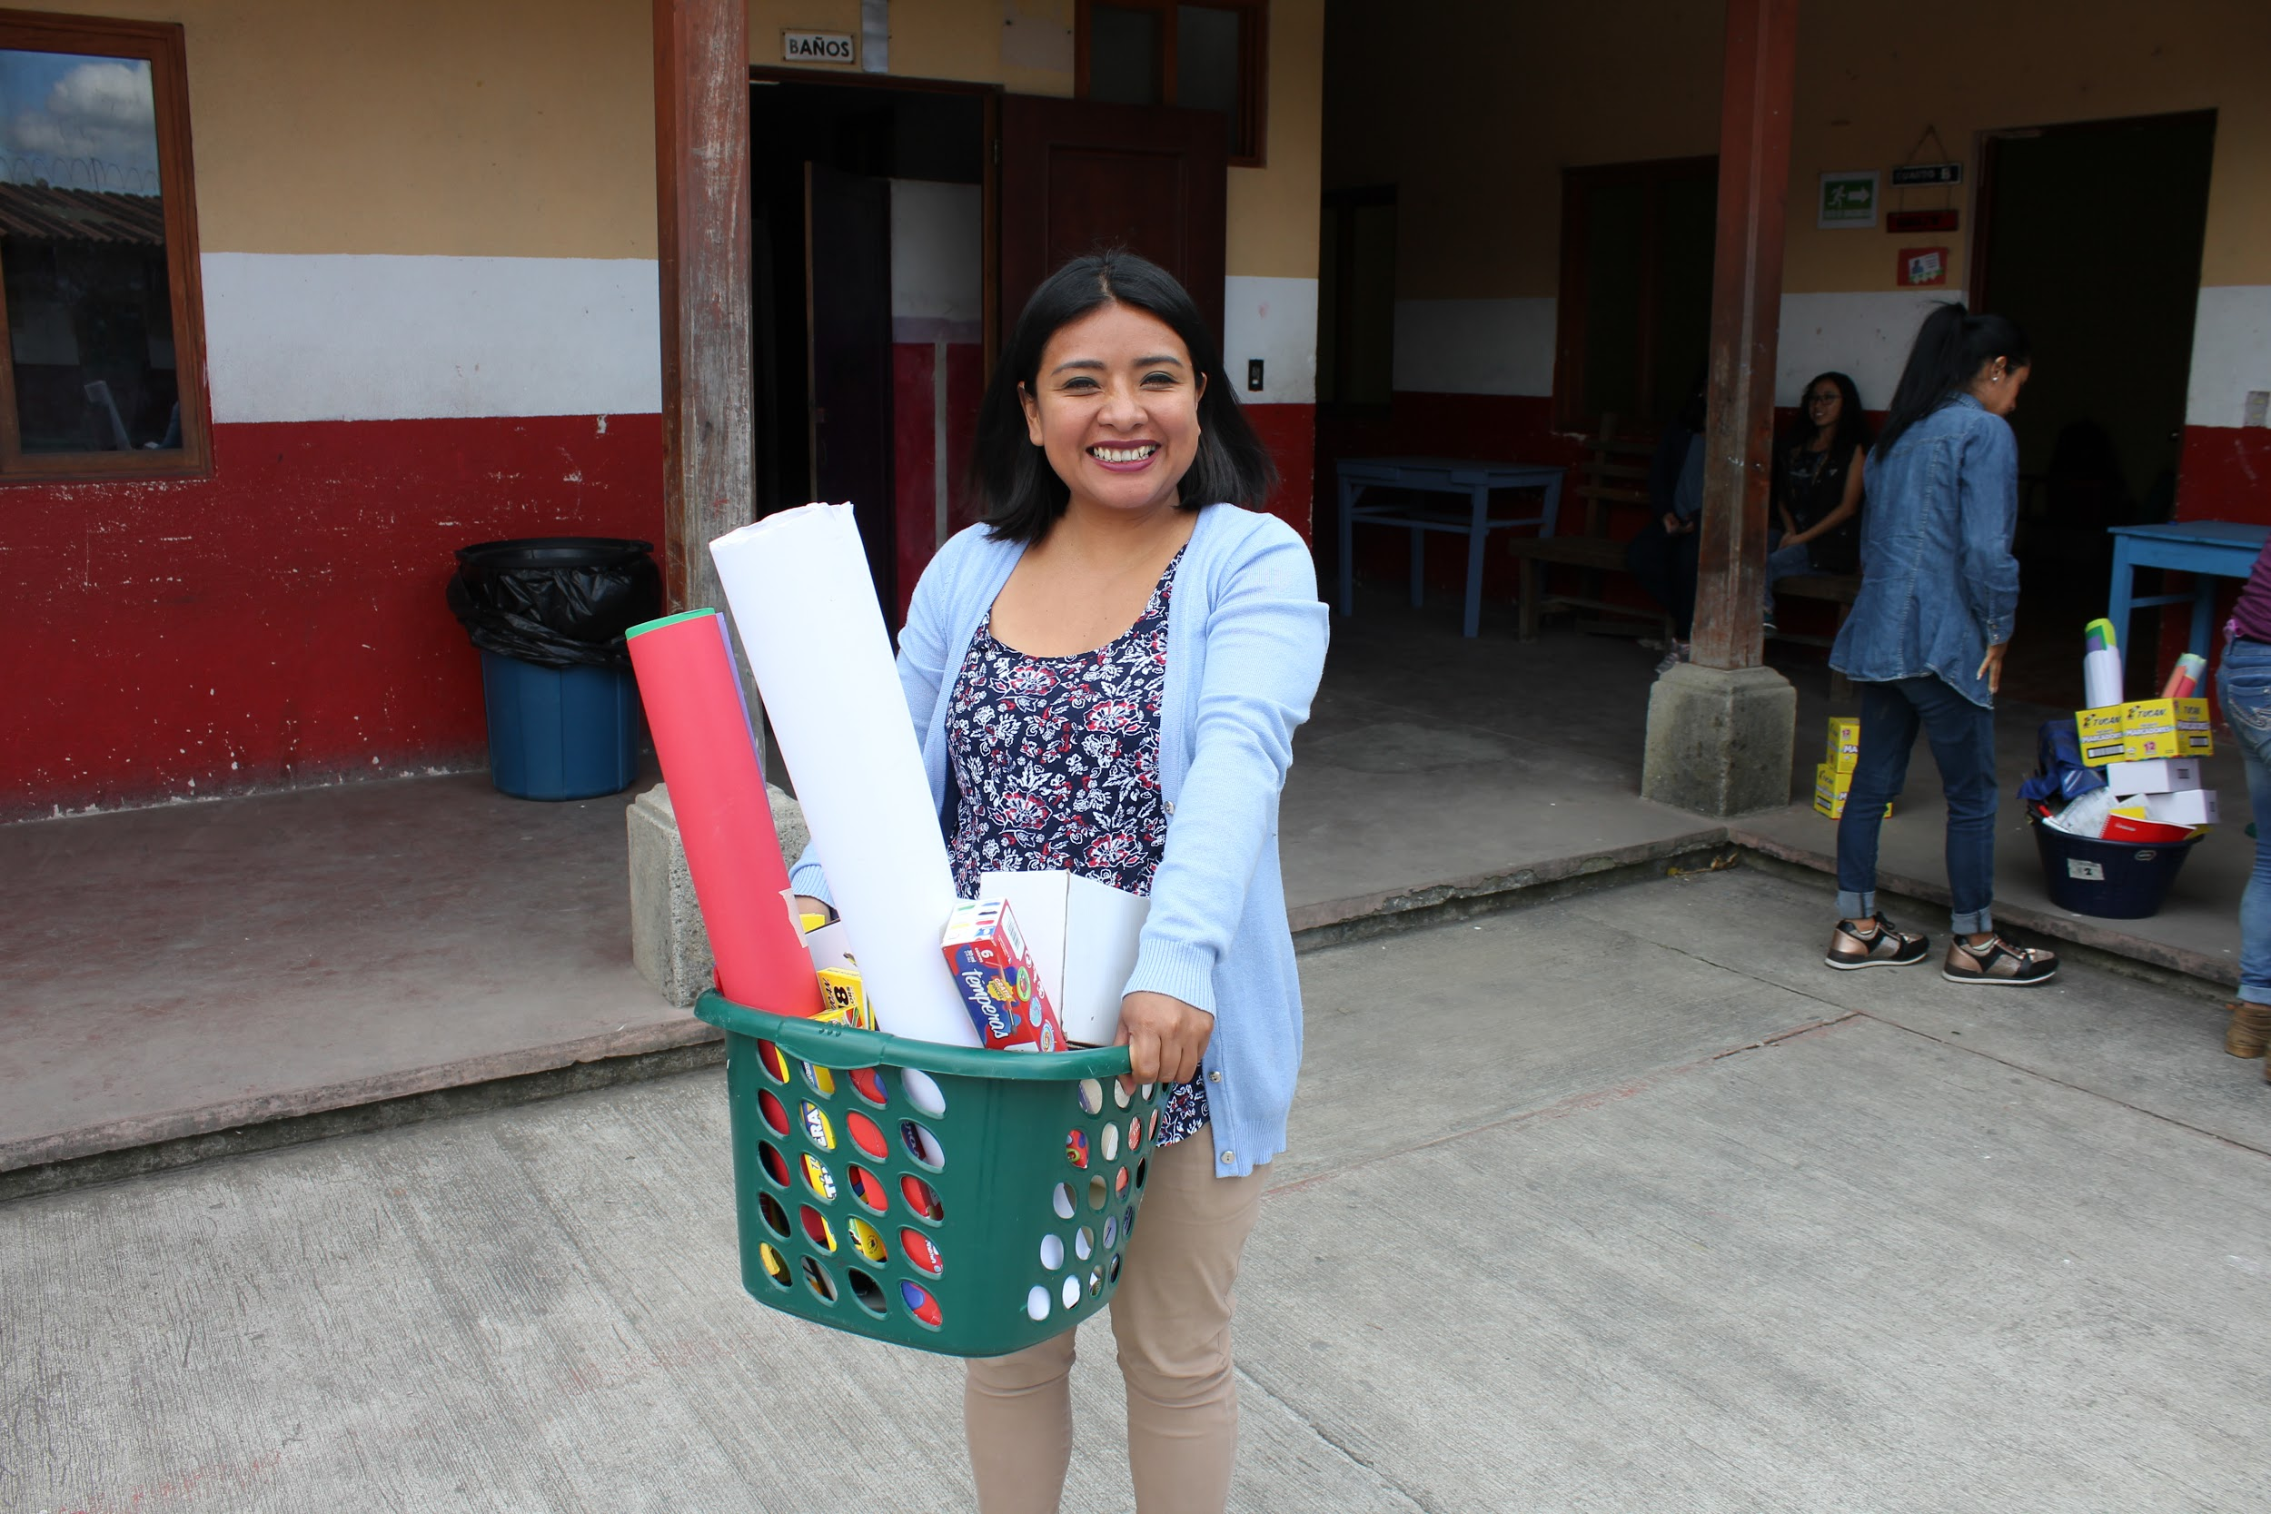
Our Staff

Slide 9
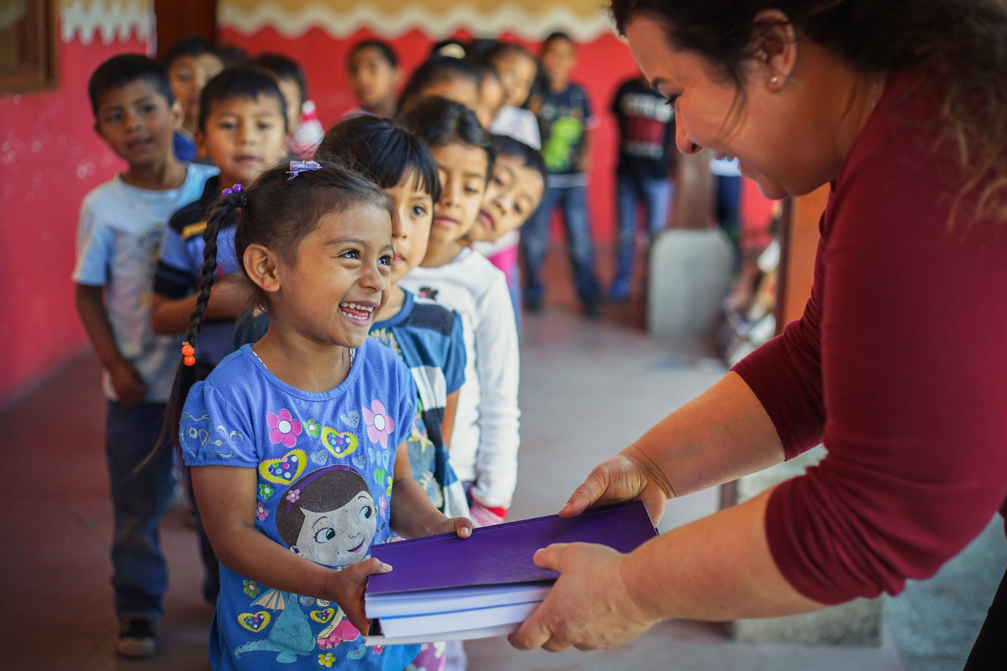
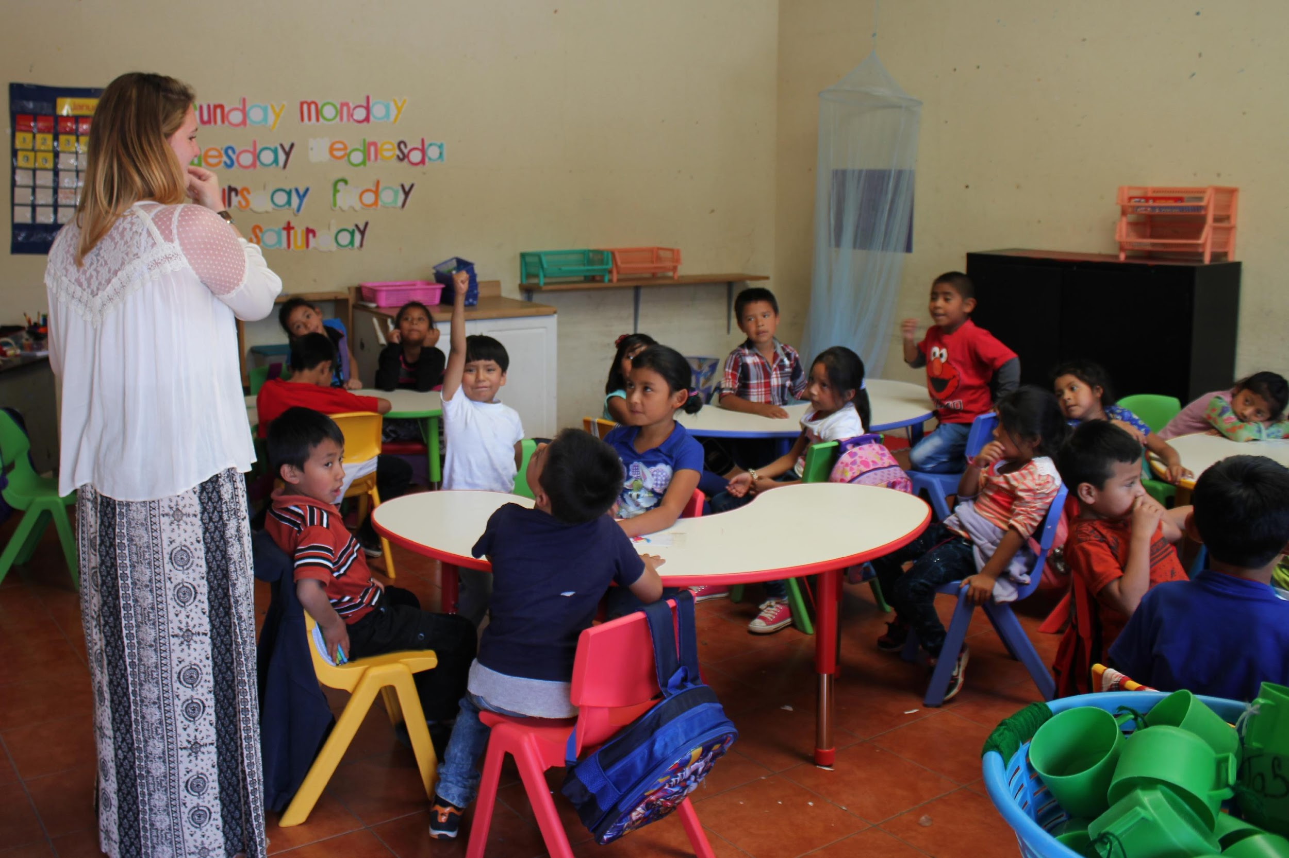
The School of Hope
EFTC provides a rounded education with a special emphasis on english, technology, literacy and life skills.
Follows Guatemalan National Curriculum
Grown from a school of 155 primary school students in 2003 to 702 students from primary right through to university

Slide 10
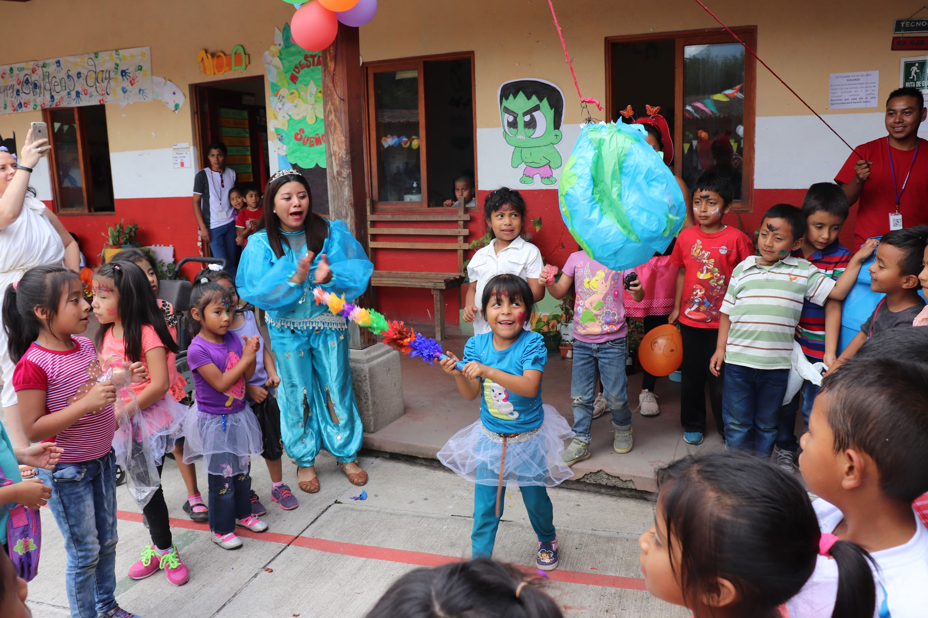
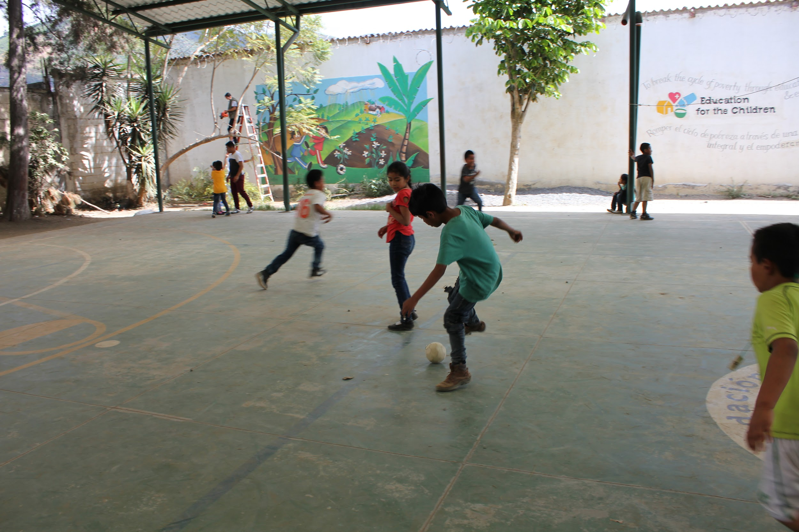
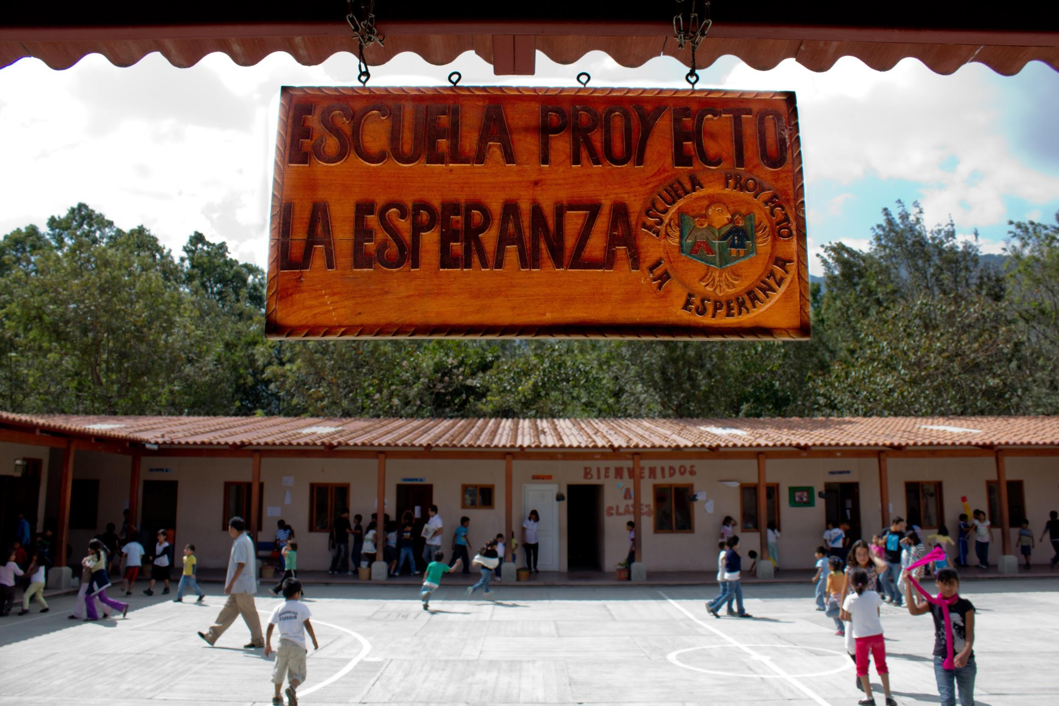
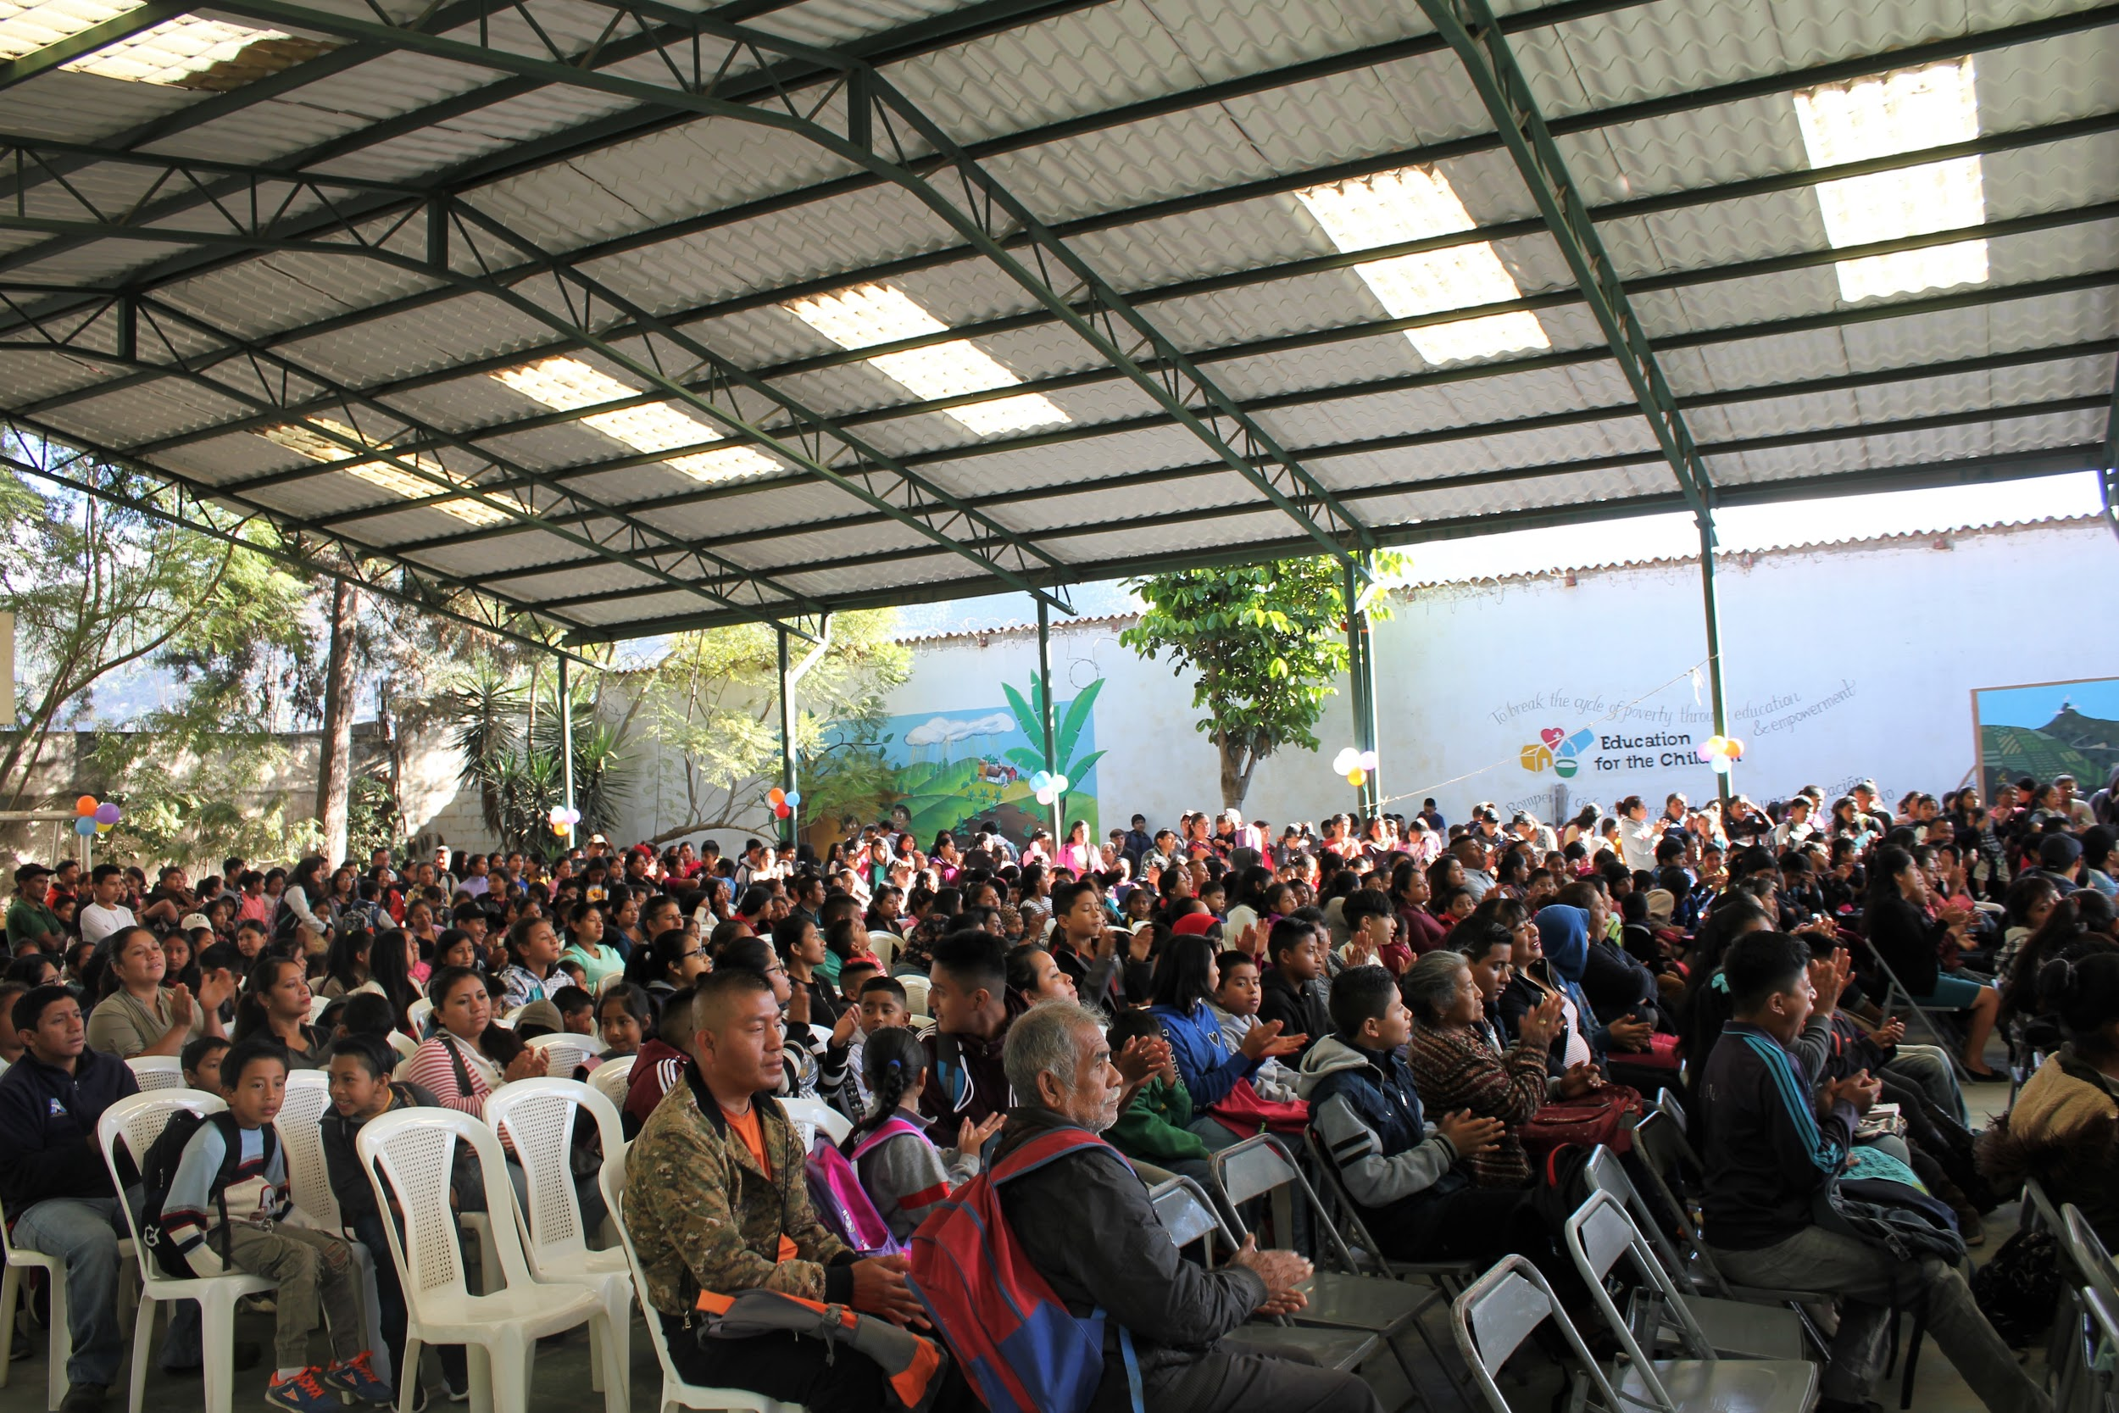
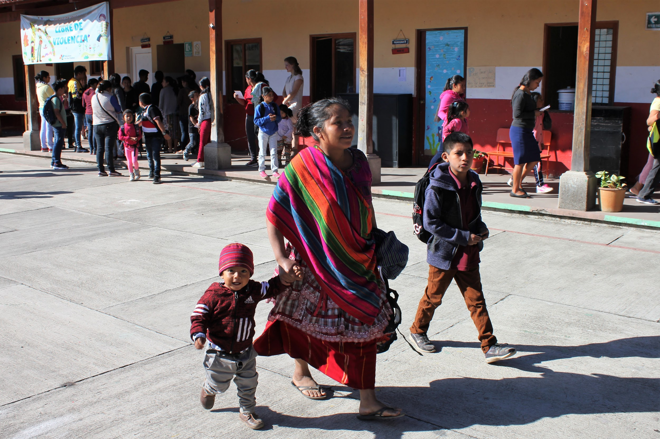
The School of Hope

Slide 11
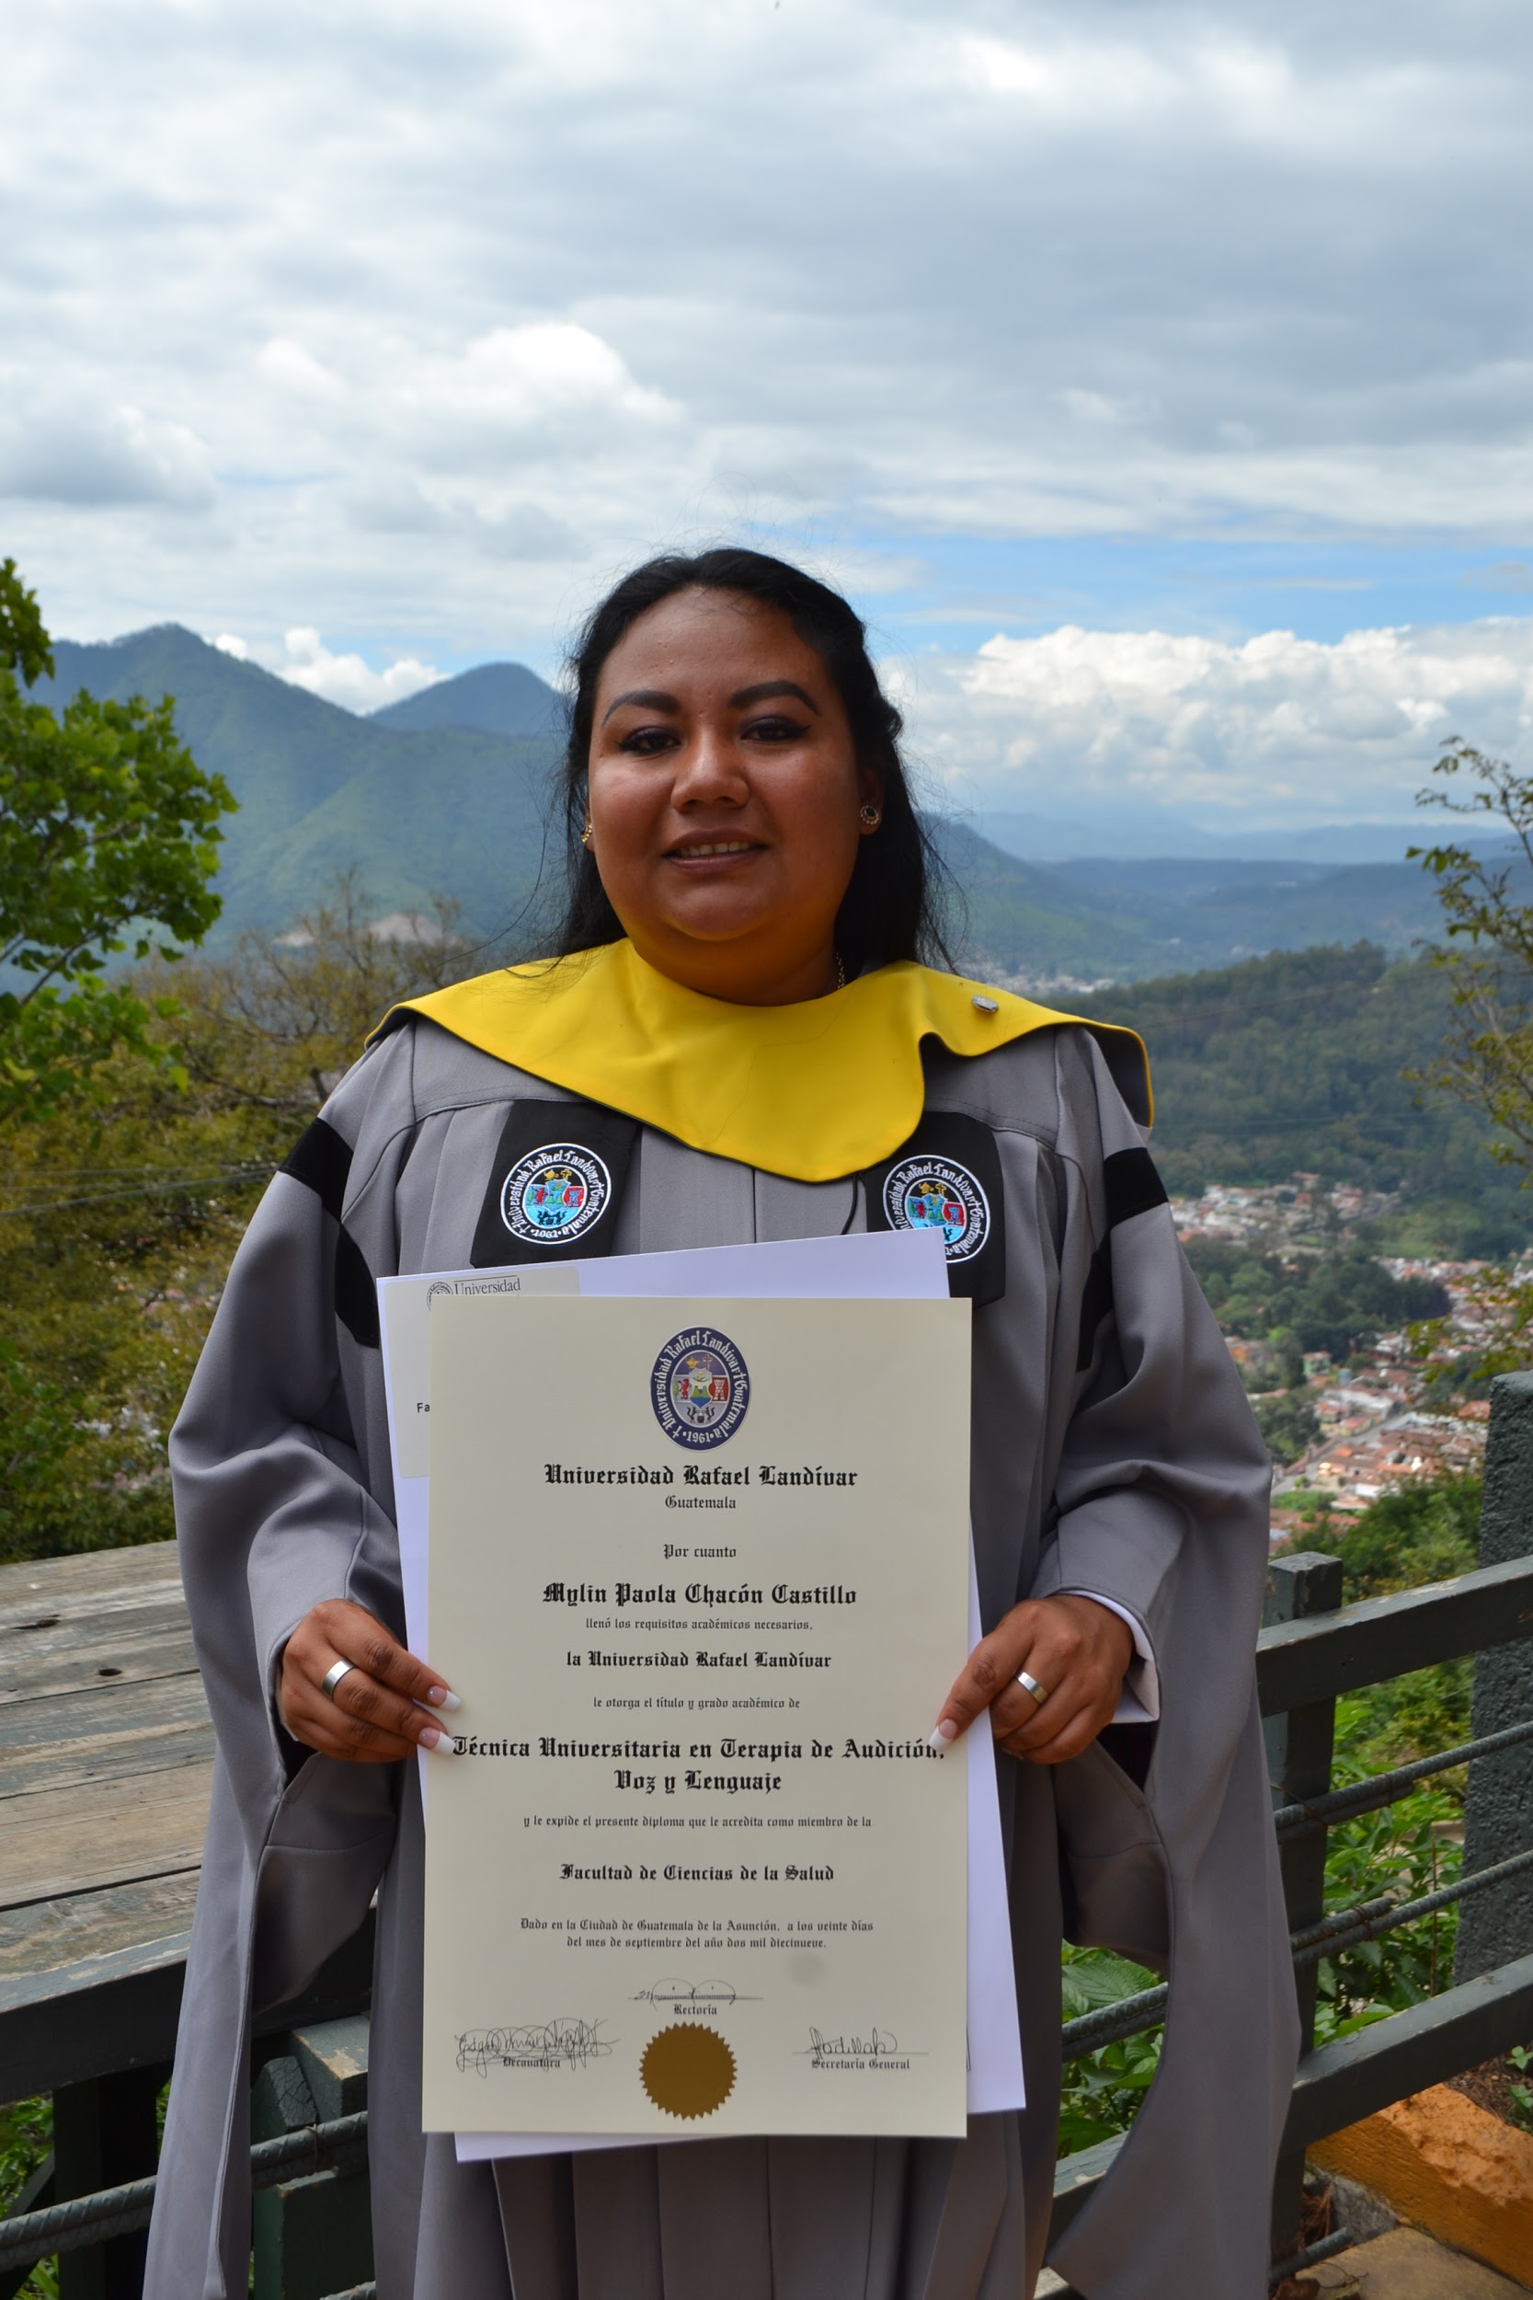
Further Education
Only 10% of students graduate high school in Guatemala
EFTC have created the Further Education Programme – which provides School of Hope graduates with scholarships to move on into higher education
The team also supports students emotionally, giving them career advice and life skills

Slide 12
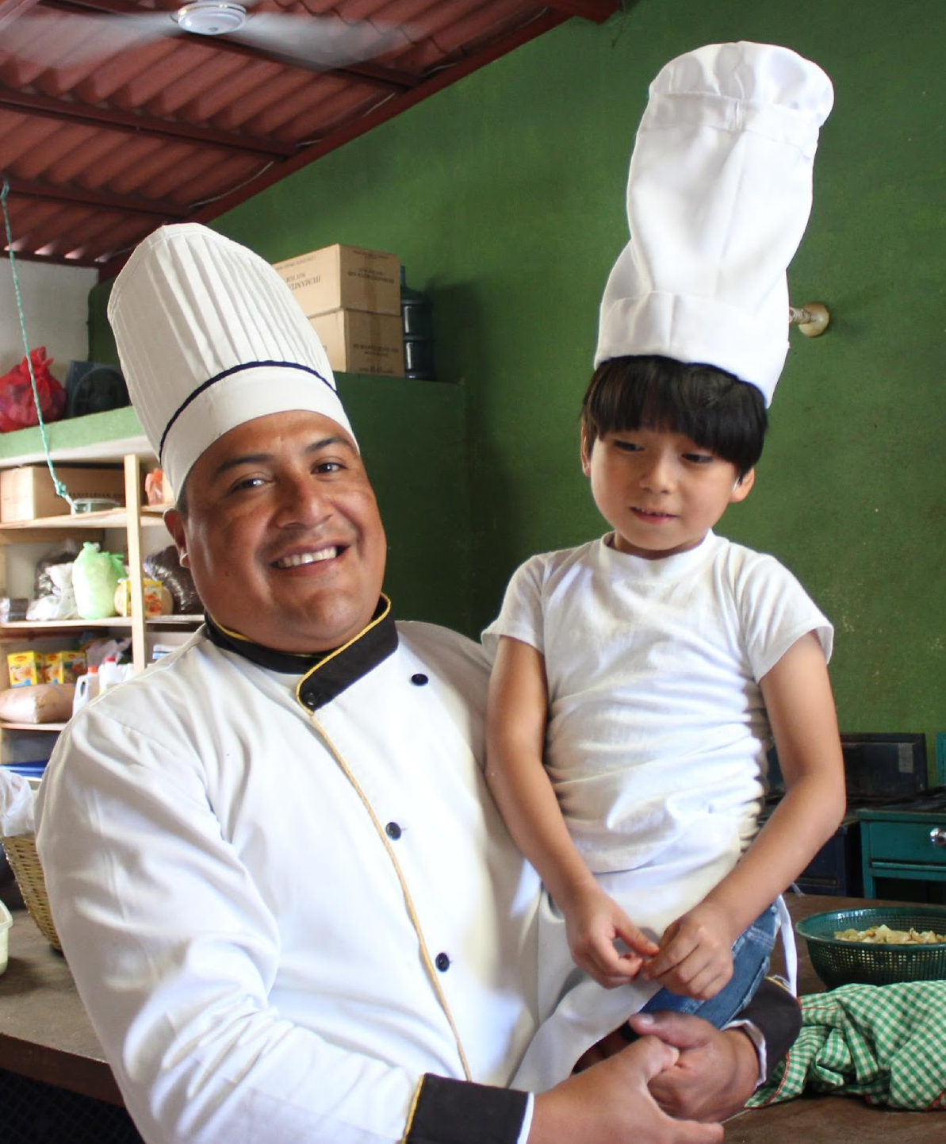
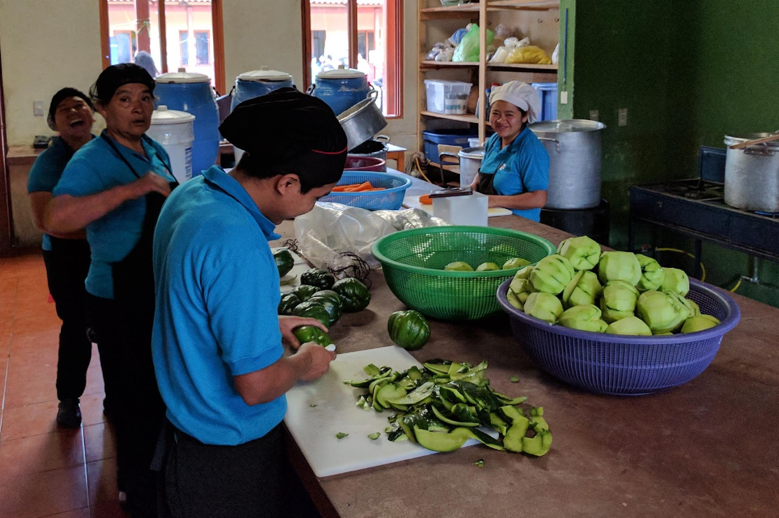
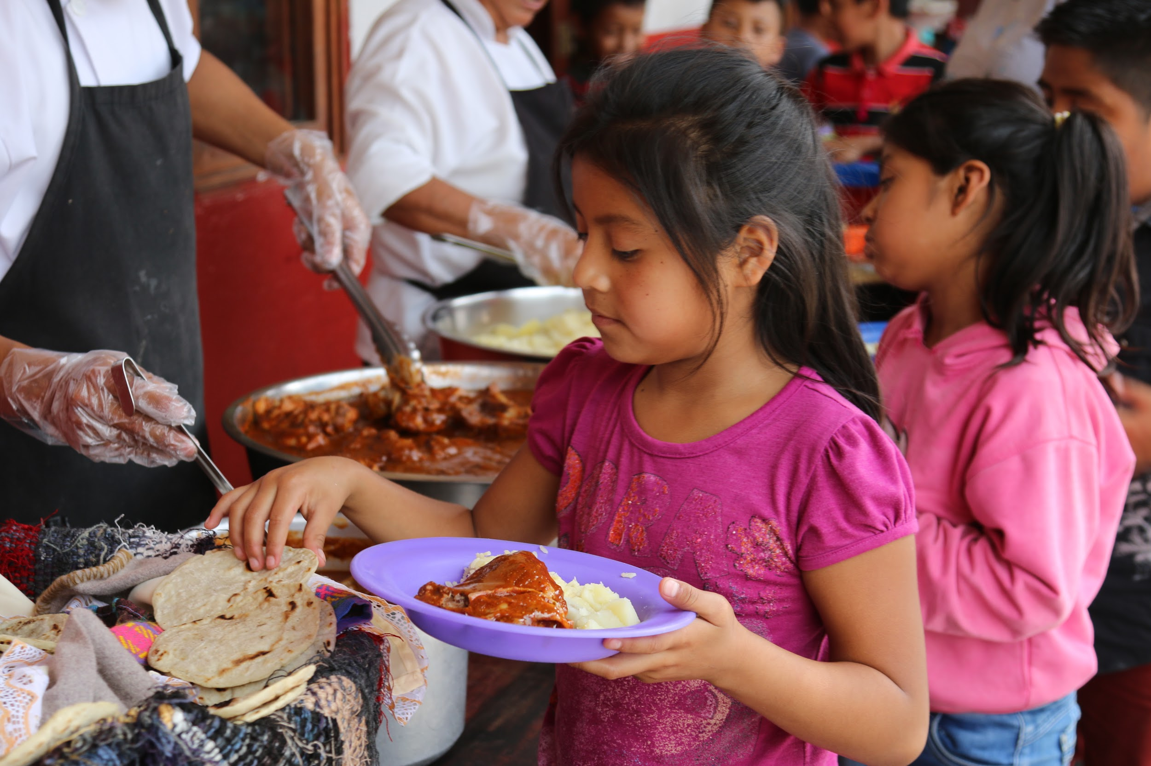
Nutrition
24% of Guatemalan children under five are underweight
EFTC provide 2 nutritious meals a day to aid both the physical and cognitive development of our students.
Our goal is to educate our students about healthy eating as well as provide them with a balanced diet.

Slide 13
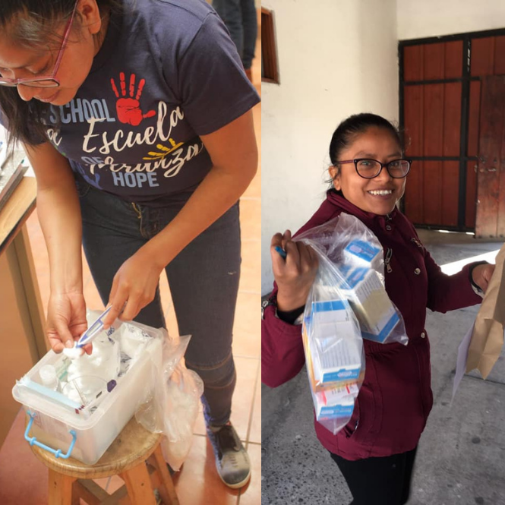
Healthcare
The reality is that as much as 40% of the Guatemalan population don’t have access to healthcare
Dedicated school nurse who is a former student
Regular health tests and access to preventive healthcare advice
EFTC provide students with essential items such as toothbrushes as well as glasses and hearing aids if needed

Slide 14
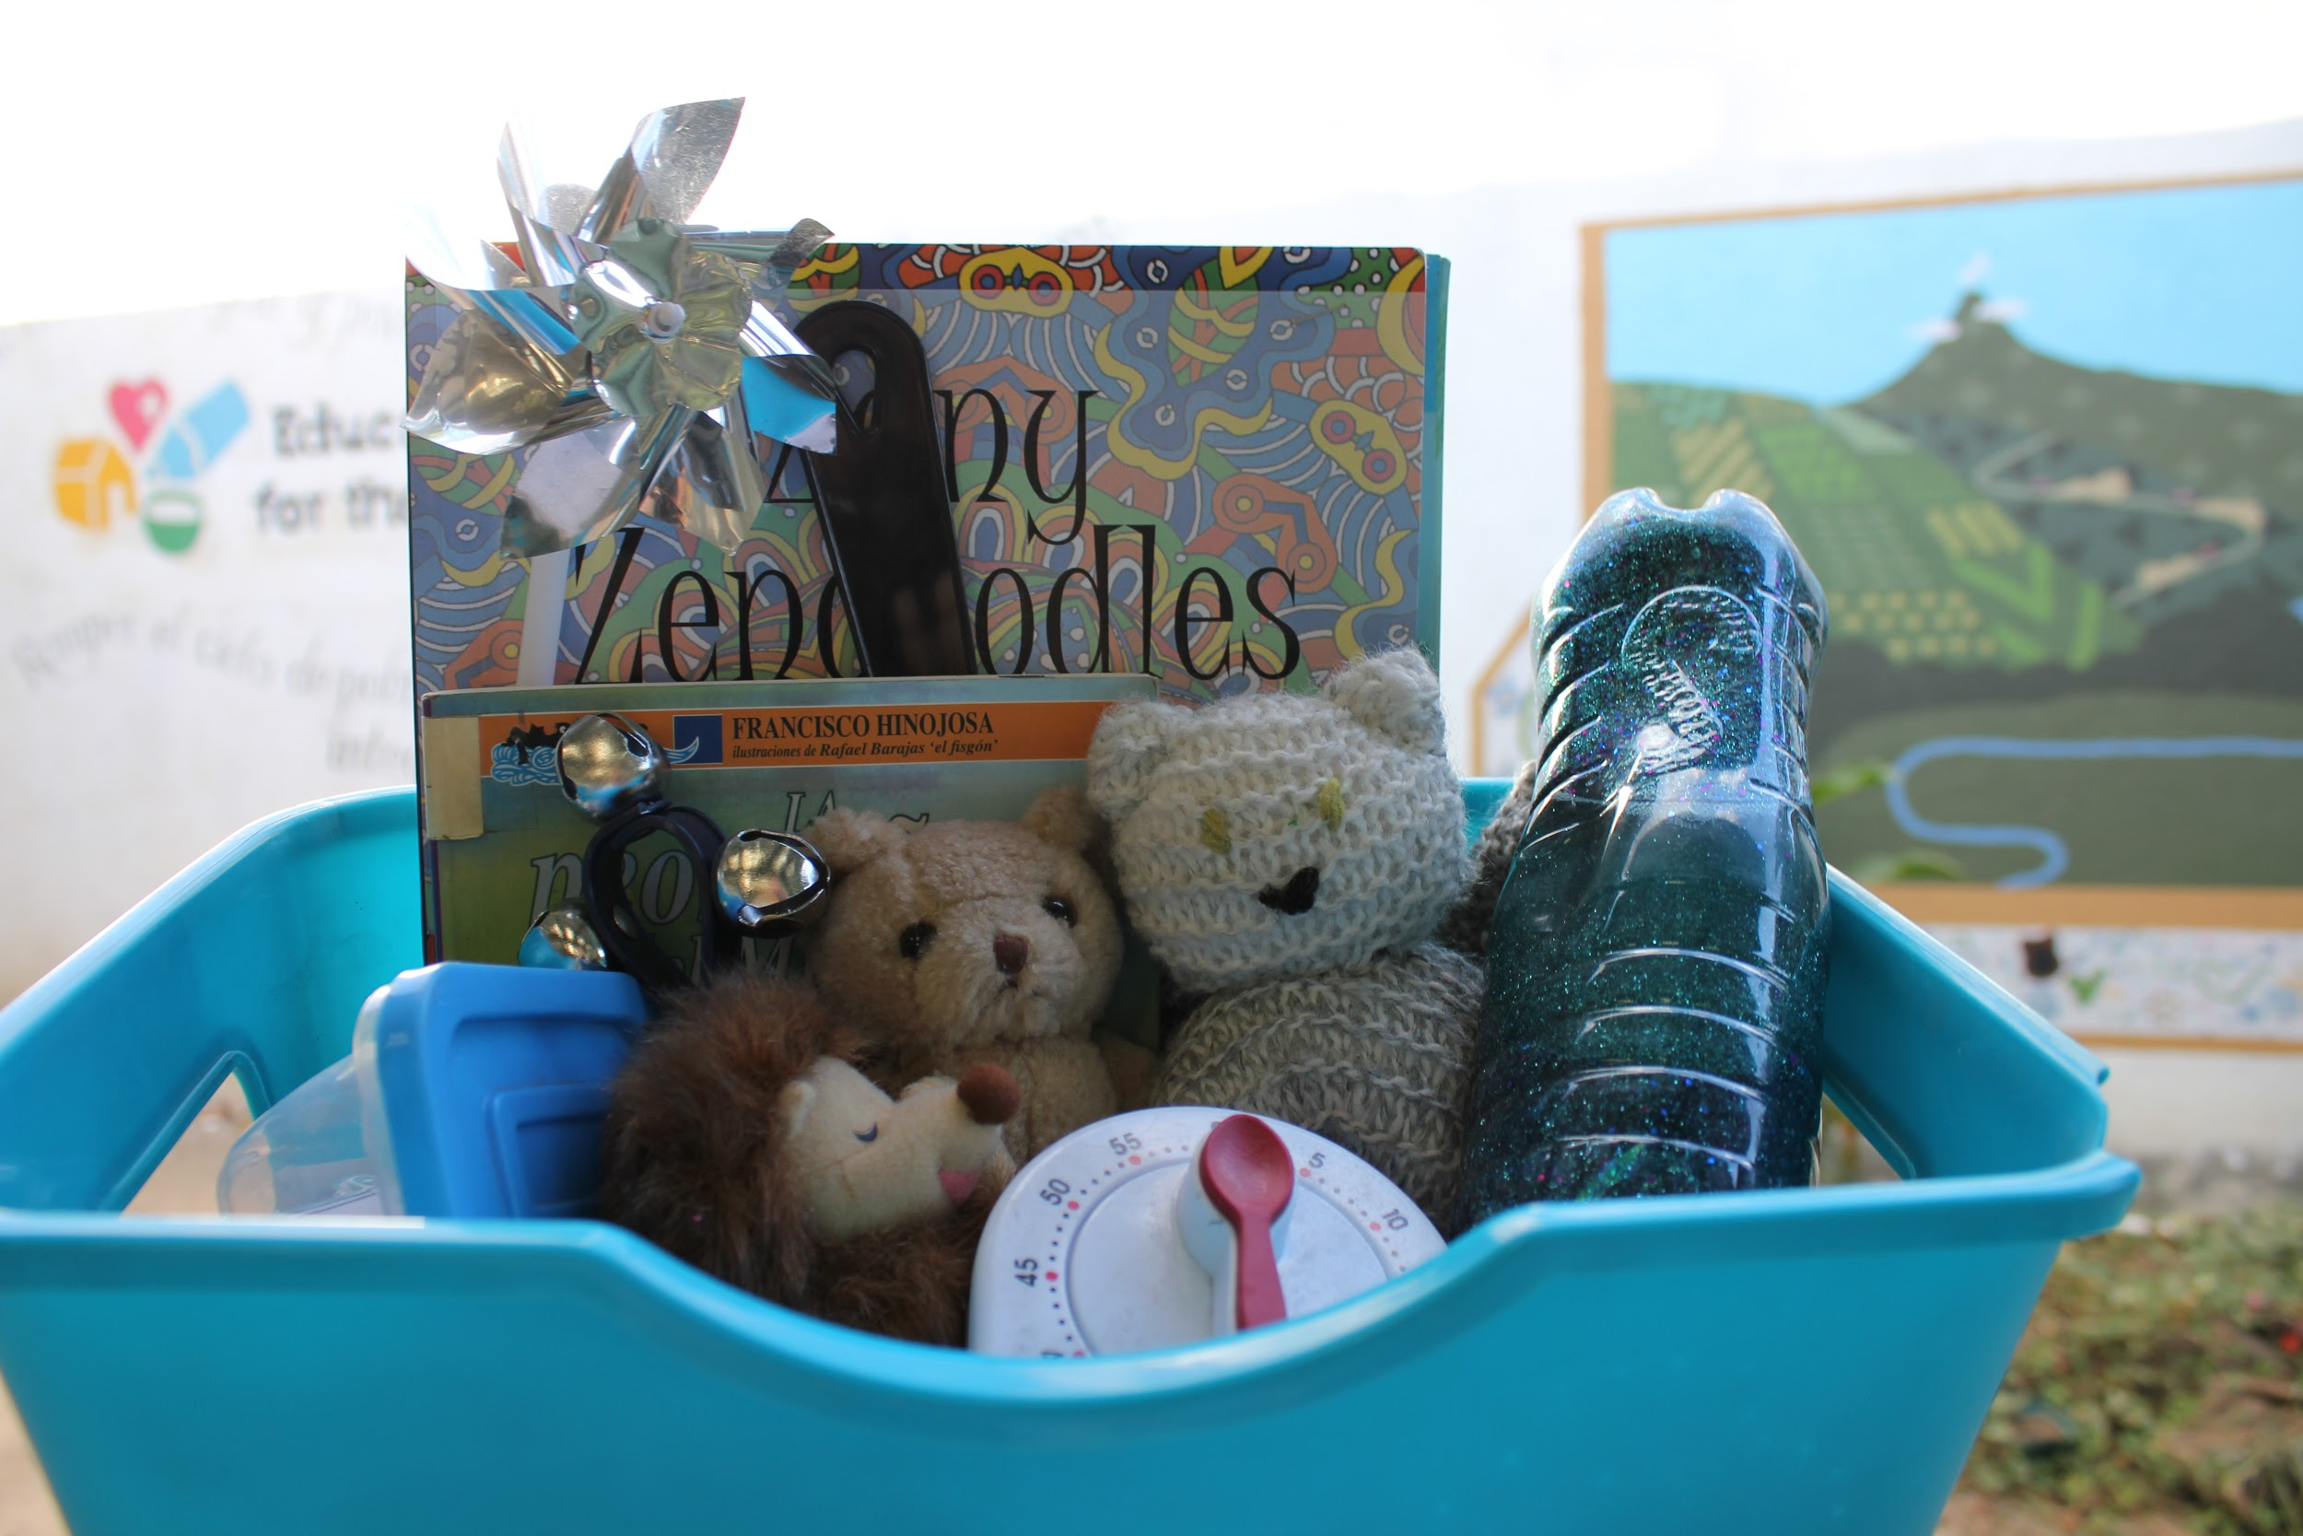
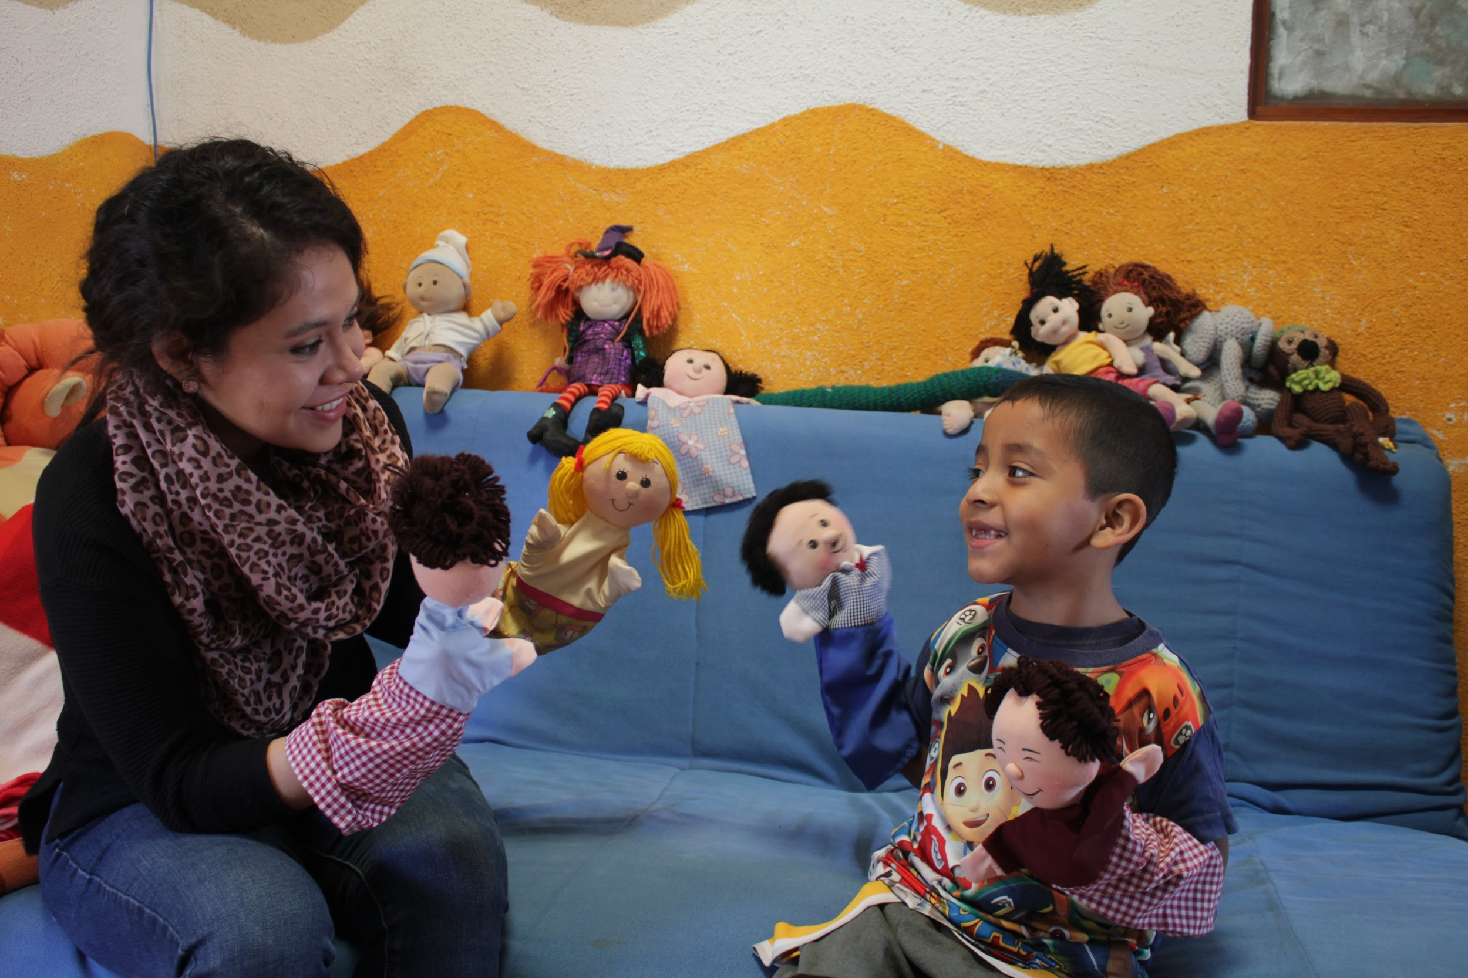
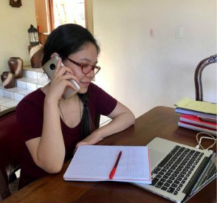
Social Support
Exposure to gang related crime, physical and sexual abuse is a common occuence in Jocotenango
School psychologist
Career Counsellor
Lifeskills
Legal Assistance

Slide 15
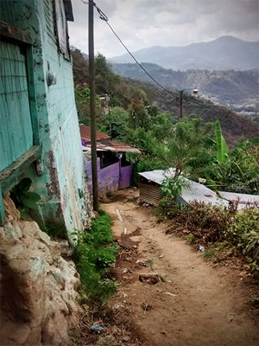
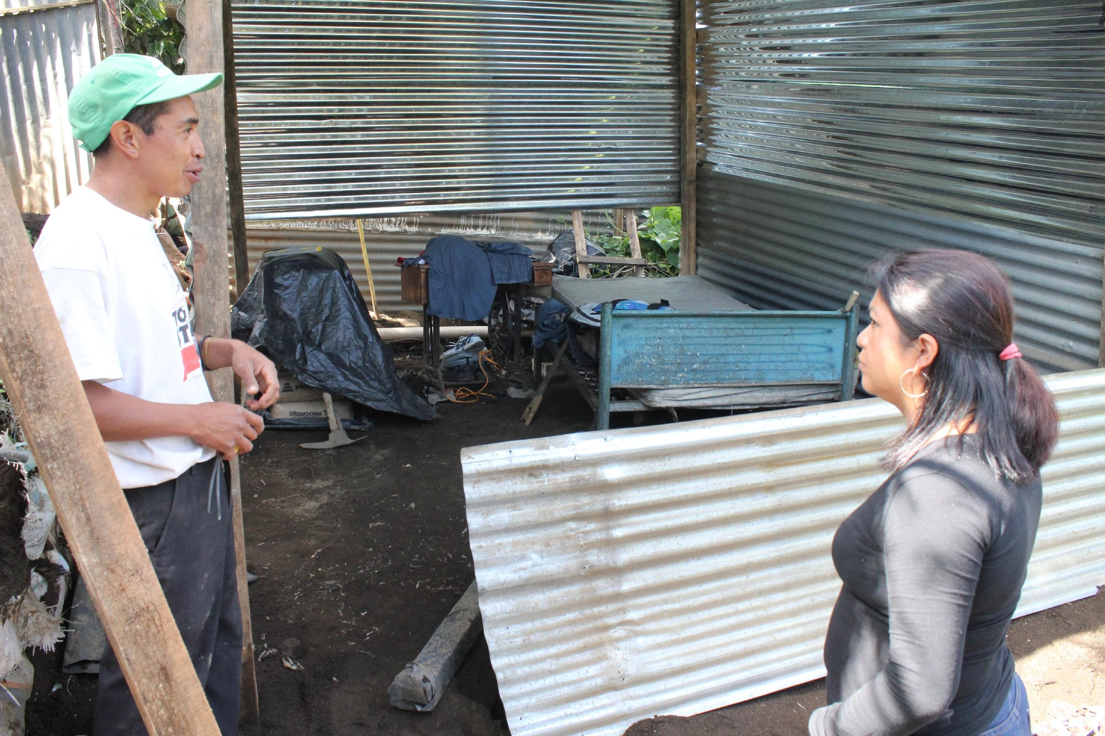
Housing
Families sleep in cramped, shared beds with mud or concrete floors and corrugated walls
Many are located on hillsides so are at risk from erosion and landslides
EFTC helps to fix and rebuild homes to create a safer environment

Slide 16

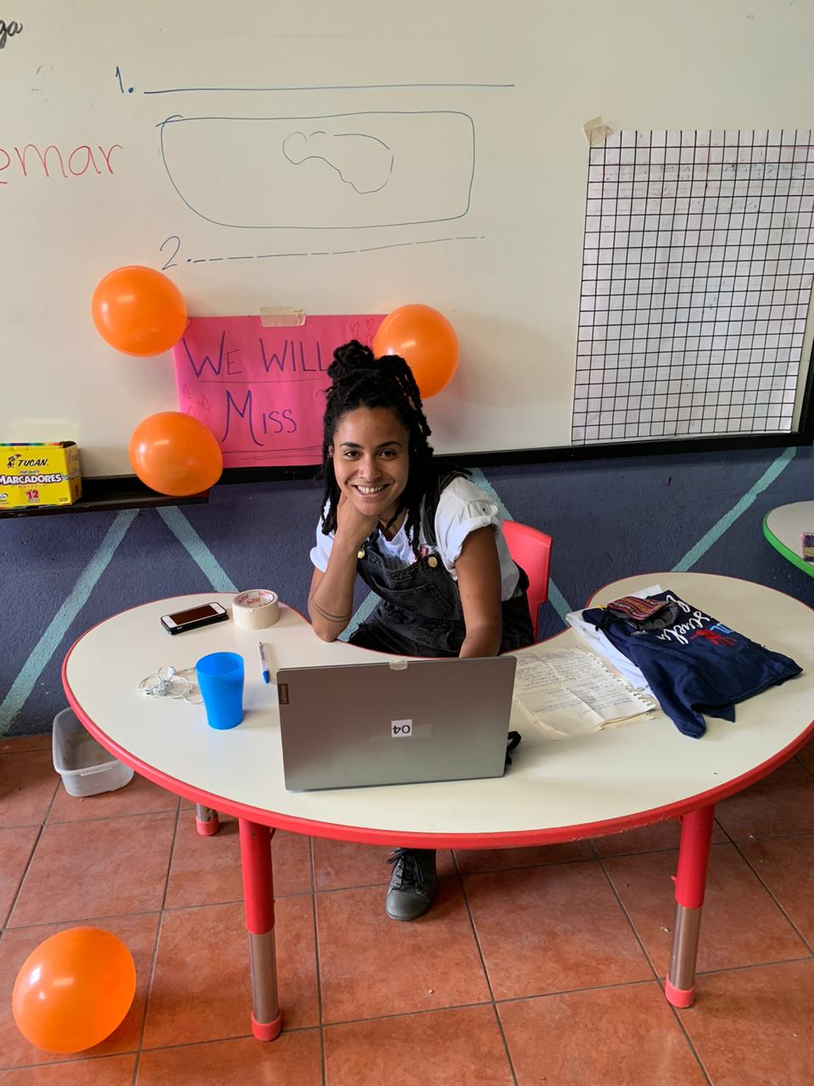
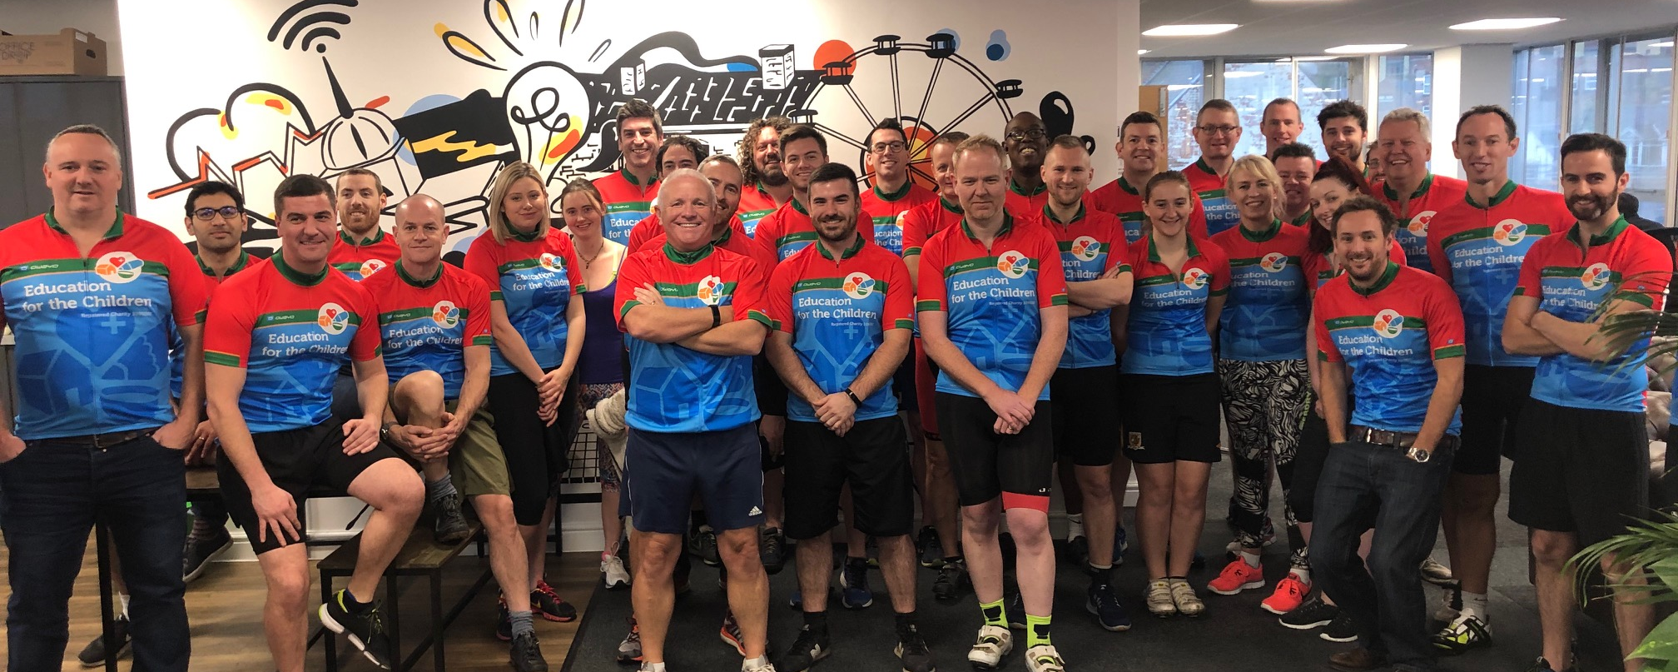
Fundraising
UK & USA
Sponsorship programme
Volunteer programme
Corporate partnerships
Community fundraising
Events

Slide 17
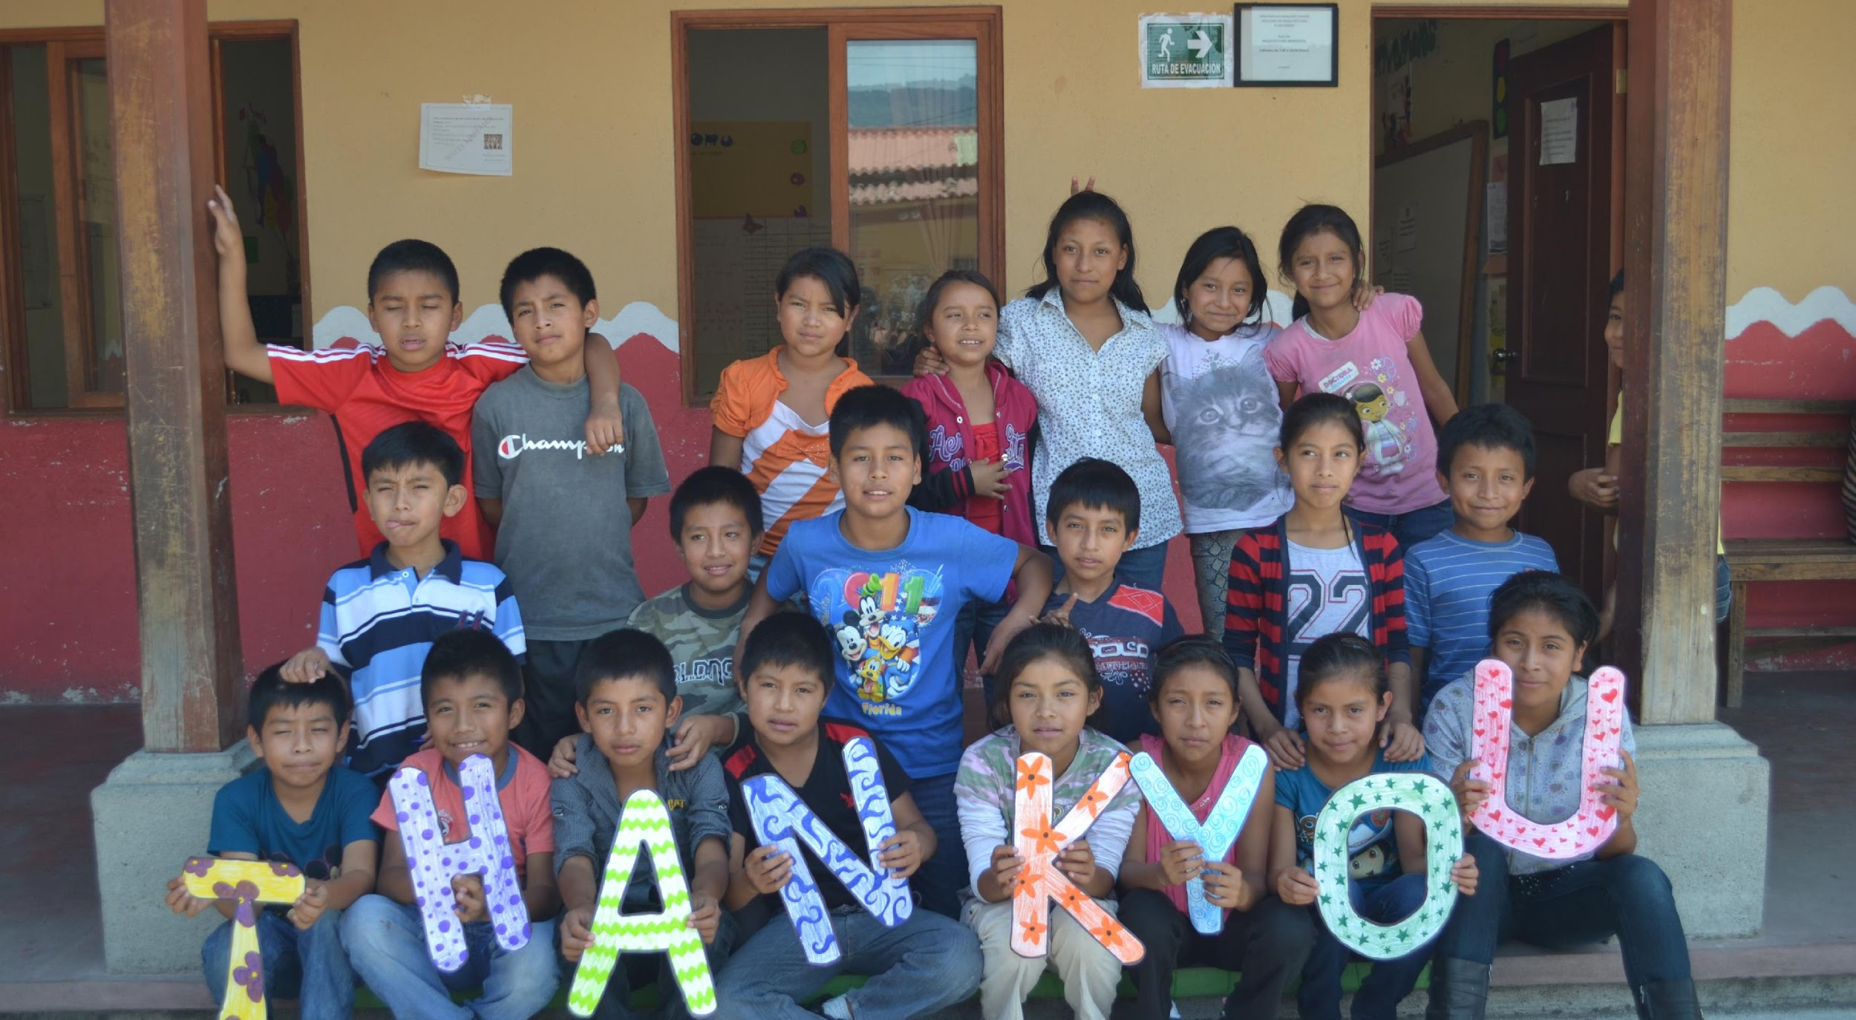
Any Questions?

