Slide 1

Curriculum meeting
Aims – To share the purpose and our vision of the Lady Bay curriculum
To give you an opportunity to share your ideas about the curriculum
To answer any questions you may have about our curriculum

Slide 2
Curriculum meeting
Our school values and motto
Values
Respect, Enjoyment, Determination, Collaboration, Reflection, Curiosity
Motto
Growing together: caring for ourselves, each other and the environment.
Context and why
Mainly White British community
Children mainly come from well-supported households and have a great range of experiences
Eco – friendly community with green party councillors
So…
Our curriculum needed to be
Aspirational for personal development, focus on the whole child, giving children the cultural capital to be global citizens and the leaders of the future.
Give children an understanding of communities different to their own
Help children to take responsibility for the environment and help them to understand how they can live sustainably
Ensure the children reflective so they care for/look after their own and other people’s wellbeing in an ever changing world

Slide 3
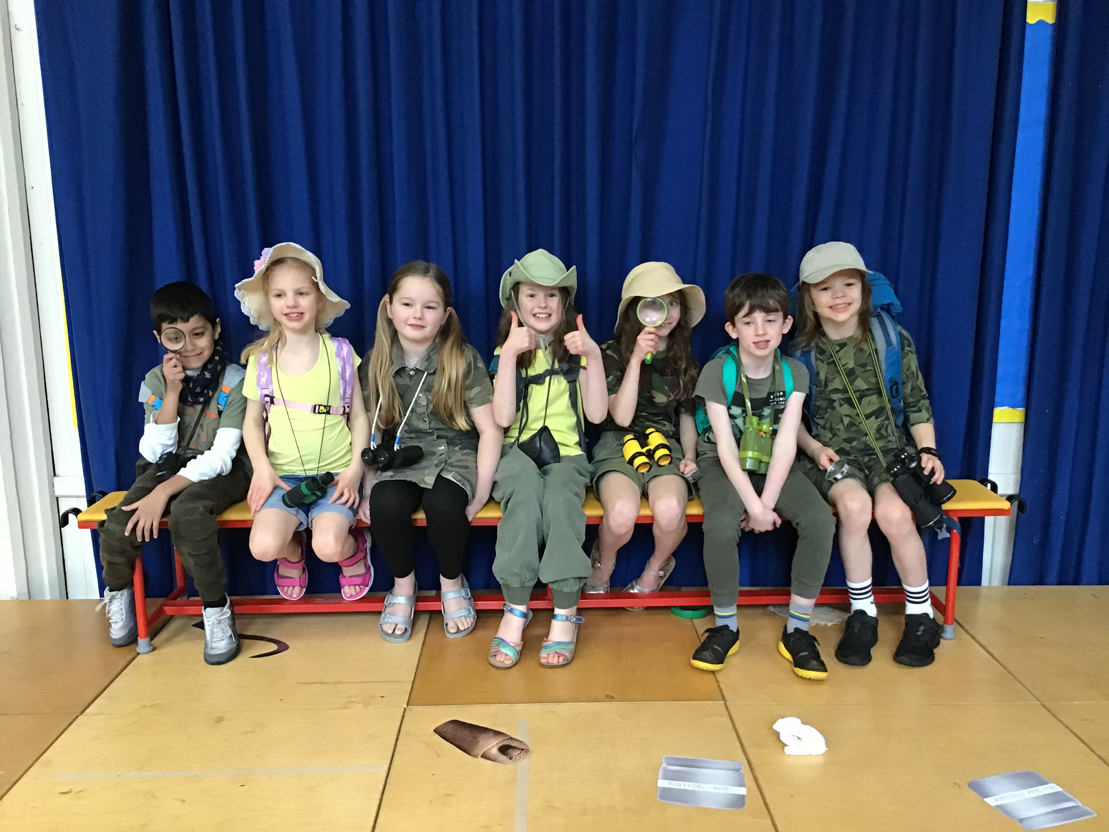
Curriculum meeting
Curriculum and wider curriculum
Long term planning based on the EYFS framework and the National Curriculum
Broad and balanced curriculum
Specialist teachers for Spanish, Music and PE
Website – Class pages, LTPs, half term overviews, knowledge organisers, subject overviews, latest news and newsletters
Enrichment opportunities
20 things to do before the children leave Lady Bay
Improvements in leadership at all levels – subject leadership and monitoring, coaching of staff, changes in English to reading and writing, maths
High quality CPD and consultants working with staff to support them
Rosenshine principles of instruction
Support for children in receipt of a pupil premium, those who have SEND and children who need additional support in class
Funding from different avenues has allowed us to resource the curriculum more proficiently (ICT, books, adult support – from 9 to 15 Teaching Assistants, catch up)

Slide 4
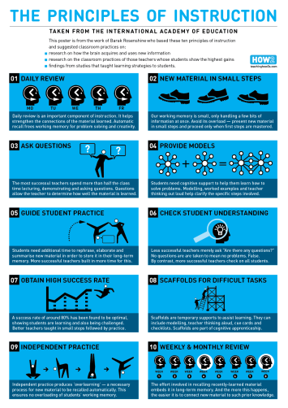
Principles of instruction

Slide 5
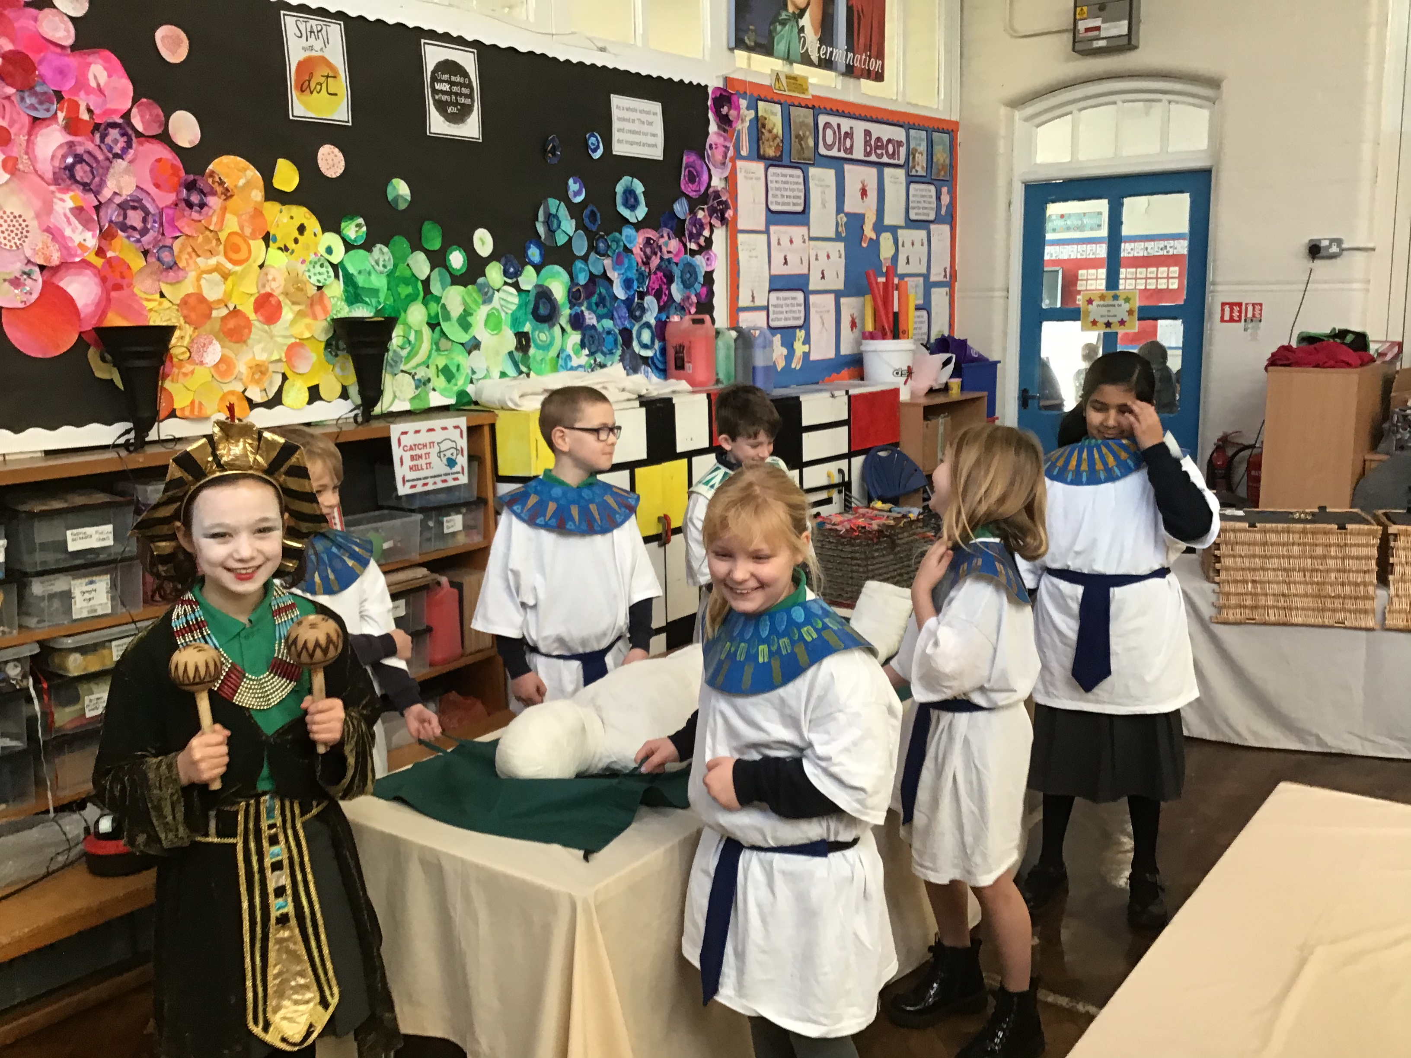
Curriculum meeting
Caring for ourselves
Personal development
Ambitious for all of our children
Curriculum and the wider curriculum
Wellbeing
Jigsaw and rights respecting school (UNICEF)
Global citizenship/ British values
Assemblies
2 hours of PE a week and further enrichment opportunities

Slide 6
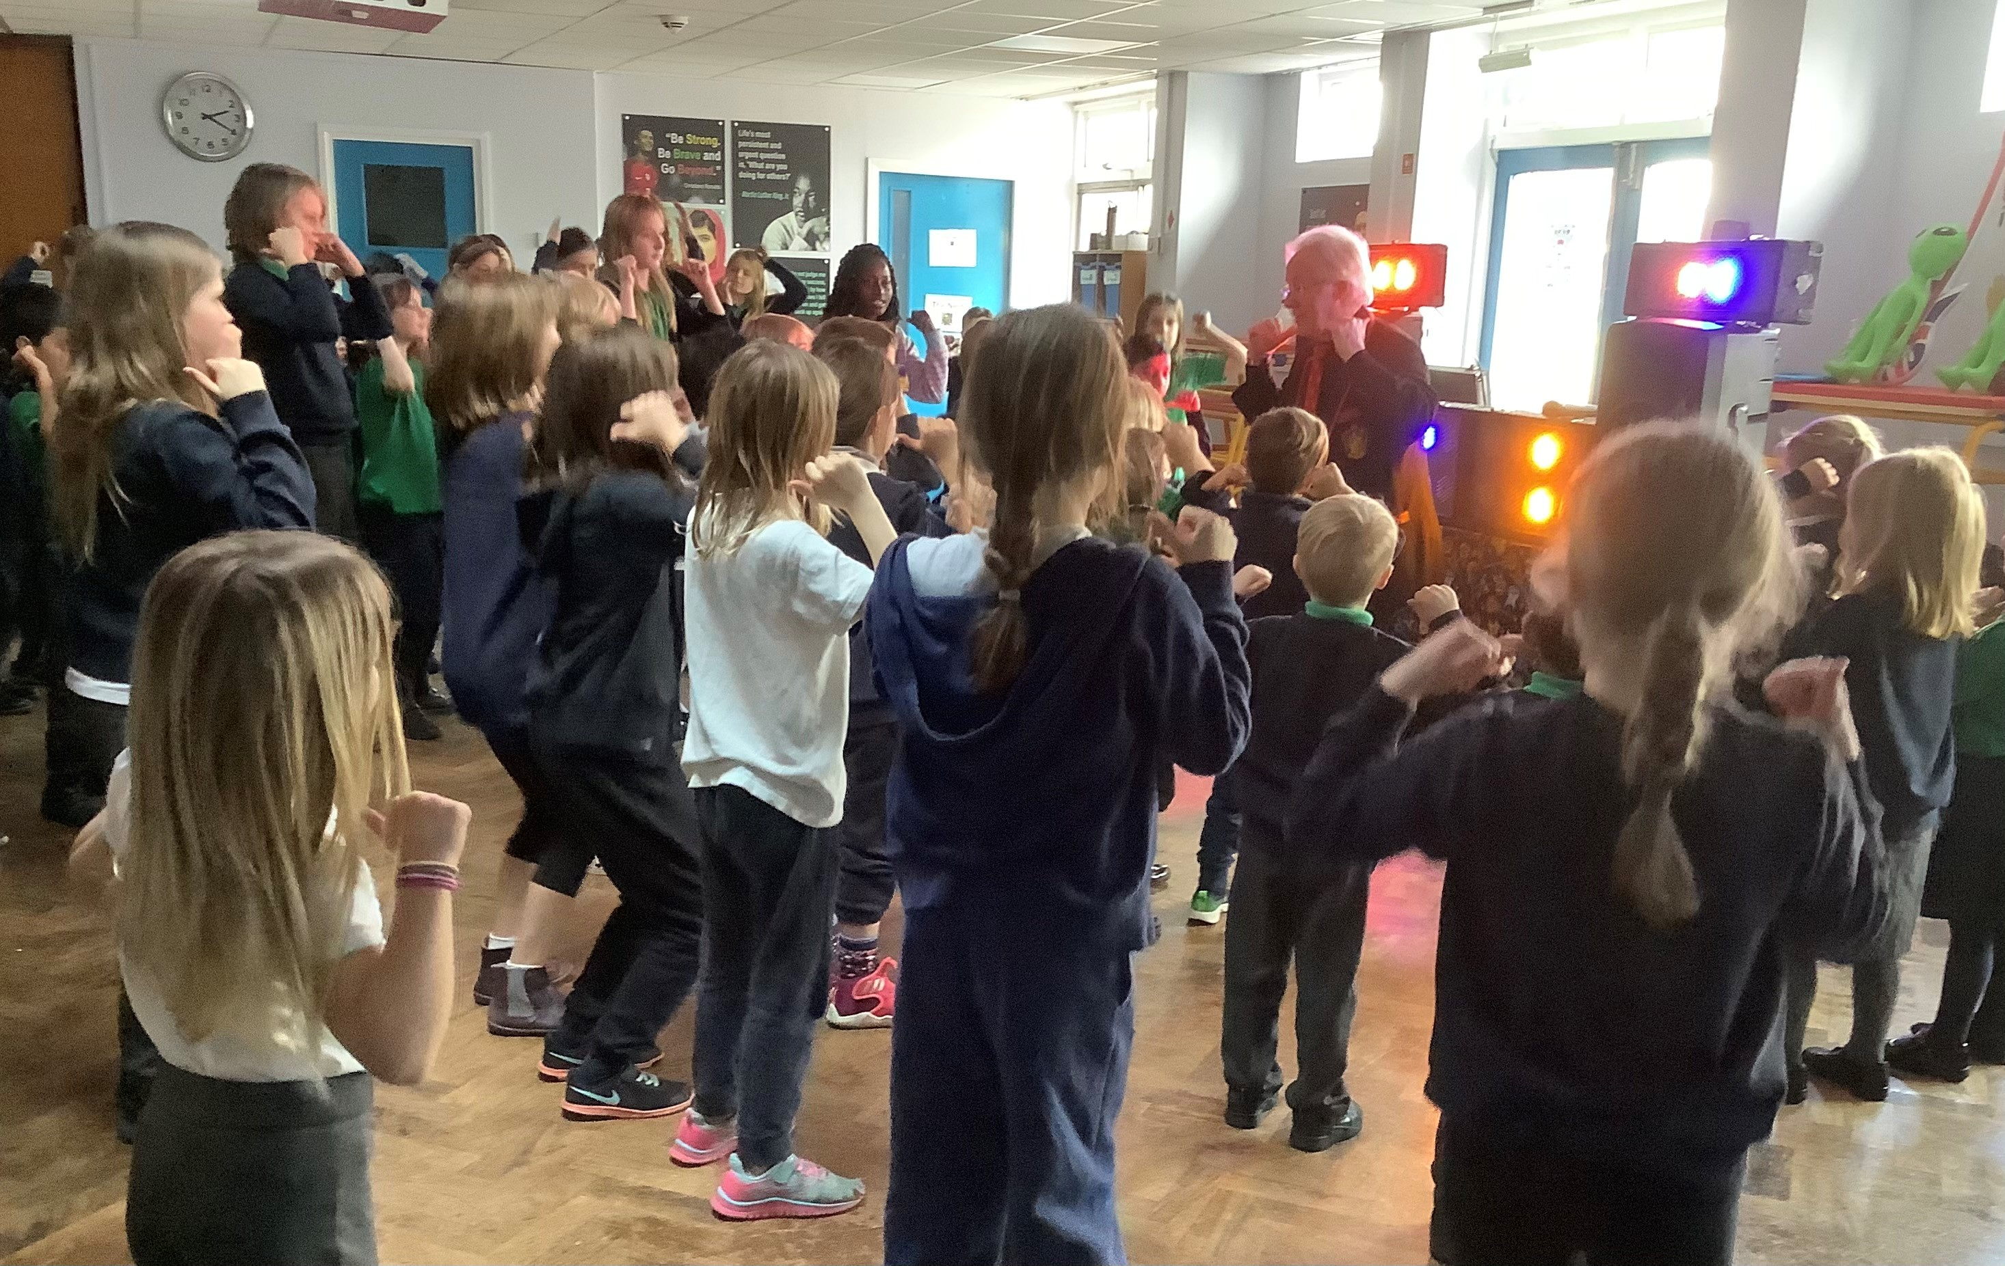
Curriculum meeting
Caring for each other
Excellence in behaviour
House system and buddy systems
Global citizenship, values and rights
Pupil voice
School council
Charities and fund-raising
Inter and intra sport
Anti-bullying, online safety, Jigsaw,

Slide 7

Curriculum meeting
Caring for the environment
Eco team and their initiatives (recycling)
Curriculum
Enrichment days and weeks
Visits
Assemblies
Plastic free school initiative
Walk to school Wednesdays

Slide 8
Curriculum meeting
Approach to English
DHT mentors the subject leader
Consistent phonics approach with good outcomes
Approach to the teaching of reading – 1 to 1, guided reading, structured reading
Promoting the love of reading – Patron of reading, reading hut, library trips, reading diaries and awards, reading spine, enrichment days
2/3 week approach to teach writing
SPAG starters in every lesson
Progressive spelling scheme
Handwriting

Slide 9
Curriculum meeting
Approach to Maths
HT mentors the subject leader
Consistent approach following the White Rose
New White Rose booklets
Focus on reasoning and problem solving
Use of manipulatives to support children
4-a-day
Timetables strategy – year 4 test and rewards
Extension in every lesson

