Slide 1


Autism and Anxiety
Wendy Kozakis & Cheryl Thomas
Communication & Interaction Team, SFSS

Slide 2

Introductions

Slide 3
Aims of the session
Where does the anxiety stem from in our ASC learners?
Consequences for our learners – shutdown or meltdown?
The 8th Sense
Conclusions & Discussion
Expectations
Please ask questions at any stage!!!

Slide 4
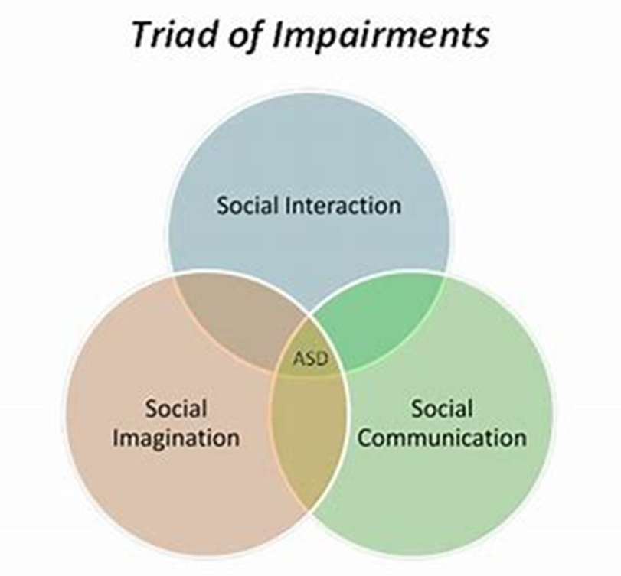

A deficit model of Autism

Slide 5


Communication
Differences in understanding and expressing communication and language, with skills ranging from individuals who are highly articulate, to others who may be non-verbal. Good language skills may mask a deep level of misunderstanding.

Slide 6
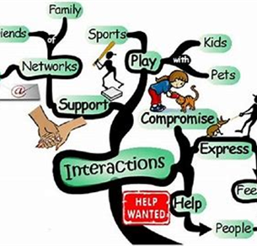
Interaction
Differences in understanding social behaviour and the feelings of others, which informs the development of friendships and relationships

Slide 7
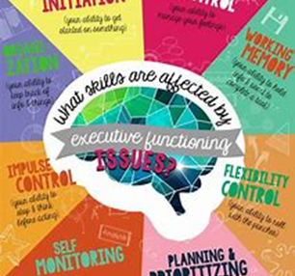
Information Processing
Differences in perception, planning, understanding concepts, generalising, predicting, managing transitions, passions for interest and ability to absorb auditory or spoken information.

Slide 8

Attention
Information Processing
Executive Function
Motivation and self-esteem
Memory and recall
Understanding others’ viewpoints
Organisation
Knowing how to start a new task
Planning and predicting
(anxiety about change)
Prioritising
Self-monitoring

Slide 9



Focused Interests

Slide 10
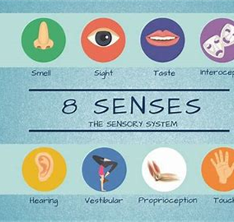
Sensory
Differences in perceiving sensory information. Hypo (low sensitivity), hyper (high sensitivity), touch, sight, hearing, smell, taste, vestibular inner ear (balance), proprioceptive (body awareness).

Slide 11
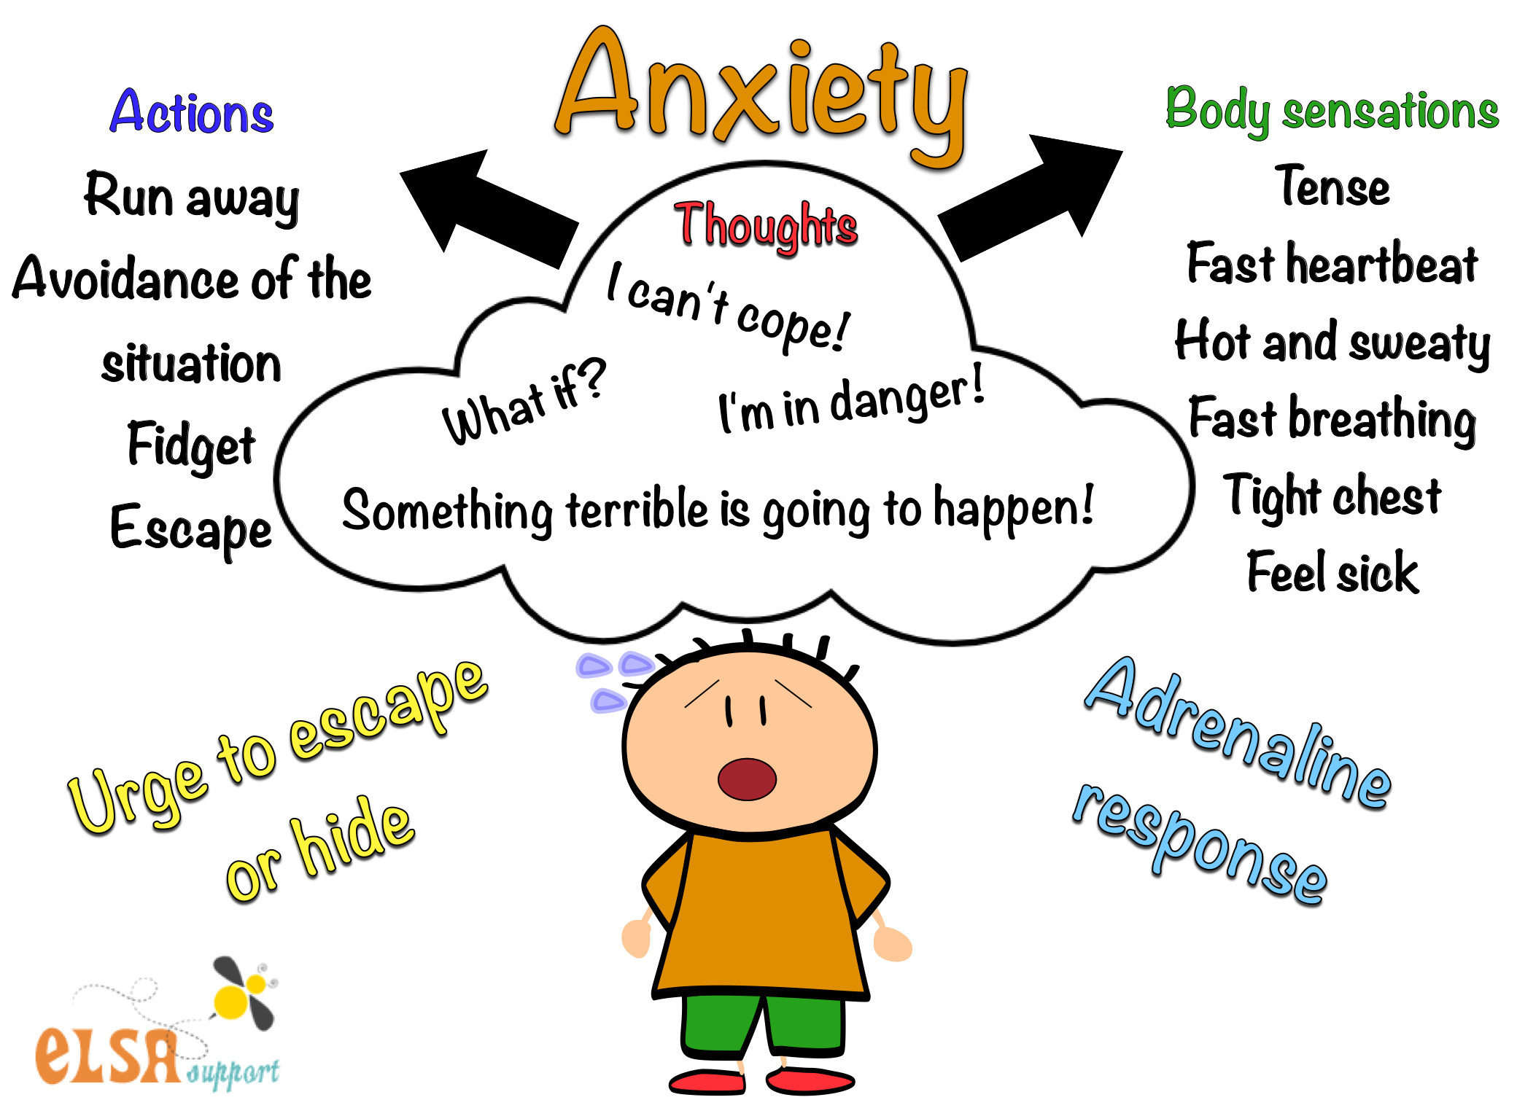

Slide 12
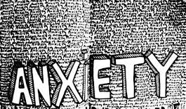
Anxiety is the consequence of unmet need

Slide 13





Slide 14


Why is the autism so important in understanding the anxiety?

Slide 15
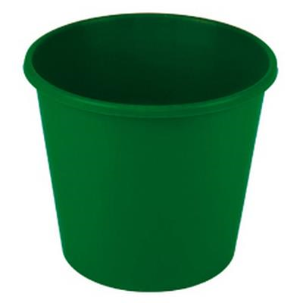

Possible Triggers to anxiety
Sensory Processing
Sensory sensitivities
Disturbed sleep,eating and toileting issues
Communication
Communication difficulties
Literal interpretation
Social Understanding
Perception of others thoughts/feelings
Not knowing or understanding rules
Working in a group
Information Processing
Change in routine
Uncertainty/Unpredictability
Anxious about failure
Poor concept of time

Slide 16
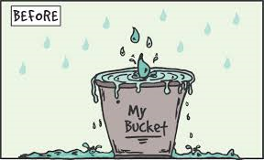
ANXIETY IS LIKE A BUCKET OF WATER
If WE KEEP ADDING STRESSORS TO THE BUCKET OVER TIME IT FILLS UP
UNTIL, ONE DAY, IT OVERFLOWS

Slide 17



OR EXPLODES…..
This could be in a week, month, or after school everyday

Slide 18
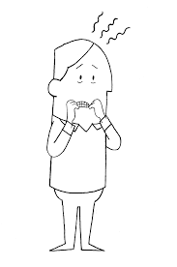



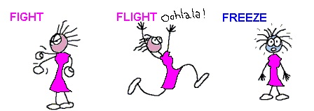
Fight, Flight or Freeze

Slide 19
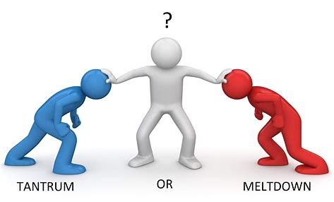

Slide 20


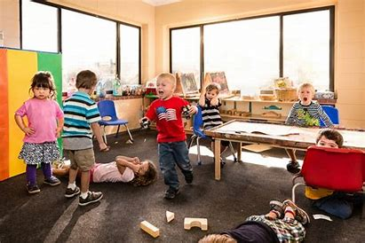
Autistic Meltdown…
a reaction to an overwhelming experience
A meltdown is not the same as a temper tantrum. It is not bad or naughty behaviour and should not be considered as such. When a person is completely overwhelmed, and their condition means it is difficult to express that in appropriate way, it is understandable that the result is a meltdown

Slide 21
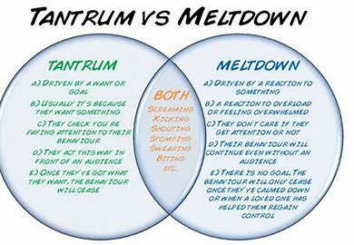

Slide 22


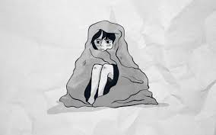


Close down Shutdown

Slide 23


The silent treatment
Shutdowns are a more muted response to extreme overload or stress. When an autistic person goes into shutdown mode, there are a few common signs. These are:
Being completely silent
Not being able to communicate in any way
Withdrawing to a quiet, dark space to get away from the cause of their shutdown
Not being able to move from where they are because they’re thinking too much about the cause of their shutdown
Lying down on a flat surface, being completely still

Slide 24
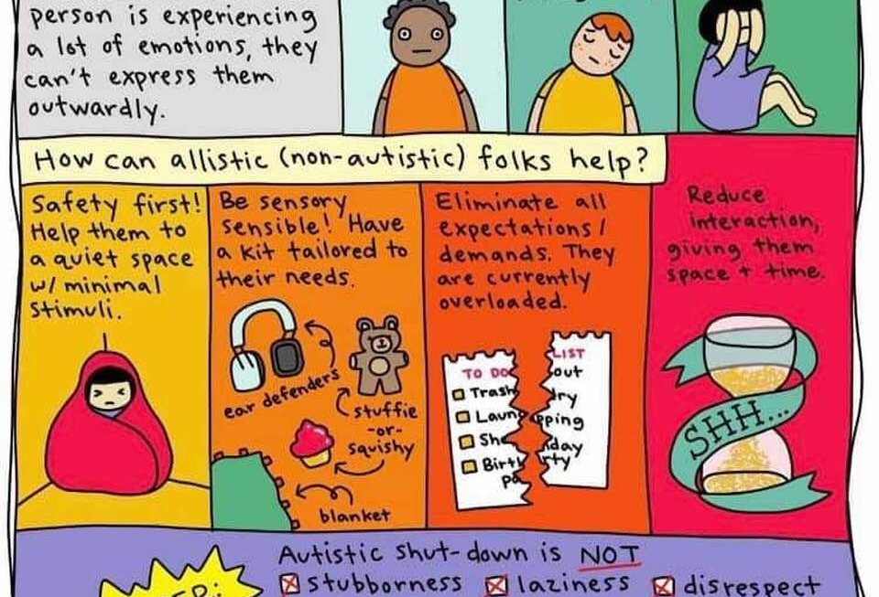

Slide 25
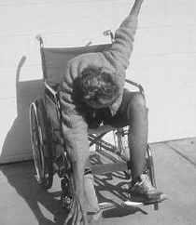


Catatonia,
Autistic breakdown,
& Shutdown

Slide 26

Risk Factors for Catatonia, breakdown and shutdown
Trauma and PTSD
Attachment
Unmet Need
  Communication
  Interaction
  Processing
  Sensory

Slide 27
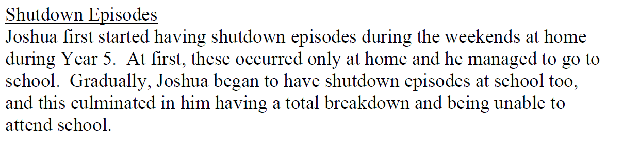
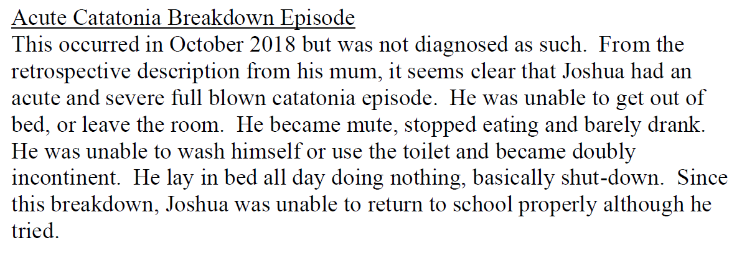

















Extract from report by Dr Shah
June 2020

Slide 28
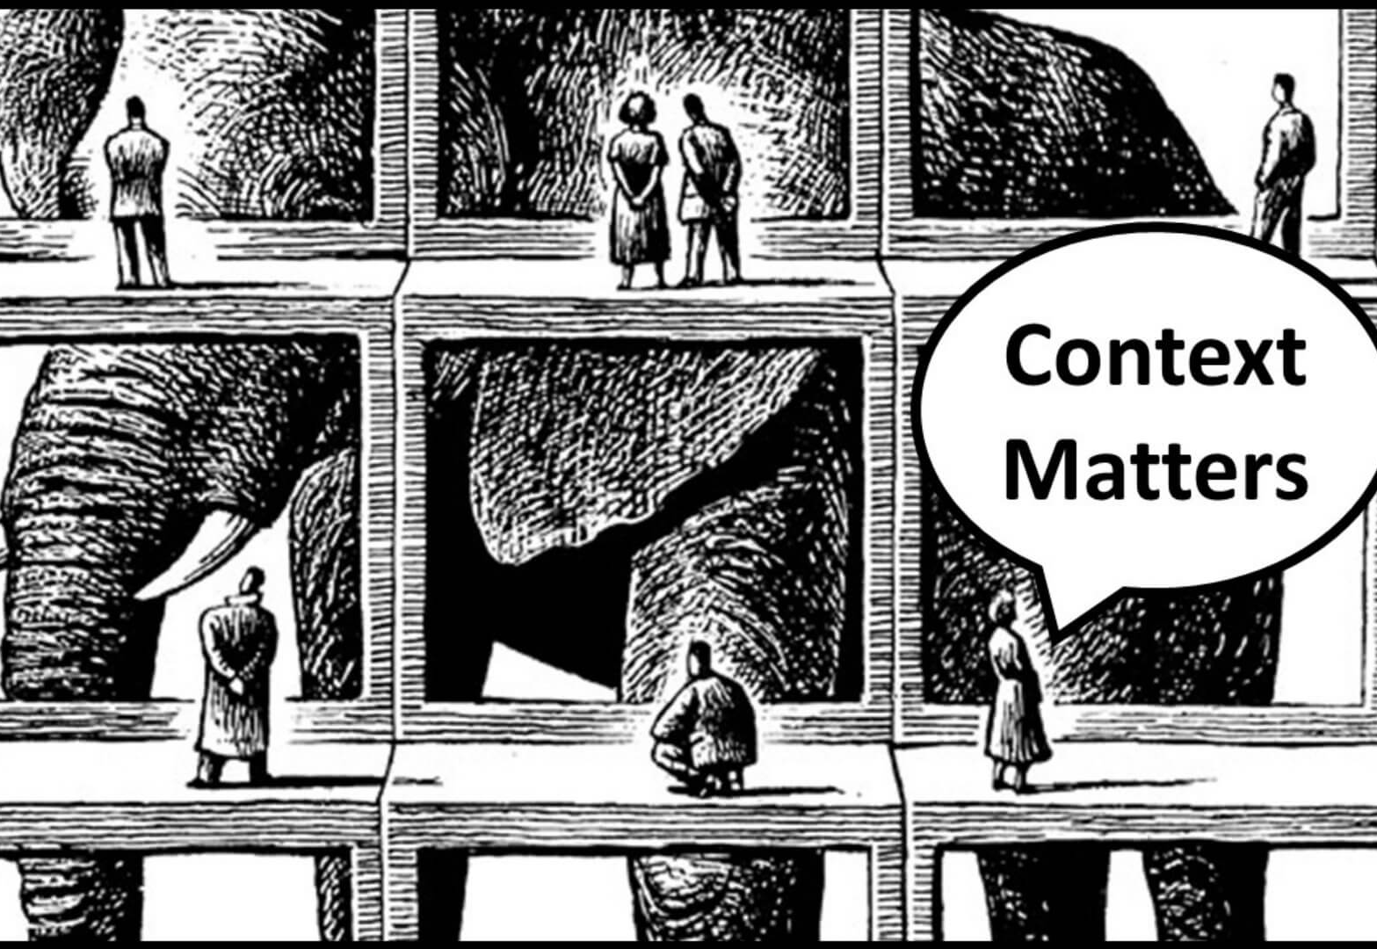

Slide 29

Iceberg
Notes:
Everything is communication- basis of all teaching and learning.

Slide 30

The Invisible Barrier
I just can’t…….

Slide 31
A new day
Further Risk Factors
Loss of control
Shutdown
Unmet need-4 areas of difference:
Interaction
Processing information
Sensory processing
Communication
Intolerance of uncertainty
Manifests as demand avoidant behaviours
C-19
Heightened Anxiety
Loss of control
Meltdown
Loss of Protective Factors
Continual demands

Slide 32

Being torn in 2 by demand avoidance is very stressful
They are not bad people, they are stressed and feel out of control
Give them back as much control as reasonably possible, this can significantly help
Notes:
DA pupils are not bad people they are STRESSED and feeling OUT OF CONTROL
Giving them back as much control as reasonably possible can significantly help them

Slide 33
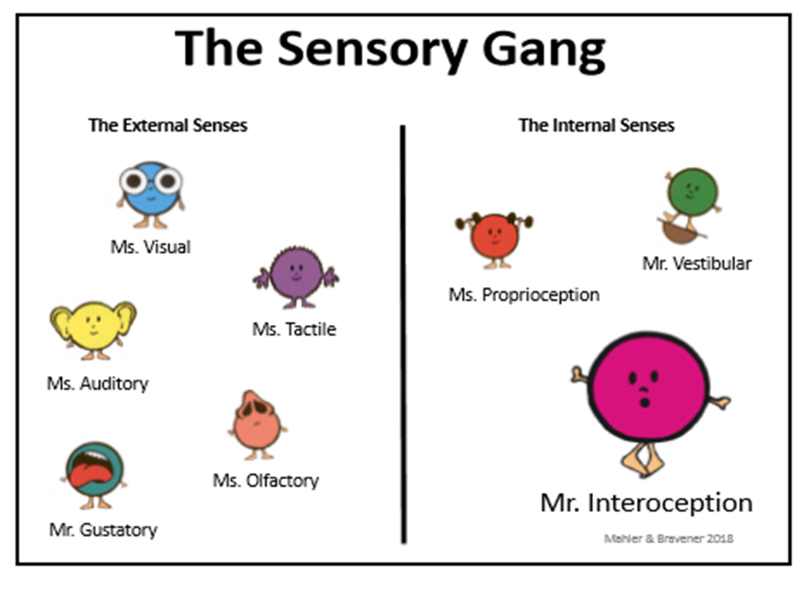

Slide 34
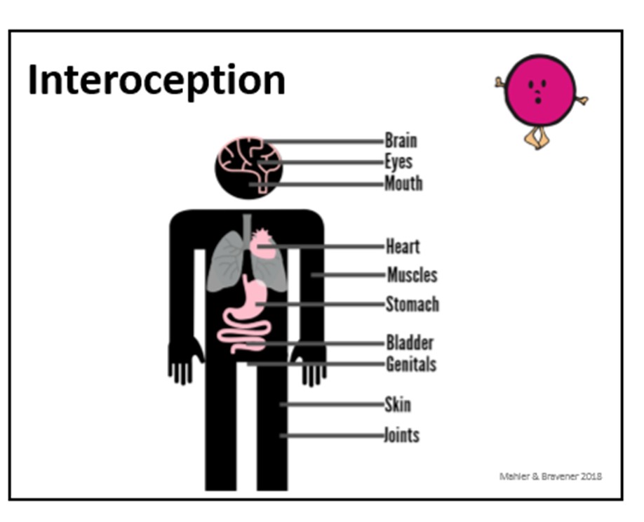
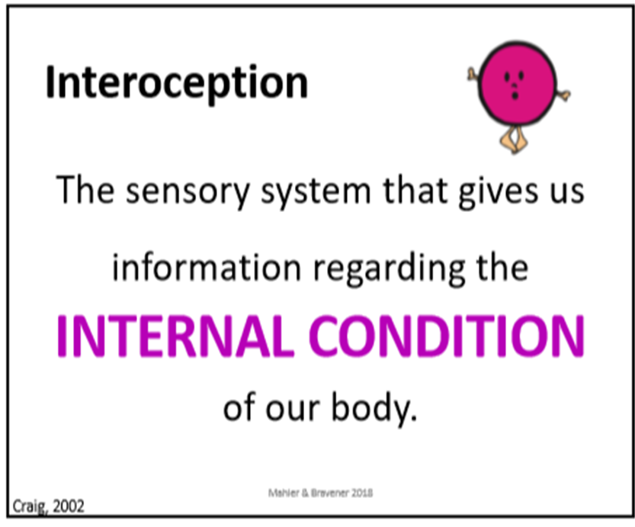

Slide 35




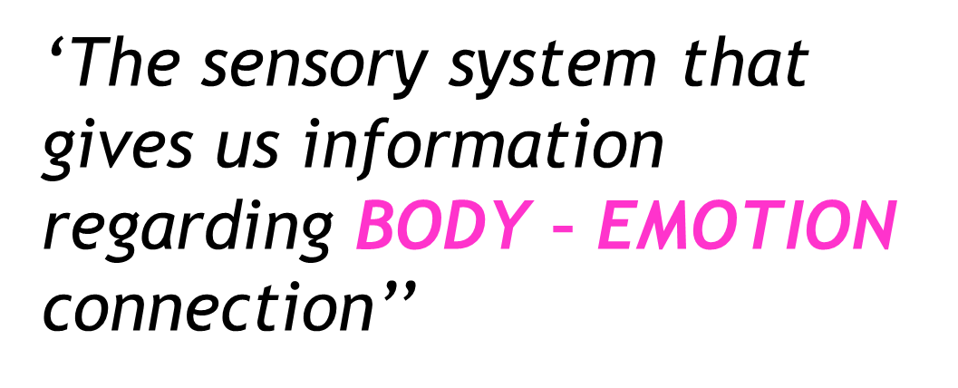

Slide 36
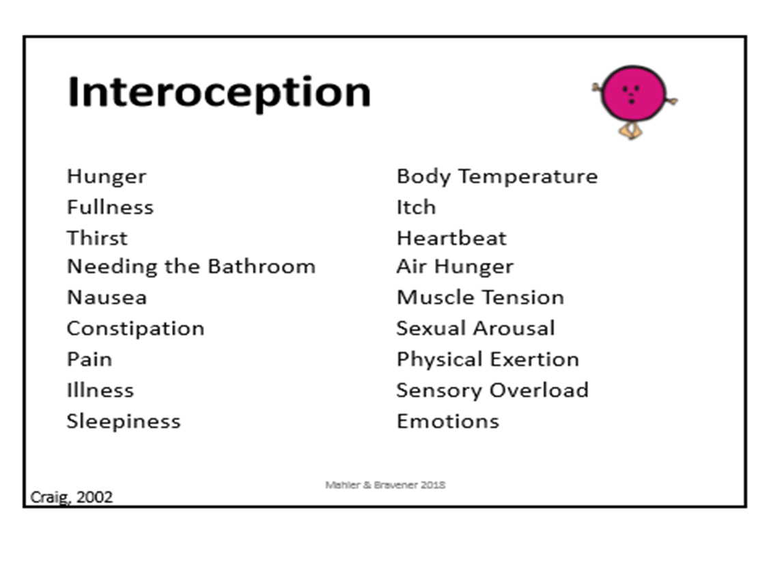

Slide 37
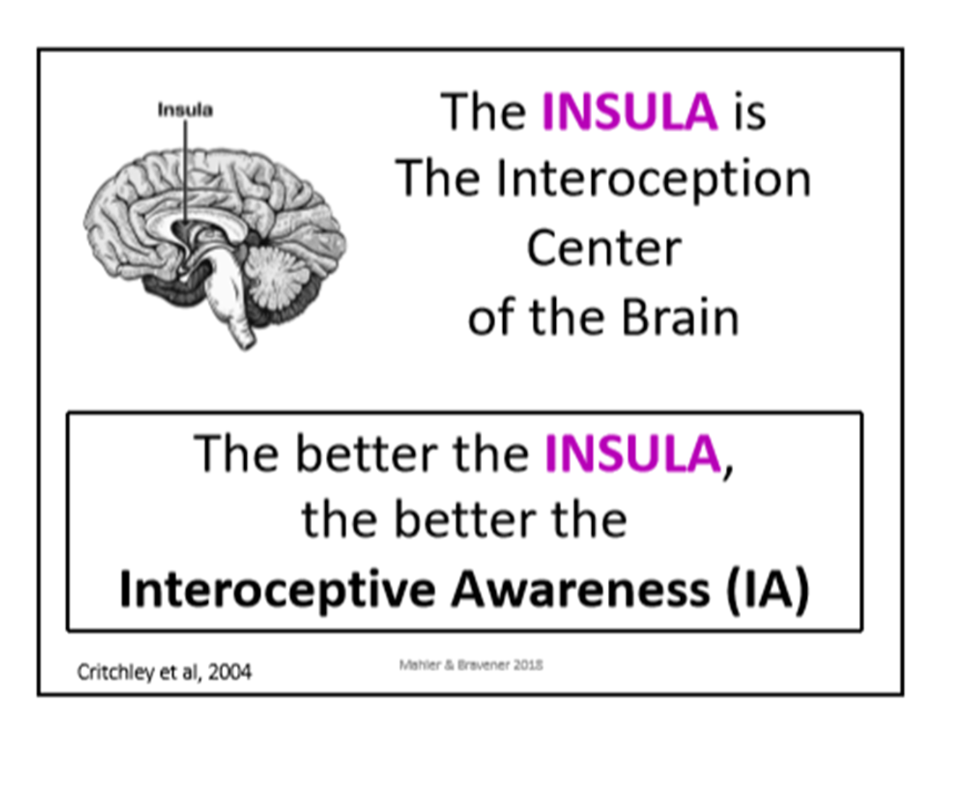

Slide 38

Self-regulation is the ability to IDENTIFY and MANAGE the way we feel
Interoceptive awareness is the foundation of self-regulation

Slide 39
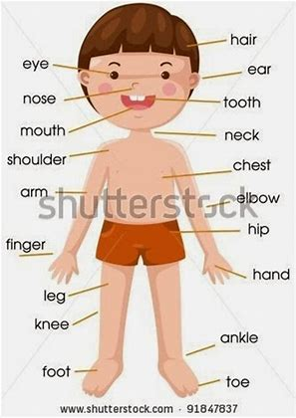

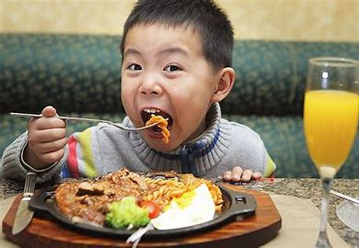
BODY
NOTICE
EMOTION
CONNECT
[Affective or
ACTION
ACT
[Regulate]
Homeostatic]
[sensation]

Slide 40

Body signals are different for everyone

Slide 41
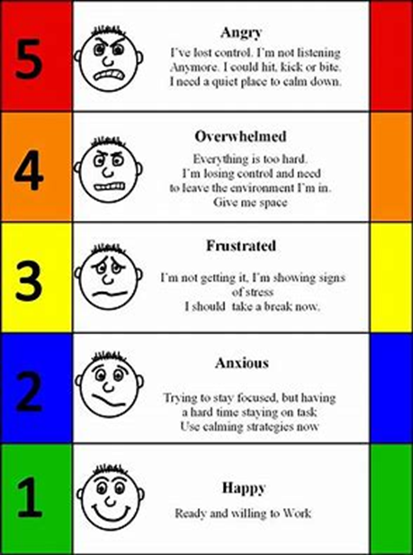
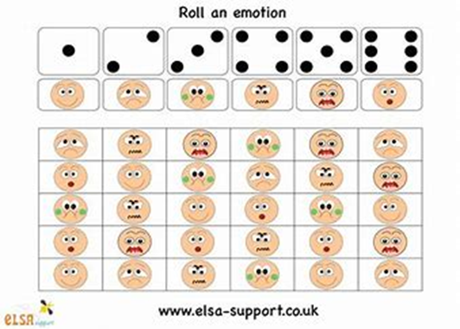
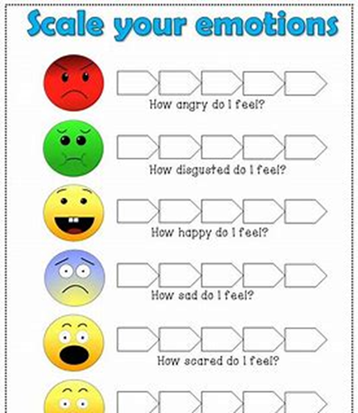

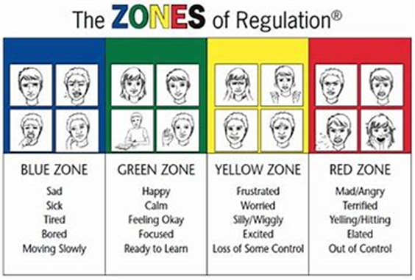

Slide 42
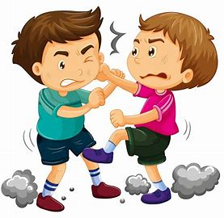
How do you feel…
How do I feel..

Slide 43
Building IA can enhance challenge existing Self-regulation Strategies
Does not make the person ‘typical’
Does not modify behaviour
Makes the young person comfortable within the environment
Not focussing on being ‘typical’
Builds skills through coaching
Life long regulators
Is not an external support
Is an internal support

Slide 44
RESOURCES & LINKS
https://occupationaltherapychildren.com.au/what-is-interoception/
http://autismwest.org.au/cms/wp-content/uploads/2016/11/Emma-Goodall-Interoception.pdf
https://thegirlwiththecurlyhair.co.uk/
https://www.amazon.co.uk/Catatonia-Autism-Psychological-Understanding-Management/dp/1785922491

Slide 45
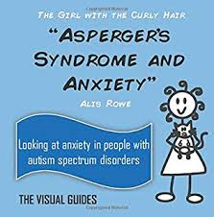
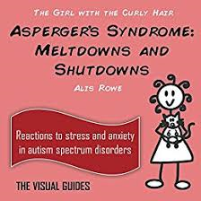
The Girl with the Curly Hair series
By Alis Rowe

Slide 46

Guide to mental health issues in girls and young women on the Autism Spectrum by Dr Judy Eaton

Slide 47
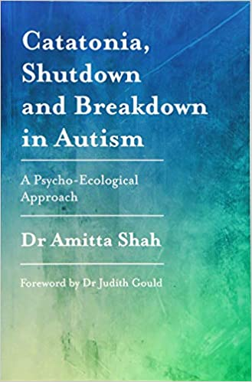
Dr Amitta Shah

